Slide 1
Exploring Health and Wellness
Chapter 1
LESSON 1.1
Live Well: Middle School Health
Notes:
Jose Luis Pelaez Inc/DigitalVision/Getty Images

Slide 2
Write About It
Do you think that a person who has a disability can be healthy?
Why or why not?

Slide 3
Health, Wellness, and Disease
Health means you are free of illness or disease.
Wellness is more than just being free from disease; it is the pursuit of making healthy choices in all parts of your daily life.
A disease is something that causes the body not to function properly.

Slide 4
Components of Wellness (1 of 3)
Mental and emotional
How you feel, connect with others, manage stress, solve complex problems, and deal with changes
Intellectual
How you do in school and engage in creative activities
Spiritual
Having a sense of purpose in life
(continued)

Slide 5
Components of Wellness (2 of 3)
Social
Finding meaningful connections with others and doing well in different social situations
Physical
Having the physical energy and ability to do daily activities, bounce back from being sick, cope with stress, and recover from injury
(continued)

Slide 6
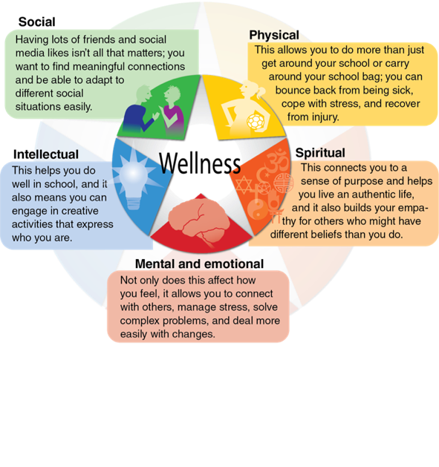
Components of Wellness (3 of 3)
Notes:
Fig. 1.1 The five components of wellness.

Slide 7
Disability
A disability is different from a disease or illness.
A person with a disability experiences a loss of function somewhere in the body.
It is important to provide accommodations to those with disabilities so that they can fully engage in all aspects of life.

Slide 8
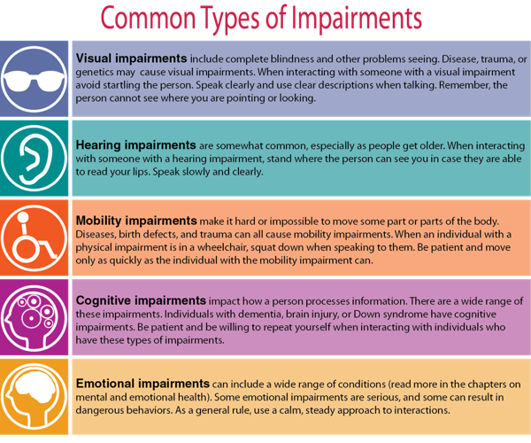
Common Types of Impairment

Slide 9
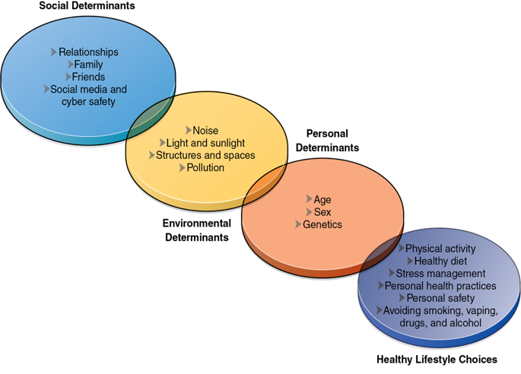
Factors That Influence Health
Notes:
Figure 1.2 Factors that influence health.

Slide 10
Personal Influences on Health
Personal influences on your health are not things you can control
Age
Heredity (Genetics)
Biological Sex
Heredity is the passing of characteristics from a parent to a child.

Slide 11
Environmental Influences on Health
Sunlight can damage skin and cause cancer.
Pollution can affect respiratory health.
Access to open space, food, and medical care can affect all aspects of your wellness.
Loud noises can harm hearing.

Slide 12

Social Influences on Health
The people you socialize with influence your choices and your health.
If your friends take risks, you are more likely to take risks.
If your friends exercise and eat healthy, you are more likely to do those things too.
Notes:
Hero Images/Getty Images

Slide 13
Healthy Lifestyle Choices
Getting regular physical activity
Eating a well-balanced diet
Managing your stress and anxiety
Avoiding dangerous situations and maintaining boundaries
Practicing good hygiene and personal health
Getting regular and adequate sleep
Avoiding tobacco, vaping, alcohol, and drugs

