Slide 1
Developing Skills for Healthy Living
Chapter 1
LESSON 1.2
Live Well: Middle School Health
Notes:
Hill Street Studios/DigitalVision/ Getty Images

Slide 2
Write About It
Write your responses to these questions in a one-paragraph summary:
How much health information do you think you know?
Where do you get your information about health?
How do you know it is accurate?

Slide 3
Health Literacy and Health Skills
A person with good health literacy can find and understand basic health information and can use that information to make good health decisions.
Health skills allow you to put your knowledge into practice.
Healthy skills can become healthy habits.

Slide 4
Health Knowledge
Knowing basic information allows you to understand accurate health information.
Health knowledge helps you to not be confused or overwhelmed by health information.
Basic health knowledge can also help you in managing health emergencies.

Slide 5
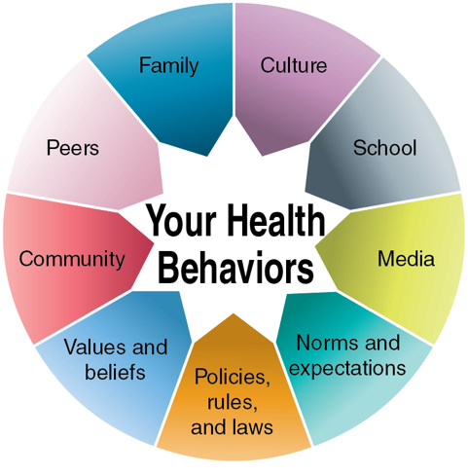
Analyzing Influences on Health
Notes:
Figure 1.3 What influences your health behaviors?

Slide 6
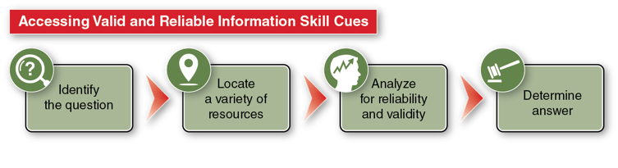
Accessing Valid and Reliable Health Information and Services
Valid information = logically and factually accurate
Reliable information = consistent across sources and dependable
Reliable websites often end in .gov, .edu, and .org.

Slide 7
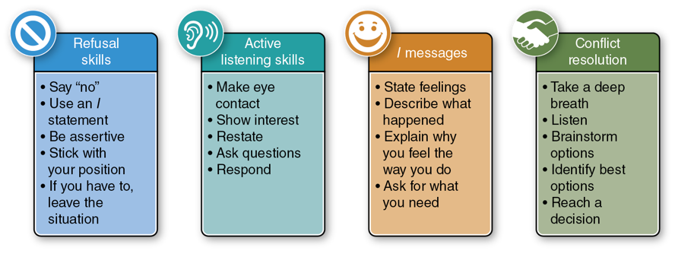
Communicating Your Health Needs
Communication skills influence your health behaviors in many ways.
Notes:
Figure 1.6 The four types of communication skills.

Slide 8
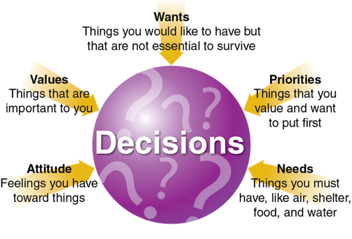
Making Healthy Decisions
Many factors influence your decision making. Making healthy decisions is critical to good health.
Notes:
Figure 1.5 What influences your decision making?

Slide 9
Setting Healthy Goals
Short-term goals
Smaller targets you can reach in a shorter amount of time
Usually one day to one month
Long-term goals
Larger targets that require one to six months to achieve

Slide 10
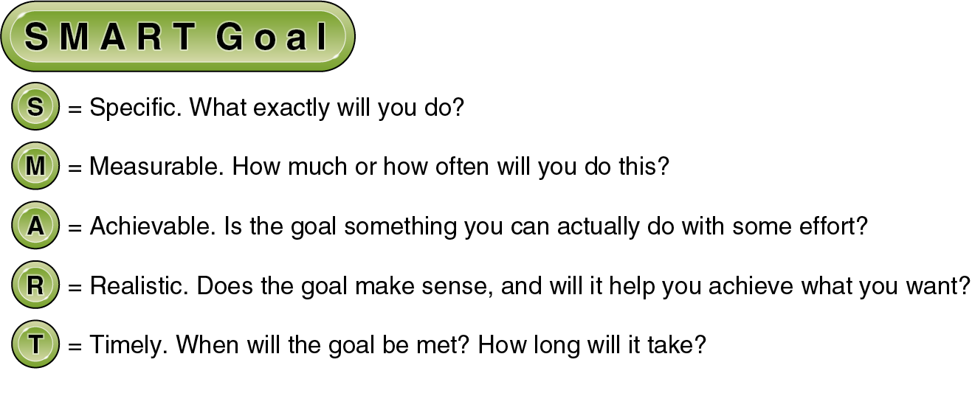
SMART Goals
Notes:
Figure 1.6: When you are creating goals, you should practice using SMART goals.

Slide 11
Practicing Healthy Behaviors
Good health is a series of choices you make every day.
The only way to become healthy is to practice being healthy.
Try to develop these healthy habits:
Being physically active.
Eating a well-balanced diet.
Getting enough quality sleep.
Being supportive and kind to others.

Slide 12
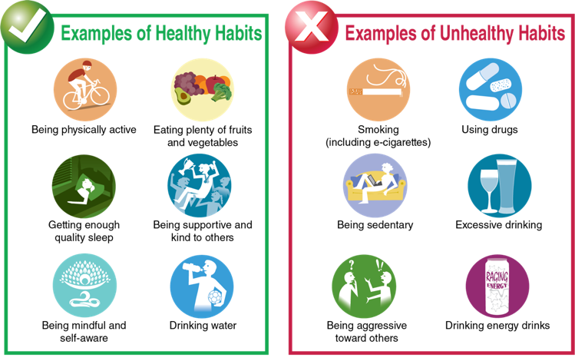
Healthy Habits vs Unhealthy Habits
Notes:
Figure 1.7 Habits can be healthy or unhealthy.

Slide 13
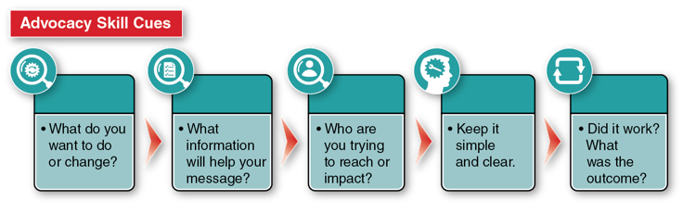
Promoting Good Health
Part of good health is learning how to advocate for yourself and others.
Advocacy is the process of supporting or promoting a cause or an issue.
You can advocate for your own health, for family members and friends, and for your community.

