Slide 1
Your Immune System
Chapter 1
LESSON 1.3
Live Well: Middle School Health
Notes:
JUAN GAERTNER/SCIENCE PHOTO LIBRARY/Getty Images

Slide 2
Write About It
When was the last time you were really sick?
What type of illness did you have?
Why do you think you got sick?
What did you do to try to feel better and to get healthy again?

Slide 3
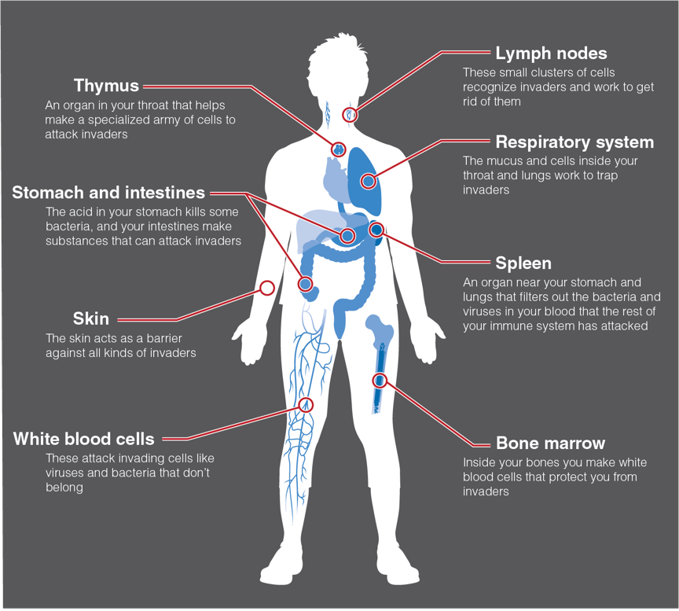
The Immune System
Notes:
Figure 1.11 The immune system.

Slide 4
Types of Pathogens (1 of 2)
Anything foreign that enters your body and can cause disease is called a pathogen.
The two most common examples of pathogens are viruses and bacteria.
(continued)

Slide 5
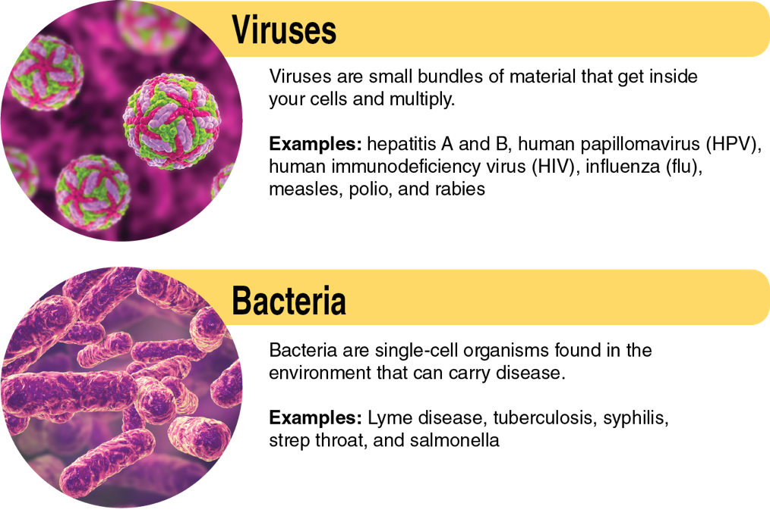
Types of Pathogens (2 of 2)
Notes:
Figure 1.10 Comparing viruses and bacteria.

Slide 6
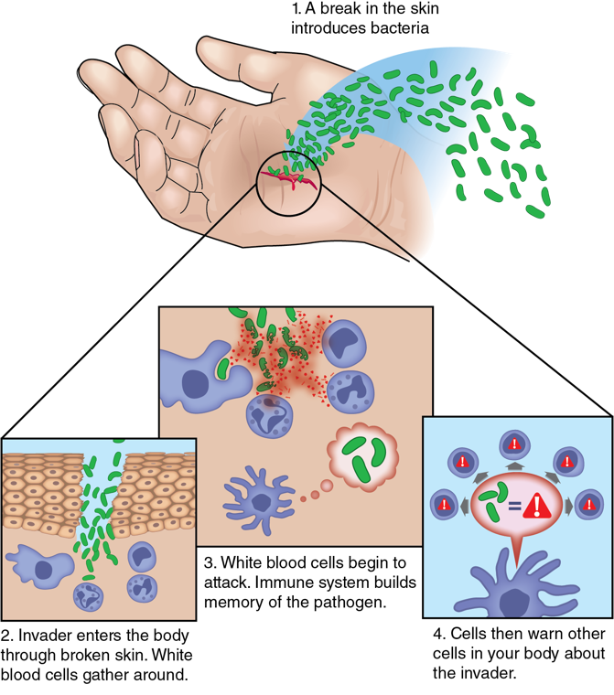
The Immune Response
Notes:
Figure 1.11 Your immune response.

Slide 7
Keeping Your Immune System Healthy
Eat foods rich in vitamins and minerals
Get at least 30 minutes of exercise most days
Get 8 to 10 hours of sleep every night
Wash your hands regularly
Keep up with your vaccinations
Maintain a healthy weight
Don’t drink alcohol, smoke, or vape
Manage stress with relaxation and exercise

Slide 8
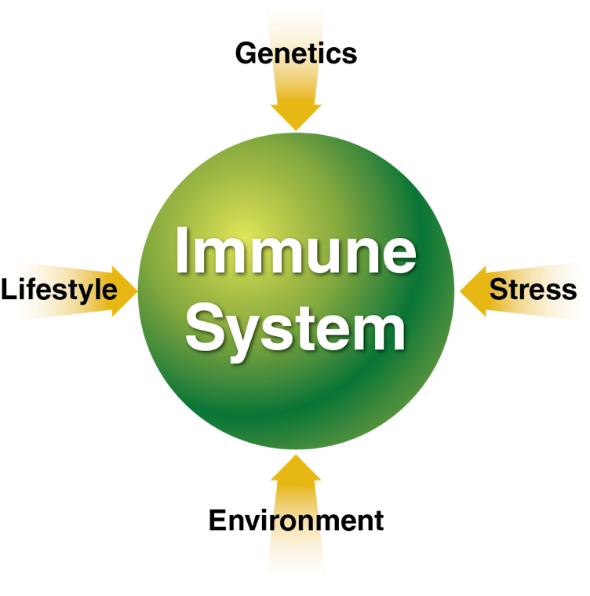
Influences on Your Immune System
Notes:
Figure 1.12 Influences on your immune system.

Slide 9
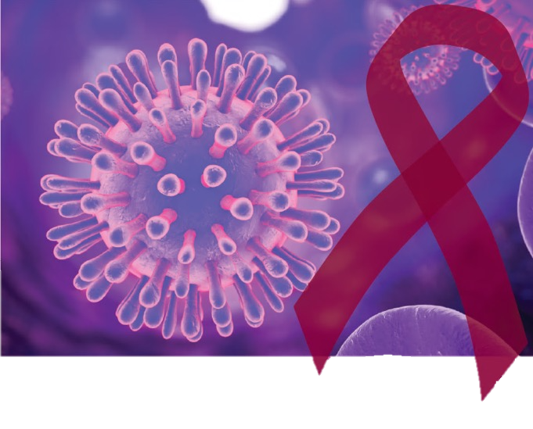
HIV and AIDS
HIV, or Human Immunodeficiency Virus, is a virus that attacks the immune system.
AIDS, or Acquired Immunodeficiency Syndrome, is a medical condition that can result from HIV. It makes the immune system too weak to fight off infections and cancers.
AIDS is the sixth leading cause of death among young people ages 25 to 44.
Notes:
KATERYNA KON/SCIENCE PHOTO LIBRARY/Getty Images

Slide 10
Problems With the Immune System
Your immune system can experience health problems of its own.
Immune deficiency disorders, such as HIV: Immune system is weak
Autoimmune disorders, such as rheumatoid arthritis: Immune system attacks parts of the body
Allergies: Body becomes hypersensitive to allergens in the environment, causing a damaging immune response
Cancers of the immune system (lymphoma): Immune system develops cancerous cells

Slide 11
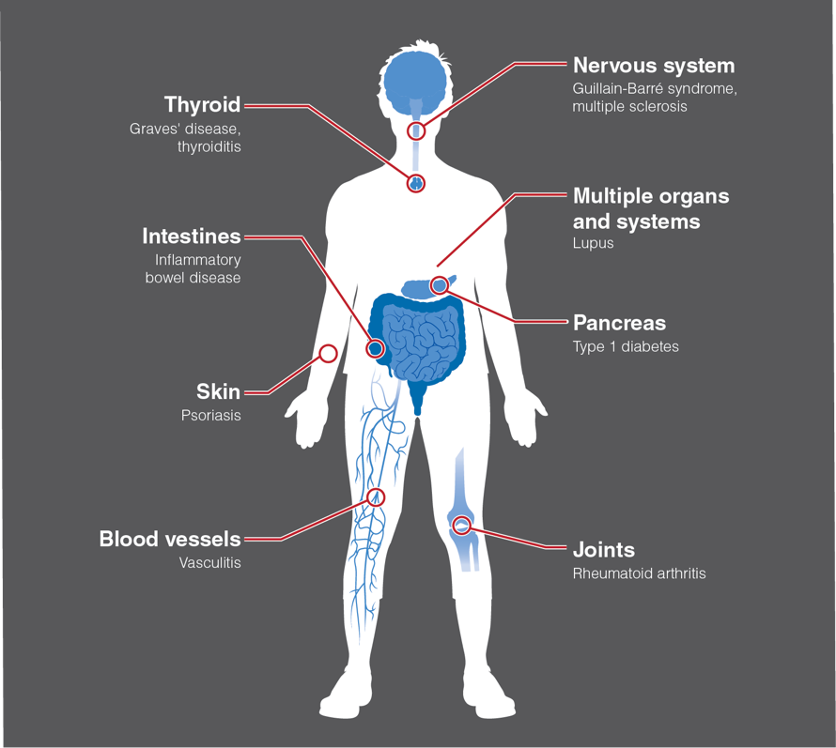
Problems With the Immune System
Notes:
Figure 1.14 Organs and systems affected by autoimmune diseases.

