Slide 1
Communicable Diseases
Chapter 1
LESSON 1.4
Live Well: Middle School Health
Notes:
SDI Productions/E+/Getty Images

Slide 2
Write About It
How often do you wash your hands each day?
Describe how you wash your hands.
Why do you think it is important to keep your hands clean?

Slide 3
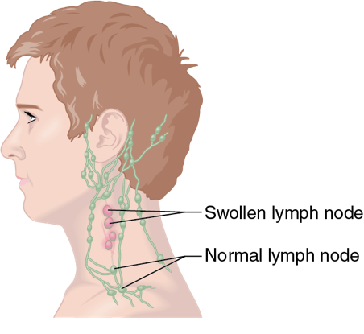
Communicable Disease
When a disease can spread between two people, it is said to be contagious.
Contagious diseases are also called communicable diseases.
Notes:
Figure 1.17 Swollen lymph nodes are one symptom of strep throat.

Slide 4
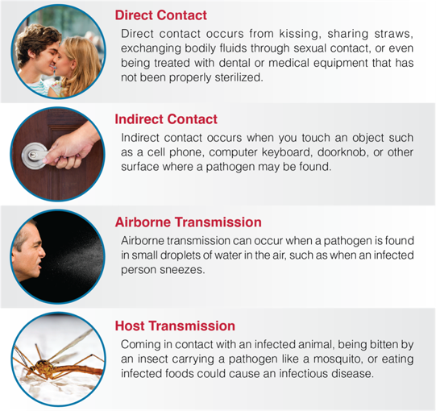
Methods of Transmission
Notes:
Figure 1.15 Methods of transmission: (a) direct contact, (b) indirect contact, (c) airborne transmission, and (d) host transmission.
photos in figure 1.15: Westend61/ Getty Images (direct contact); Kasipat Phonlamai/EyeEm/Getty Images (indirect contact); John M Lund Photography Inc/DigitalVision/Getty Images (airborne transmission); iStockphoto. com/Viktor Kitaykin (host transmission)

Slide 5
Preventing Communicable Diseases (1 of 2)
Universal precautions are a set of specific steps that are taken to prevent diseases from spreading through blood and body fluid contact.
Other ways to prevent the spread of disease include
washing hands with soap and water,
covering face and nose when sneezing,
getting vaccinated, and
staying home if you are sick.
(continued)

Slide 6
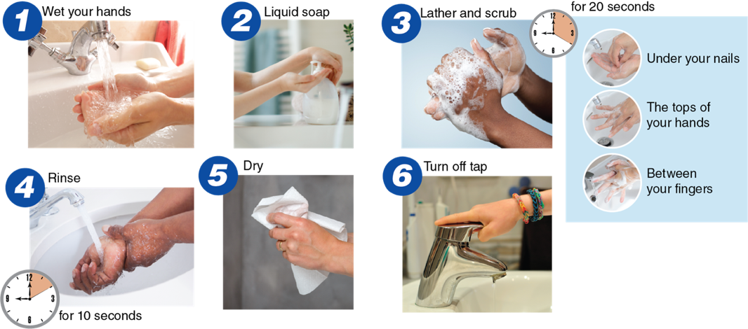
Preventing Communicable Diseases (2 of 2)
Notes:
Figure 1.16 Steps for washing your hands.
photos in figure 1.16: Peter Cade/ Photodisc/Getty Images (1); Damircudic/E+/Getty Images (2); Roy Hsu/ Photographer’s Choice RF/Getty Images (3); Saksit Srisuksai/EyeEm/ Getty Images (under your nails, tops of your hands); BSIP/UIG/Getty Images (between your fingers); BFG Images/ Getty Images (4); mheim3011/iStock/ Getty Images (5); Miguel Sotomayor/ Moment Open/Getty Images (6)

Slide 7
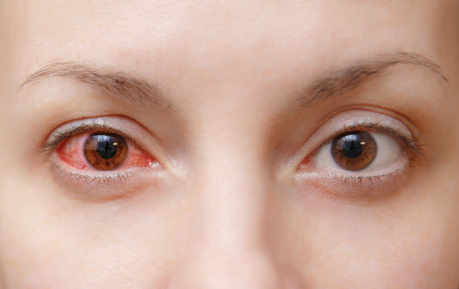
Types of Communicable Diseases
Bacterial infections
Lyme disease and tuberculosis
Viruses and viral infections
Flu, cold, mononucleosis, and conjunctivitis (pink eye)
Fungi and fungal infections
Athlete’s foot
Protozoan infections
Malaria
Notes:
Figure 1.19 Conjunctivitis, also called pink eye, is a viral or bacterial infection of the eye.
ViDi Stuido/iStock/Getty Images

Slide 8
Communication: Tips for Being Assertive
Use I statements.
Practice saying no.
Practice what you want to say.
Watch your body language.
Check your emotions.

