Slide 1
Noncommunicable Diseases
Chapter 1
LESSON 1.5
Live Well: Middle School Health
Notes:
Suriyo Hmun Kaew/EyeEm/ Getty Images

Slide 2
Write About It
What do you know about heart disease, cancer, or diabetes?
Do you know anyone with any of these diseases?
Make a list of things you know about each of these diseases.

Slide 3
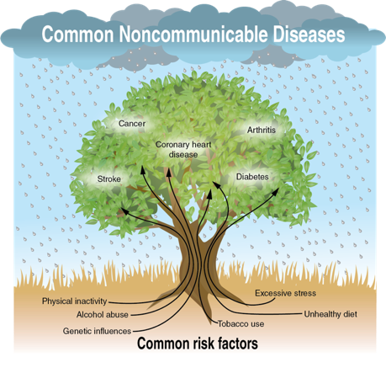
Noncommunicable Diseases and Risk Factors
Notes:
Figure 1.21 Noncommunicable diseases and risk factors.

Slide 4
Cardiovascular Disease
Coronary heart disease
Atherosclerosis = clogged arteries
Arteriosclerosis = hardened arteries
Heart attack = loss of blood and oxygen to the heart
Stroke = loss of blood and oxygen to the brain
High blood pressure (hypertension) = increased pressure of blood in cardiovascular system
Notes:
Ivan-balvan/iStock/Getty Images

Slide 5
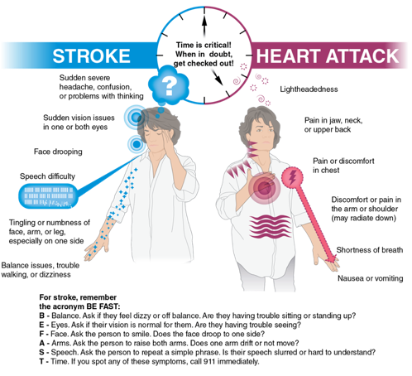
Warning Signs of Heart Attack and Stroke
Notes:
Figure 1.22 Signs of heart attack and stroke.

Slide 6
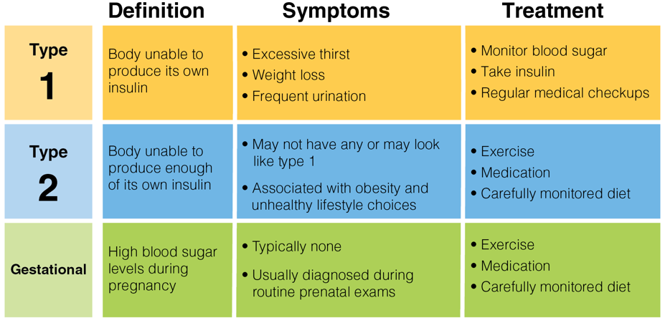
Diabetes
 | Definition | Symptoms | Treatment
Type 1 | Body unable to produce its own insulin | Excessive thirst Weight loss Frequent urination | Monitor blood sugar Take insulin Regular medical checkups
Type 2 | Body unable to produce enough of its own insulin | May not have any or may look like type 1 Associated with obesity and unhealthy lifestyle choices | Exercise Medication Carefully monitored diet
Gestational | High blood sugar levels during pregnancy | Typically none Usually diagnosed during routine prenatal exams | Exercise Medication Carefully monitored diet
Notes:
Figure 1.23 Symptoms and treatments for the different types of diabetes.

Slide 7
Cancers
Cancer is the uncontrolled growth of abnormal cells in the body.
Common types of cancer include the following:
Breast cancer
Colon cancer
Leukemia
Lung cancer
Melanoma
Prostate cancer

Slide 8
Preventing Skin Cancer
Seek shade, especially at middle of the day
Wear clothing that covers and protects your skin
Wear a hat with a wide brim to protect neck, ears, and face
1
2
3
Wear sunglasses that block UVA and UVB sun rays
5
Use sunscreen with SPF at least 15
Avoid tanning indoors or outdoors
4
6

Slide 9
Osteoporosis
Weakening of the bones
Osteoporosis is caused by not making new bone or losing existing bone or both.
Caucasian women are at highest risk.
Teenagers with eating disorders are at higher risk later in life.
Notes:
Michael Krinke/iStock/Getty Images

Slide 10
Arthritis and Lung Disease
Arthritis = swelling and damage to joints
Over 100 different types exist.
Exercise, diet, and medications can help manage arthritis.
Lung disease = a variety of conditions that affect ability to breathe and use oxygen
Asthma, or inflammation of the lungs, is one common form of lung disease.
Notes:
Lea Paterson/Science Photo Library/Getty Images

Slide 11
Alzheimer’s and Dementia
Dementia = a loss of brain function over time
Alzheimer’s disease = the most common form of dementia
Alzheimer’s disease is more common among women.
High blood pressure or past head trauma increase risk.

Slide 12
Behavior Contracts
A behavior contract is an agreement you make with yourself to change a specific health behavior.
A behavior contract includes the following:
Goals
Deadlines (dates)
A plan or strategy to complete goals
A reward for completing goals
Most behavior contracts are witnessed, or signed by, someone else.

