Slide 1
Healthy Skin, Hair, and Nails
Chapter 2
LESSON 2.1
Live Well: Middle School Health
Notes:
Fstop123/E+/Getty Images

Slide 2
Write About It
Have you ever used technology to improve the look of your hair or skin on an image? If so, explain the situation.
What were you trying to achieve?
If you haven’t done this, why do you think you haven’t? Do you think you might in the future?

Slide 3
Developing Good Hygiene
It is important to practice good hygiene if you want to stay healthy.
Hygiene is the practice of keeping yourself in good health by maintaining your personal cleanliness.
Brushing your teeth
Washing your face and hands
Showering
Trimming your toenails

Slide 4
Your Skin
Your skin is the largest organ you have.
It plays an important role in keeping you healthy.
Provides a barrier to all sorts of pathogens in the environment
Helps to protect every other organ in your body
Keeps your body temperature normal
Notes:
PhotoDisc/Barbara Penoyar

Slide 5
Layers of the Skin (1 of 2)
Layers of the skin
Epidermis (outermost): protects you from environment and contains melanin, cells that give skin its color
Dermis (middle): contains the hairs you see on skin, sweat glands, blood vessels, and nerves
Hypodermis (inner layer): contains blood vessels, fat, and more nerves and connects the skin to the muscles and bones underneath
(continued)

Slide 6
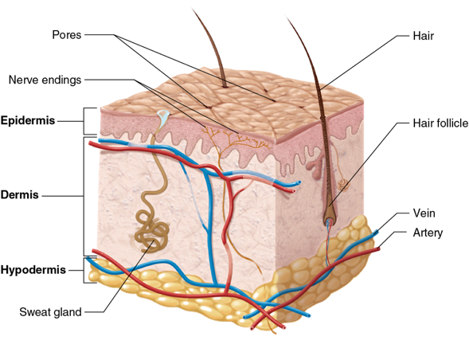
Layers of the Skin (2 of 2)
Notes:
Figure 2.1 Layers of the skin.

Slide 7
Caring for Your Skin
Your skin is a part of your body, and it responds to the choices you make.
Drink plenty of water
Get regular
physical activity
Eat a healthy diet
Avoid excessive exposure to sunlight
Avoid smoking
Manage stress

Slide 8
Tips for Good Skin Care
Don’t shower too long or in water that is too hot. Both can dry out your skin.
Use mild soaps that won’t irritate your skin.
Use clean razors and shaving cream, lotion, or gel when shaving.
Follow instructions from your health care provider when caring for new piercings or tattoos.

Slide 9
Recognizing and Treating Common Skin Problems (1 of 4)
Everyone will experience skin problems or skin irritations at some point in their life.
Most skin problems are temporary and can be treated.
(continued)

Slide 10
Recognizing and Treating Common Skin Problems (2 of 4)
Acne: a skin condition that occurs when skin cells, oil glands, and hair follicles clog, causing a collection of pimples that usually form on face, back, chest, and shoulders
Treat by keeping skin clean and washing face and if severe see a doctor because there are medications that can help.
(continued)

Slide 11
Recognizing and Treating Common Skin Problems (3 of 4)
Eczema (also called dermatitis): different types but most cause dry, itchy skin and rashes on the face, inside the elbows, behind the knees, and on the hands and feet
It is not contagious.
It may get better or worse over time but often lasts a long time.
Treatments may include medicines, skin creams, light therapy, and good skin care.
(continued)

Slide 12
Recognizing and Treating Common Skin Problems (4 of 4)
Sunburn: will make the skin turn red and hot to the touch
Sunburn typically fades on its own after a few days.
If you are sunburned too often, it can cause dry or wrinkled skin; dark spots; rough spots; and skin cancers, such as melanoma.
It is important to stay out of the sun and to protect your skin from the sun if you are outside.

Slide 13
Detecting Skin Cancer (1 of 2)
Skin cancer is the most common cancer in the United States.
Performing regular skin checks can help you detect skin cancer early.
When you do a skin check:
pay attention to all areas of the body
check for any changes in your skin
use mirrors to help you check hard-to-see areas
Most skin cancer is treatable with early detection.
(continued)

Slide 14
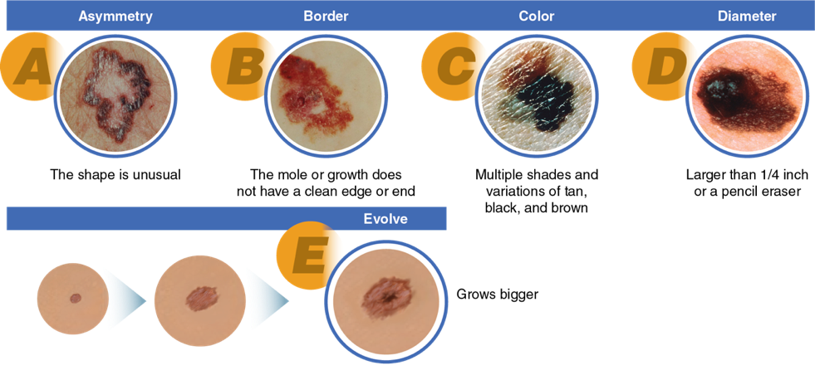
Detecting Skin Cancer (2 of 2)
Notes:
Figure 2.4 The ABCDE method.
Reprinted from National Cancer Institute (1990).

Slide 15
Your Hair and Nails (1 of 2)
Hair grows all over your body, helps keep you warm, and protects openings, such as the eyes, ears, and nose, from small particles in the air. Most hair grows for up to six years, and then it falls out and is replaced by new hair.
Your nails are made up of a hard form of protein called keratin. Healthy nails are usually smooth and consistent in color. When the nails become discolored or have big pits on them, it can be a sign of other diseases.
(continued)

Slide 16
Your Hair and Nails (2 of 2)
Caring for your hair and nails:
Wash and condition your hair regularly (every 1-3 days).
Eat a diet high in vitamins E, A, and C; zinc; biotin; omega 3; protein; iron; and fiber.
Avoid sharing combs and brushes with other people.
If you develop dandruff, use a medicated shampoo.
If you become infected with lice, you will need a special shampoo to kill the lice and their eggs. You will also need to wash in hot water all linens, towels, and clothing that contacted the lice.

Slide 17
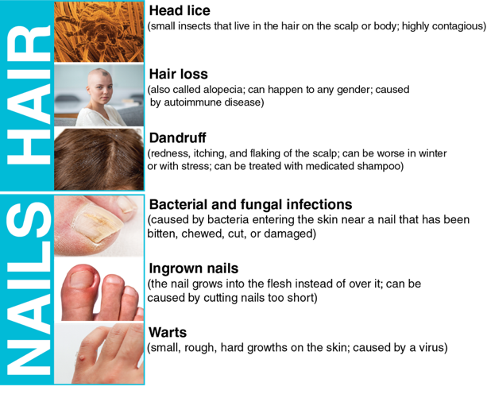
Common Hair and Nail Problems
Notes:
Figure 2.5 You are likely to experience one or more of these common hair or nail problems in your lifetime.
figure 2.5: Science Photo Library - E. GRAY/Brand X Pictures/Getty Images (head lice); FatCamera/E+/Getty Images (hair loss); Powerofforever/ E+/Getty Images (dandruff); Zlisjak/ iStock/Getty Images (bacterial and fungal infections); Apomares/E+/Getty Images (ingrown nails); Dmitry Epov/ iStock/Getty Images (warts)

Slide 18
Analyzing Influences: Beauty, Media, and Technology (1 of 2)
Today’s technology allows us to change pictures of people in a lot of ways, and almost all media images have been changed to look more appealing.
Skin: Removing imperfections, adding a tan, removing body hair on women, and adding realistic-looking facial hair for men
Features: Noses, eyes, and lips can all be altered.
Hair: The color, length, and thickness of hair can be changed.
It is important not to let unrealistic images influence your health behaviors when it comes to your hair and skin.

Slide 19
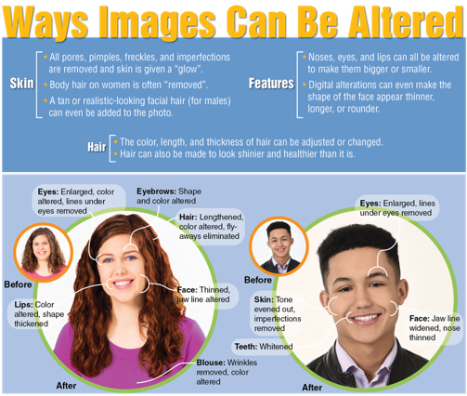
Analyzing Influences: Beauty, Media, and Technology (2 of 2)

