Slide 1
Good Oral Health
Chapter 2
LESSON 2.2
Live Well: Middle School Health
Notes:
eggeeggjiew/iStockphoto/Getty Images

Slide 2
Write About It
When was the last time you flossed your teeth or had them flossed?
Do you think flossing is important?
Why or why not?

Slide 3
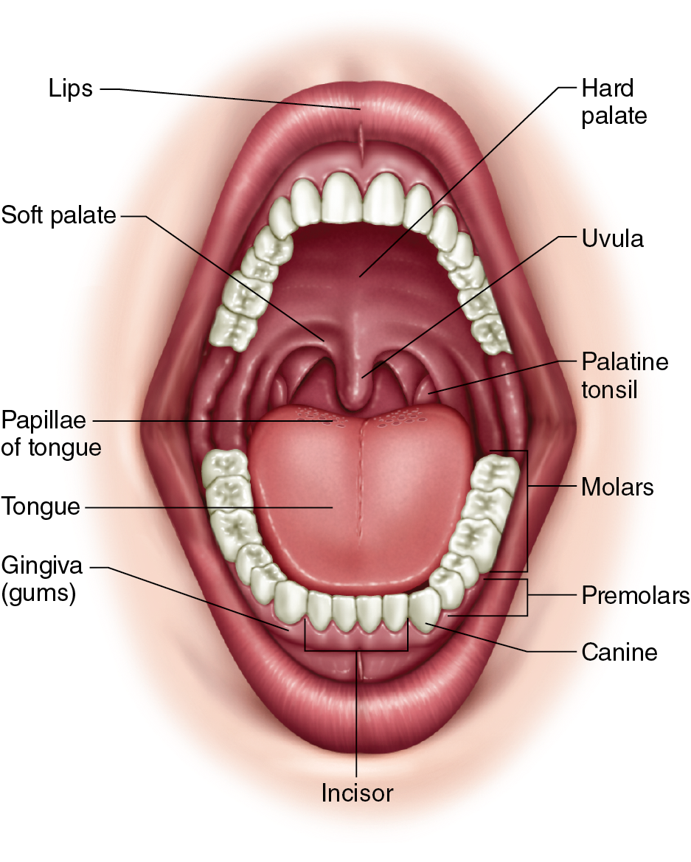
Your Mouth
Also called your oral cavity
  It provides an opening into the body for food and air.
  It is home to several organs, such as the tongue, the salivary gland ducts, and the teeth.
  The movements of your tongue, lips, and cheeks also help you produce sounds and speech.
Notes:
Figure 2.6 Anatomy of the mouth.

Slide 4
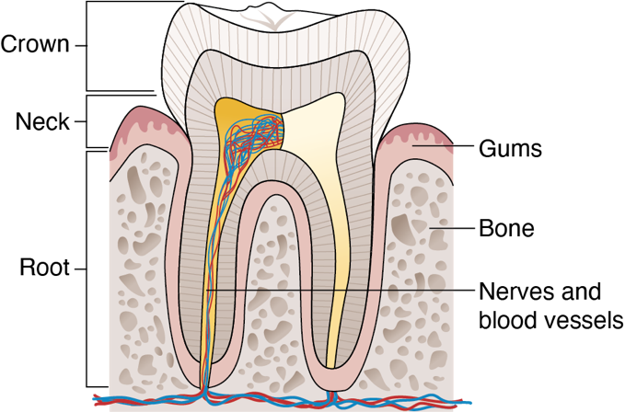
Your Teeth (1 of 3)
Complex, living organ made up of three parts
  Crown: Outside part of your tooth you can see; protected by enamel, a hard, white substance made of calcium
  Neck: Connects the crown of the tooth to the root of the tooth
  Root: Contains blood vessels and nerves and connects the tooth to the jaw
(continued)
Notes:
Figure 2.7 Anatomy of the tooth includes three different parts: the crown, neck, and root.

Slide 5
Your Teeth (2 of 3)
A normal adult mouth has 32 teeth.
There are five types of teeth, which each have different jobs to do when it comes to chewing food.
Teeth develop in stages.
  First set of teeth is typically in place by age three.
  These teeth fall out and are replaced as the person grows and larger teeth are needed to fill the larger adult mouth.
  Permanent adult teeth come in between the ages of 6 and 12.
(continued)

Slide 6
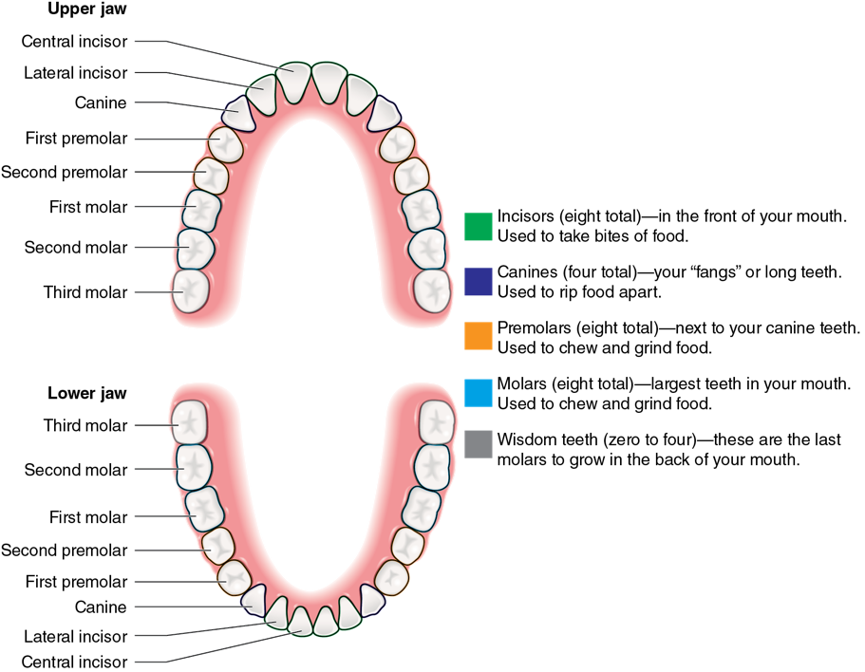
Your Teeth (3 of 3)
Notes:
Figure 2.8 Functions and location of your teeth.

Slide 7
Caring for Your Mouth and Teeth (1 of 3)
When it comes to your mouth and teeth, the most important things you can do are to regularly brush and floss your teeth.
  Brush twice a day with a soft-bristle brush.
  Floss every day, which will help remove food debris and bacteria from your teeth.
(continued)

Slide 8
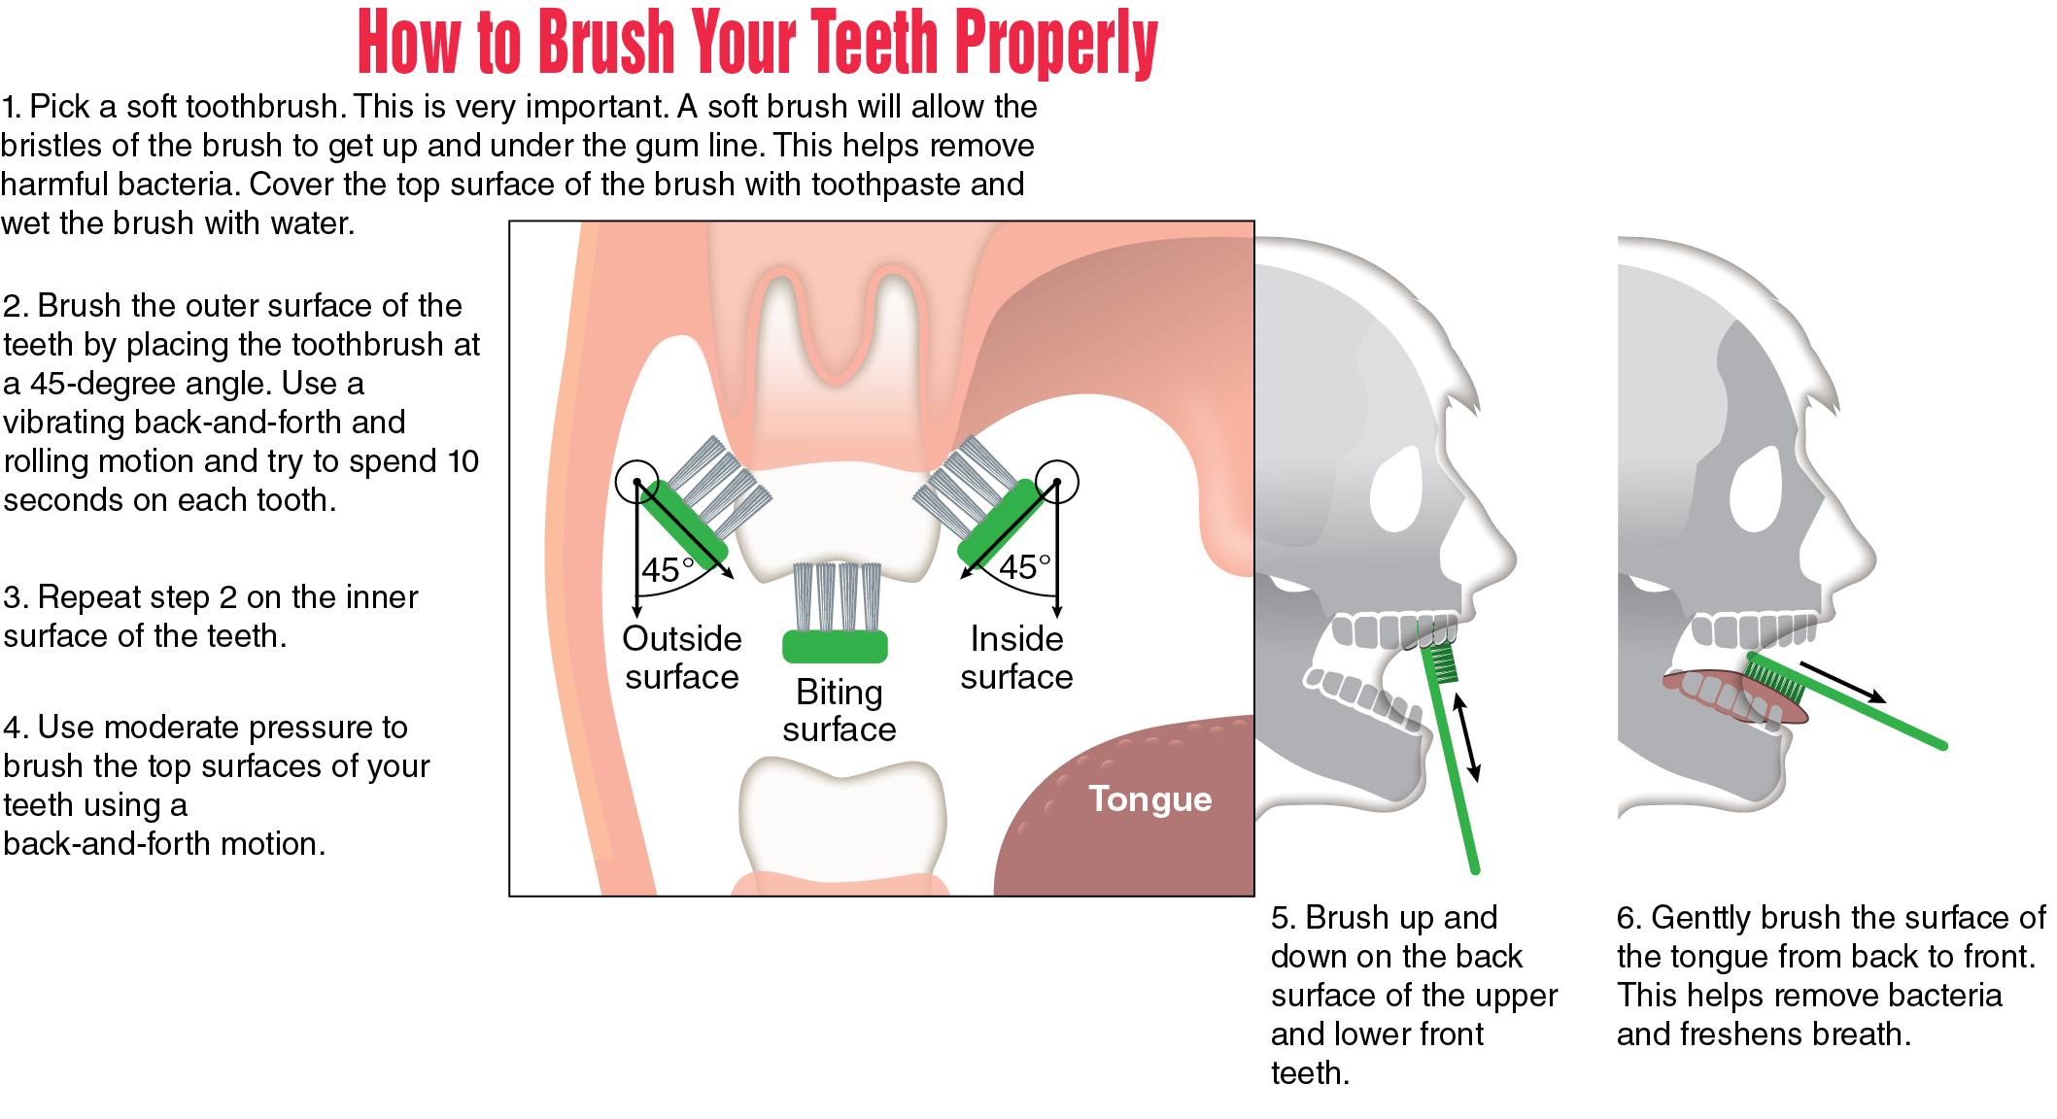
Caring for Your Mouth and Teeth (2 of 3)

Slide 9
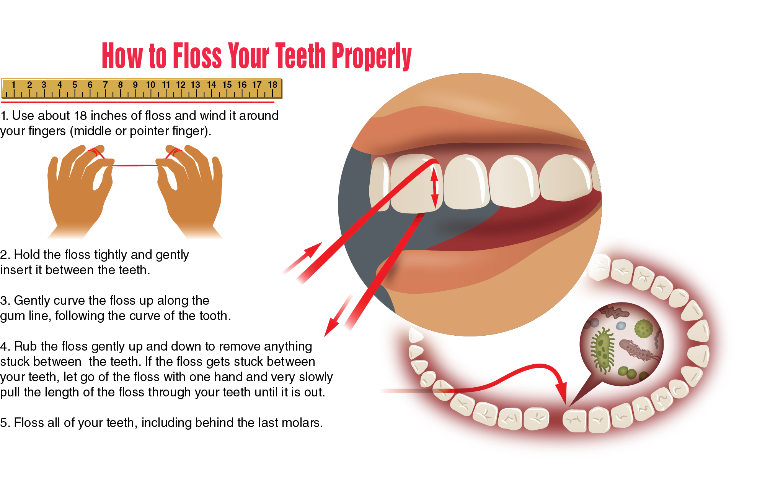
Caring for Your Mouth and Teeth (2 of 3)

Slide 10
Visiting the Dentist
Many people don’t like to visit the dentist. Fear of pain or needles, anxiety about not being able to breathe, and jaw and neck discomfort are common concerns.
  At times, these concerns get in the way of good oral health care.
  The recommendation is that you visit a dentist every six months for a deep cleaning and a checkup.
  If you are afraid, it is important to talk to your parent or guardian and to your dentist.
  Oral health care is critical to overall health.

Slide 11
Crooked or Crowded Teeth
Most of us would love a perfect smile.
Forty-five percent of kids could benefit from having braces to straighten their teeth and improve the function of the mouth.

Slide 12
Wisdom Teeth
They begin to grow in around ages 18–20, and you may experience crowding in your mouth.
They may need to be pulled to allow enough space for the other teeth, a common procedure that does not negatively affect the function of the mouth.

Slide 13
Tooth Decay
The destruction of some part of the tooth can affect the outer layer of the tooth and the inside of the tooth.
It occurs when foods containing carbohydrates, such as cereal, soda, and candy, are left on the teeth.
Plaque forms, which is a colorless, sticky film that coats the tooth and dissolves the protective enamel on the tooth.
If plaque sits on the tooth and causes a hole, it is called a cavity, which must be treated by a dentist.

Slide 14
Gum Disease
Gums are the soft tissue around your teeth that helps protect the root of the tooth and keeps your teeth in place.
Gum disease happens when plaque and tartar build up on the teeth. The bacteria in the plaque makes the gums become swollen.
When the gums become inflamed, it is called gingivitis.

Slide 15
Cold Sores
A common infection caused by the herpes simplex virus (HSV)
Small blisters on and around your lips
Contagious and can be spread by close contact, such as kissing

Slide 16
Bad Breath
It is also called halitosis.
It is caused by a variety of hygiene factors or from common diseases, such as
  food in teeth,
  tobacco use,
  poor dental hygiene, and
  other things.

Slide 17
Teeth Grinding
It is also called bruxism.
Stress and anxiety are common causes.
Sometimes, people clench their jaw while awake or grind their teeth in their sleep.
Symptoms include flattened teeth, worn tooth enamel, headaches, and many other things.

Slide 18
Goal Setting for Good Dental Hygiene (1 of 2)
Creating a habit of brushing twice a day and flossing once a day will go a long way to maintaining good oral health.
When you think about setting a goal for improving your dental hygiene, think about whether you brush and floss enough and follow guidelines.
(continued)

Slide 19
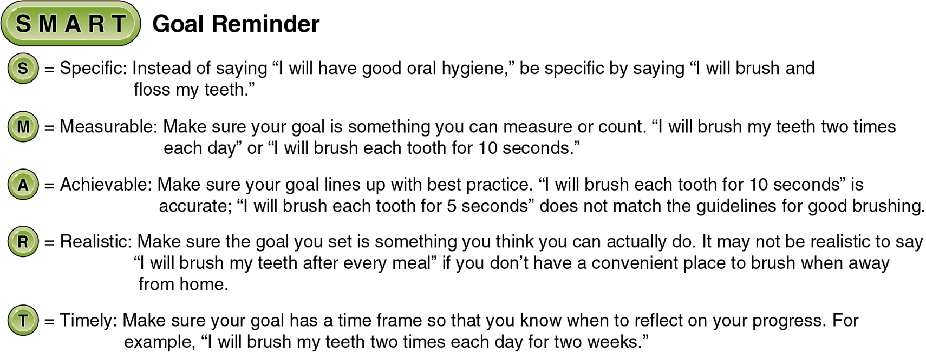
Goal Setting for Good Dental Hygiene (2 of 2)
Notes:
Figure 2.9 A SMART goal for good oral hygiene.

