Slide 1
Healthy Sleep and Rest
Chapter 2
LESSON 2.4
Live Well: Middle School Health
Notes:
REB Images/Getty Images

Slide 2
Write About It
How many hours of sleep did you get last night?
What helps you get a good night’s sleep?
What makes it harder for you to sleep?

Slide 3
Understanding Sleep (1 of 3)
Everyone needs good quality sleep each night.
  Good quality sleep is sleep that is long enough and is peaceful and deep.
  An adequate amount of sleep is enough to help you function properly throughout the day.
  If you wake up feeling refreshed and well rested, you probably got enough good quality sleep. If you feel sleepy during the day, you probably did not.
  Without enough good quality sleep each night, you will become sleep-deprived.
  (continued)

Slide 4
Understanding Sleep (2 of 3)
When you sleep, your body is unconscious. This means that your body is inactive and without awareness, even though your brain is still very active.
  Some scientists believe that your brain uses sleep to recover from stress, solve problems, and replenish important chemicals it needs to function.
  The truth is, we don’t fully understand everything that happens when we sleep.
  (continued)

Slide 5
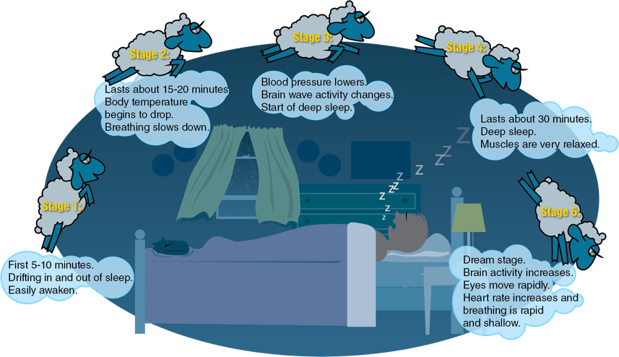
Understanding Sleep (3 of 3)
Notes:
Figure 2.14 The five stages of sleep.

Slide 6
The Importance of Sleep
Benefits of a good night’s sleep include:
Helps the body heal and stay healthy
Reduces risk of heart attack, stroke, and cancer
Helps the body with growth and development
Improves alertness and concentration
Reduces depression and enhances mood
Improves memory and productivity
Helps metabolism and can help control weight

Slide 7
Getting Enough Sleep
Everyone’s need for sleep will vary, and your needs will differ depending on your age.
Teenagers need a lot of sleep to support growth and maturation.
Sleep recommendations:
  School-age (6–12 years): 9–12 hours
  Teenage (13–18 years): 8–10 hours
  Adult (18+): 7 or more hours

Slide 8
What Happens When You Don’t Sleep Enough or Don’t Sleep Well?
Good quality sleep doesn’t just help you feel your best. It also protects you from health conditions, diseases, and other challenges to good health.
  Research shows that 6 out of 10 middle school students don’t get enough sleep.
  Poor sleep can contribute to various health issues.

Slide 9
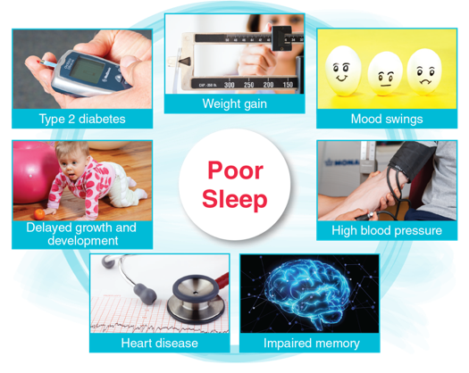
Problems Associated
With Poor Sleep
Notes:
Figure 2.15 Problems associated with poor sleep.
photos in figure 2.15: JGI/Jamie Grill/ Getty Images (weight gain); Jayk7/ Moment/Getty Images (mood swings); Yuichiro Chino/Moment/Getty Images (impaired memory); Aslan Alphan/E+/ Getty Images (heart disease)

Slide 10
Common Sleep Problems (1 of 2)
It is not unusual to have problems sleeping now and then.
  Stress, anxiety, or excitement can sometimes keep you awake or disturb your sleep.
  Almost everyone experiences an occasional disruption to sleep.
  If your sleep is disrupted night after night, your body develops a sleep debt and eventually your judgment, focus, and overall function will suffer.
  (continued)

Slide 11
Common Sleep Problems (2 of 2)
  Bed-wetting (accidentally urinating during sleep)
  Insomnia (not being able to fall asleep or sleep through the night)
  Nightmares (scary dreams that can cause you to wake up)
  Sleepwalking (getting out of bed and walking around while in a state of deep sleep)
  Sleep apnea (stopping breathing for short periods of time during sleep)
  Narcolepsy (falling asleep suddenly during the day)

Slide 12
Self-Management for Good Sleep (1 of 2)
You should plan for sleep as you do for other important parts of your life.
Develop a clear sleep routine, a set of behaviors or rituals you do consistently when getting ready for bed.
Every day you should do the following:
  Take naps. Short naps can help improve mood, alertness, and performance.
  Get regular exercise. Daily exercise helps you sleep longer and deeper.
  Get natural light during the day to help your biological clock work at its best.
  (continued)

Slide 13
Self-Management for Good Sleep (2 of 2)
When preparing to sleep, do the following:
  Set and follow a sleep schedule. Going to bed at the same time each night and getting up at the same time in the morning helps your body get into a routine.
  Avoid stimulants (caffeine, screen time) before bed.
  Relax before bed. Doing something relaxing before bed, like taking a bath or reading a book, can help you fall asleep more easily.
  Create a quality sleeping environment. You will sleep best in a cool, dark, quiet space that is comfortable.

