Slide 1
Understanding Foods and Nutrients
Chapter 3
LESSON 3.1
Live Well: Middle School Health
Notes:
IAN HOOTON/Science Photo Library RF/Getty Images (top); © gerenme/iStockphoto (bottom)

Slide 2
Write About It
What do you drink when you are thirsty, and how do you decide what to drink?
Explain your answer using three different circumstances and situations.

Slide 3
Nutrients
Nutrients are the substances found in food that your body needs to survive.
Each nutrient plays a different role.
Nutrients help keep you healthy, help you perform your best, and give you the energy you need to move.
Nutrients are grouped into six categories.

Slide 4
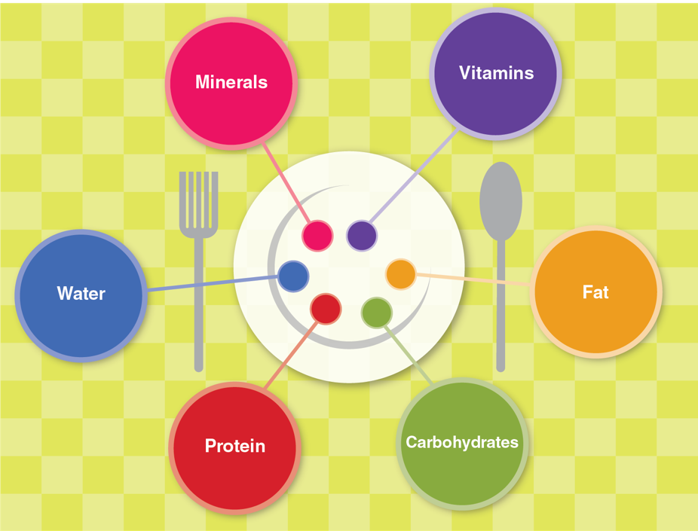
Six Categories of Nutrients
The nutrients you need to be healthy are grouped into six categories:
Notes:
Figure 3.1 The six categories of nutrients you need to be healthy.

Slide 5
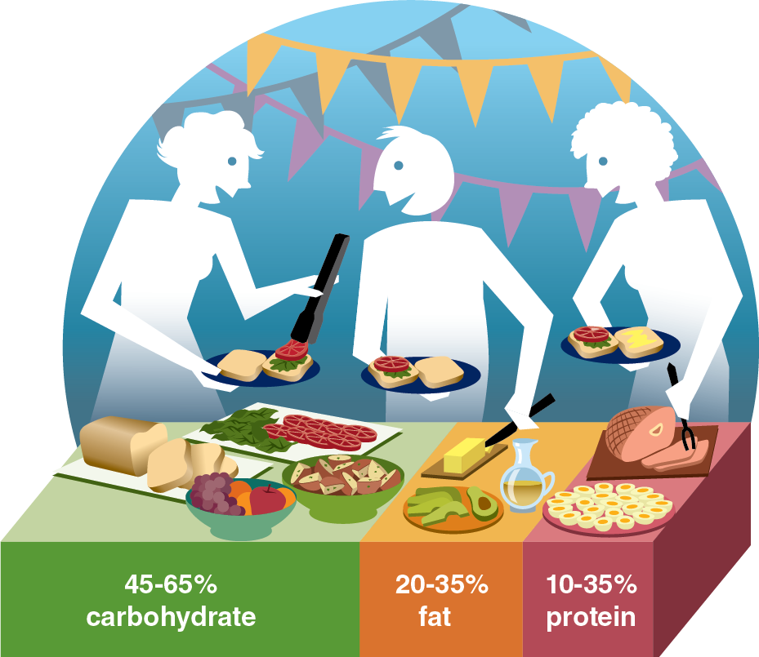
Energy Nutrients and Foods
Calories are the form of energy found in foods.
It is important to eat enough calories from the right types of foods.
The following nutrients give us calories:
Carbohydrates
Fats
Proteins
Notes:
Figure 3.2 Percentage of calories recommended by the USDA for carbohydrate, protein, and fat.

Slide 6

Carbohydrates (1 of 2)
Carbohydrates are the main source of energy for your body.
There are two types of carbohydrates.
Simple carbohydrates, also called simple sugars, can come from fruits and milks.
Complex carbohydrates, also called starches, can come from bread, pasta, potatoes, and rice.
(continued)
Notes:
Figure 3.4 A wide variety of whole grains are part of a healthy diet.
burwellphotography/E+/ Getty Images

Slide 7
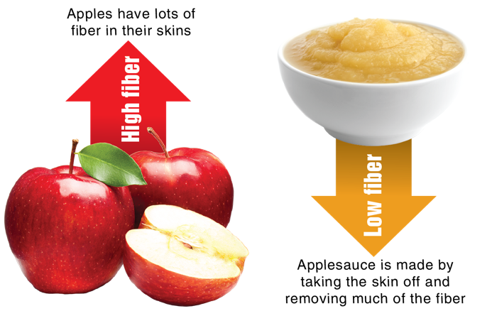
Carbohydrates (2 of 2)
Healthy carbohydrates contain fiber.
Fiber is found in plant foods, such as fruits, vegetables, and whole grain foods.
Fiber is hard for the body to digest,so it helps remove things such as cholesterol from the digestive system.
Notes:
Figure 3.3 You will get more fiber from foods that are whole, like an apple, than from processed foods, like applesauce.
photos in figure 3.3: xxmmxx/Getty Images (left); Etiennevoss/iStock/Getty Images (right)

Slide 8
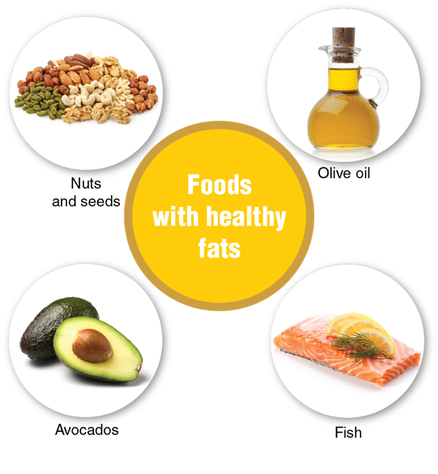
Fats
Fats are used to make hormones and serve as carriers for other substances in the blood.
Fat, stored as body fat, protects organs and keeps your body warm.
Some fats are better than others.
Fat from plants is considered healthier than fat from animals.
Notes:
Figure 3.5 Healthy fats can be found in a variety of foods.
photos in figure 3.5: egal/Getty Images/iStockphoto (nuts and seeds); iStock/Getty Images Plus (olive oil); gbh007/iStockphoto/Getty Images (fish); AshaSathees Photography/ Moment RF/ Eyewave/iStock/Getty Images (avocado)

Slide 9
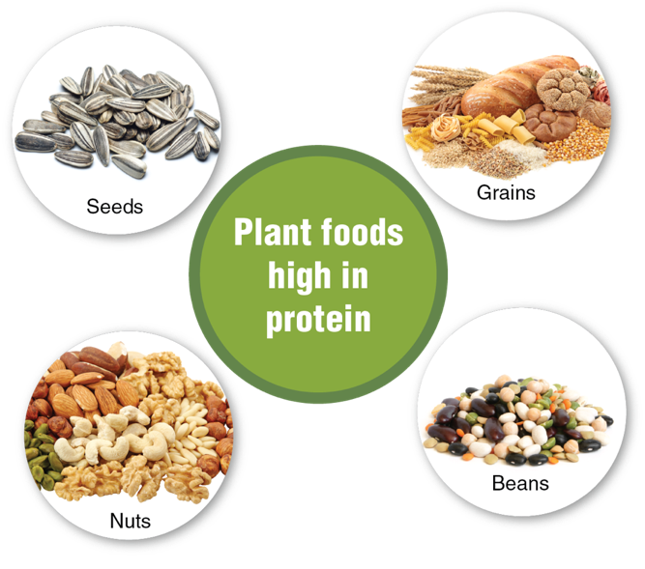
Proteins
Proteins are substances found in food that provide calories and help build and repair tissues.
The proteins you eat are like building blocks.
Complete proteins have all the building blocks you need. These come from animal products like eggs, meat, and cheese.
Incomplete proteins lack one or more building blocks. Eating plant foods in combinations, like rice and beans, provides a full set of protein building blocks.
Notes:
Figure 3.6 You can find proteins in plant foods.
photos in figure 3.6: IgorDutina/ iStockphoto/Getty Images (seeds); Elena Schweitzer/Getty Images/iStockphoto (grains); popovaphoto/Getty Images/iStockphoto (beans); conejota/ Getty Images/iStockphoto (nuts)

Slide 10
Vitamins and Minerals (1 of 2)
Vitamins and minerals are small substances found in foods that are essential for life.
Vitamins and minerals have no calories, so they don’t provide energy.
These nutrients help your body create the chemical reactions needed to get the energy out of carbohydrates, fats, and proteins.

Slide 11
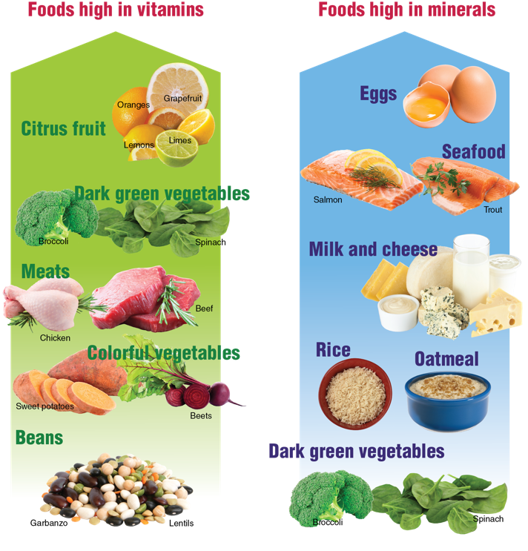
Vitamins and Minerals (2 of 2)
Notes:
Figure 3.7 Good sources of vitamins and minerals.
photos in figure 3.7: tanuha2001/ iStock/Getty Images (broccoli); Creativeye99/iStockphoto/Getty Images (spinach); Carlos Gawronski/Getty Images (chicken); Kateryna Maksimenko/iStockphoto/Getty Images (beef ); margouillatphotos/Getty Images/iStockphoto (sweet potatoes); vitalssss/Getty Images/iStockphoto (beets); popovaphoto/Getty Images/ iStockphoto (beans); Dominik Pabis/ Getty Images (eggs); gbh007/iStockphoto/Getty Images (salmon); Antonio Scarpi/iStockphoto/Getty Images (trout); fcafotodigital/Getty Images/ iStockphoto (milk and cheese); PhotoDisc (oatmeal)

Slide 12
Water
Water is essential for life. It carries nutrients around in the body and keeps the body at a constant temperature.
Your body is made up mostly of water.
Water should be the main fluid in your diet.
Drinks such as coffee, sport drinks, and energy drinks can have unnecessary or even dangerous levels of sugar and caffeine.

Slide 13
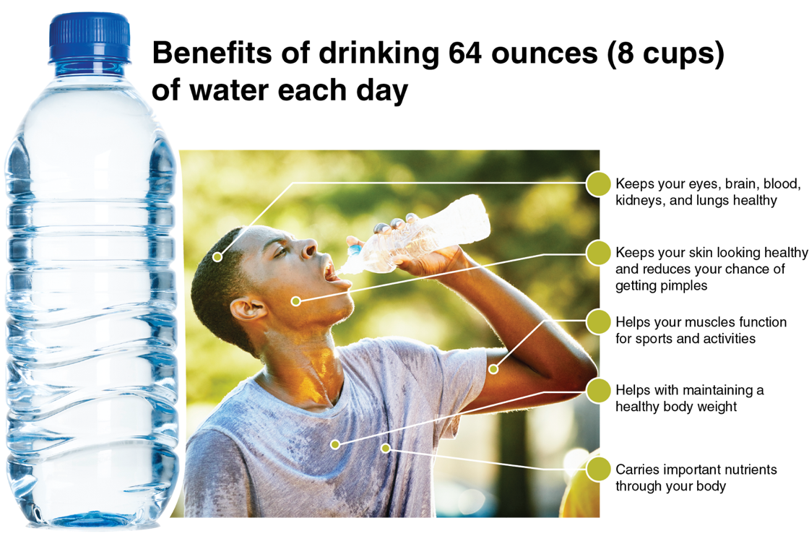
Benefits of Drinking Water
Notes:
Figure 3.8 There are many benefits to drinking water.
photos in figure 3.8: Creative Crop/ DigitalVision/Getty Images (left); Thomas Barwick/DigitalVision/Getty Images (right)

Slide 14
Drinks High in Sugar
Drinks high in sugar, sodium, or caffeine are not healthy choices for getting the water you need.
Sodas can be the biggest source of sugar in your diet.
Sugar can lead to cavities in your teeth, a risk of type 2 diabetes, and weight gain.
Drinks high in sugar are described as empty-calorie foods because they have no real nutritious value.
High sugar drinks can also keep you from eating healthier foods, such as fruits and vegetables.
Notes:
VICTOR DE SCHWANBERG/Science Photo Library/Getty Images

Slide 15
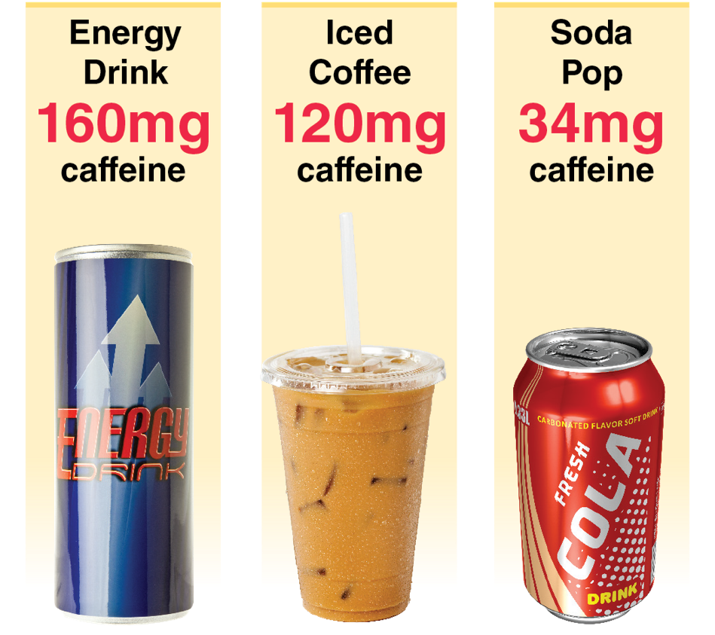
Energy Drinks
Notes:
Figure 3.9 Most energy drinks have more caffeine than coffee, tea, or soda.
photos in figure 3.9: Magnetcreative/ E+/Getty Images (left); Perch Images/ Photodisc/Getty Images (middle); Scanrail/iStock/Getty Images (right)

