Slide 1
Energy Balance, Hunger, and Appetite
Chapter 3
LESSON 3.2
Live Well: Middle School Health
Notes:
Steve Debenport/iStockphoto/ Getty Images

Slide 2
Write About It
What does it feel like to be hungry?
Have you ever eaten something even though you weren’t hungry?
What influenced you to eat when you weren’t hungry?

Slide 3
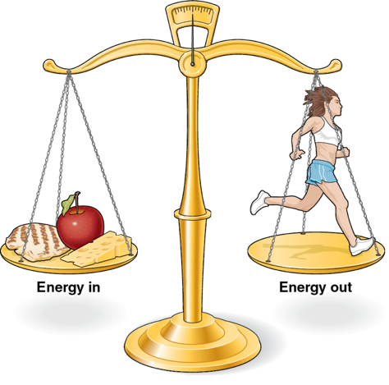
Energy Balance (1 of 2)
Energy balance is the relationship between the calories (energy) you eat and the calories (energy) you burn off.
The human body works best when the amount we eat is similar to the amount we use.
(continued)
Notes:
Figure 3.10 Energy Balance

Slide 4
Energy Balance (2 of 2)
Positive energy balance: If you eat more than you use, you have too many calories in your body.
Can lead to weight gain
Negative energy balance: When you burn off more than you eat, your body does not have enough energy.
Can lead to weight loss
Notes:
Figure 3.10 Energy Balance

Slide 5
How You Burn Calories
You burn energy doing three main things.
Daily survival
Your body burns calories daily by having your brain, heart, blood, and lungs work properly.
The number of calories you burn to keep your basic body functions working is called metabolic rate.
Ingesting and digesting foods
Physical activity and movement

Slide 6
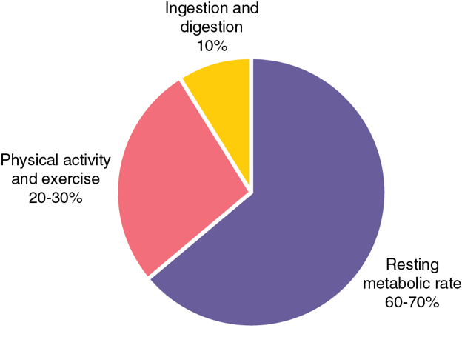
Contributors to Daily Energy Expenditure
Notes:
Figure 3.11 Contributors to daily energy expenditure.

Slide 7
Daily Energy Need (1 of 2)
Daily energy need is the number of calories you need each day to stay healthy.
Not everyone needs the same number of calories each day.
Some people need more calories because they are taller or bigger or have more muscle.
People who are active or growing also need more energy.
(continued)
Notes:
Steve Debenport/Getty Images

Slide 8
Daily Energy Need (2 of 2)
Eating more calories than you need each day can lead to weight gain.
If you don’t eat enough calories each day, you may lose weight, or you may not grow and gain weight the way you should.
Not eating enough food can lead to a deficiency in which you don’t get enough of a needed nutrient.
Deficiencies can lead to brittle hair and nails, weak bones, and poor night vision.

Slide 9
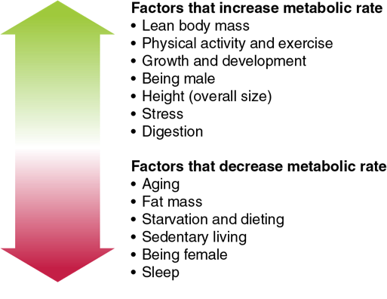
Determining Your Caloric Need
Look at table 3.1 (next slide) to determine a starting point for how many calories you should be consuming for your gender and age.
Remember, if you are active, you might need to eat more calories, but, if you participate in sedentary activities, you might need to eat fewer.
Notes:
Figure 3.12 Your level of daily physical activity will influence how many calories you need each day.

Slide 10
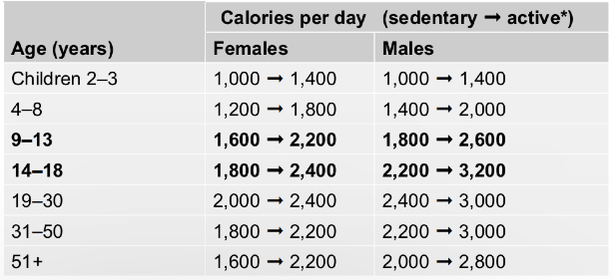
Energy Needs Across the Life Span
 | Calories per day (sedentary -. active*) | Calories per day (sedentary -. active*)
Age (years) | Females | Males
Children 2 to 3 | 1000 to 1400 | 1000 to 1400
4 to 8 | 1200 to 1800 | 1400 to 2000
9 to 13 | 1600 to 2200 | 1800 to 2600
14 to 18 | 1800 to 2400 | 2200 to 3200
19 to 30 | 2000 to 2400 | 2400 to 3000
31 to 50 | 1800 to 2200 | 2200 to 3000
51+ | 1600 to 2200 | 2000 to 2800
Notes:
Table 3.1 Energy Needs Across the Life Span

Slide 11
Understanding Your Hunger
When your energy levels are low, your brain tells your body that it’s time to eat.
Your stomach might be growling, or you feel like you don’t have very much energy.
This communication inside your body is hunger.
Hormones, what you eat, your physical activity levels, and even genetics influence hunger.
When your body is full and your hunger is satisfied, you are satiated.

Slide 12
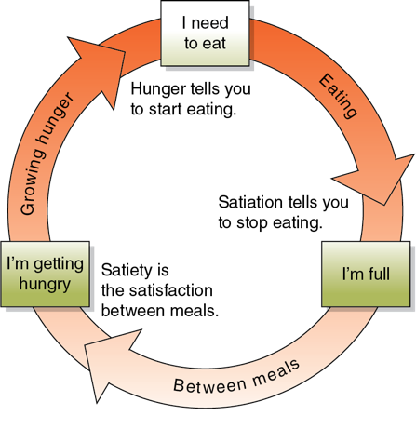
Understanding Your Appetite
Appetite is all the external influences on your food choices.
Your appetite is what makes you want to eat even if you are not feeling hungry. It can also keep you from eating even when your body is hungry.
Notes:
Figure 3.13 Hunger, satiation, and satiety are cues that tell you when to start and stop eating.

Slide 13
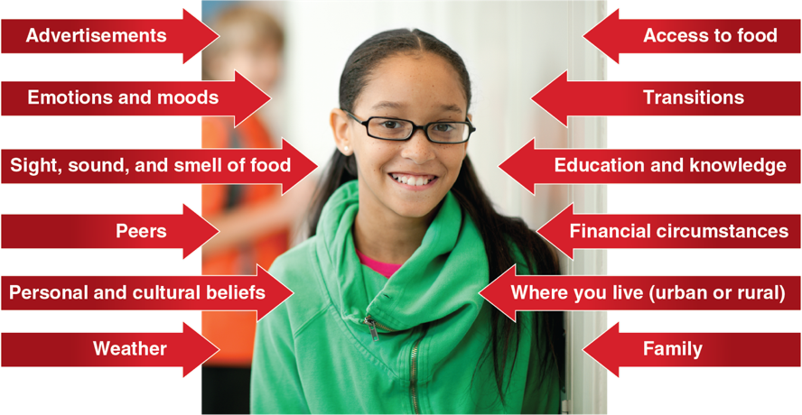
Factors That Influence Appetite
Notes:
Figure 3.14 Factors that influence appetite.
photo in figure 3.14: FatCamera/E+/ Getty Images

Slide 14
Influences on Food Choices
Think about what it is like to smell fresh bread baking or garlic cooking. Does it make you want to eat when you walk by?
Have you ever gone to a fast-food restaurant or ordered something because of a commercial or ad you saw?
These times are when your appetite might change when you eat, how much you eat, or what you eat.

Slide 15
Cultural Influences on Food Choices
Culture can affect
our beliefs about who should make food,
how much food we should eat,
how many meals we should have in one day, and
what time we eat what foods.
Culture can also influence our food choices.
If you grew up eating in a certain type of ethnic food tradition, such as Italian, you may crave that food more often.

Slide 16
Peer Influences on Food Choices
Peers can influence daily food choices, especially when away from home or at school.
The pressure to fit in and belong can affect the foods you choose to eat.
If you have a friend who loves fried, greasy foods, you are more likely to eat those too.
If you have friends who eat healthy foods, you will be more likely to eat healthy with them.

Slide 17
Family Influences on Food Choices
When you are a teen, your family may influence your food choices more than anything.
You likely don’t do the grocery shopping.
You only have access to what’s in your home.
You might be limited in what you’re allowed to safely cook.
It is important to talk with your parents about your desire to eat healthy.

Slide 18
School and Community Influences on Food Choices
Access to food, food options, and pressure to eat a certain way are part of school influences.
Schools are required to follow federal guidelines when it comes to the foods they serve or provide access to.
Choosing salads, vegetables, and foods that have not been fried is also a better choice to include a variety of nutrients in your diet.

