Slide 1
Tips and Tools for Eating Well
Chapter 3
LESSON 3.3
Live Well: Middle School Health
Notes:
Chris Ryan/OJO Images/Getty Images

Slide 2
Write About It
How often do you read a food label when you are choosing what to eat?
Have you ever asked to see the nutrition information when eating at a restaurant?
Why do you think you do or do not use these tools to help you make decisions?

Slide 3
Building a Healthy Diet
The combinations of nutrients you eat and the way you eat is called your diet.
You can think of balance, variety, moderation, and adequacy as the four pillars or legs of a table.
All four are needed for the table to be strong and to do what it is supposed to do.

Slide 4
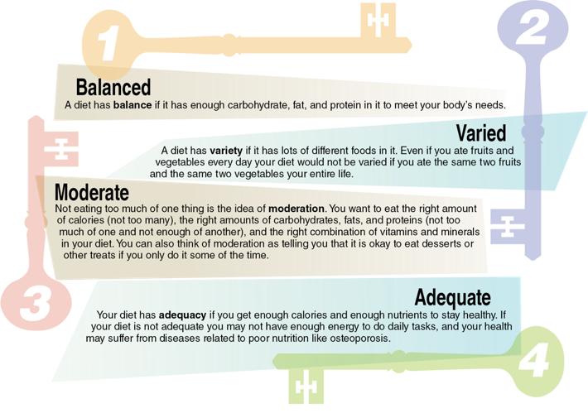
The Four Keys to a Healthy Diet
Notes:
Figure 3.16 The four keys to a healthy diet.

Slide 5
Accessing and Using
Nutrition Information
Not all nutrition information on the Internet is accurate.
Inaccurate information that is based on feelings and opinions more than facts is called biased information.
Some websites might also try to sell you vitamin and mineral supplements with inaccurate information.
  The goal of these sites is to get your money, not to make you healthier.

Slide 6
Dietary Guidelines for Americans
The Dietary Guidelines for Americans help us understand what we need to do to eat healthy.
These guidelines are based on research and are updated every five years.

Slide 7
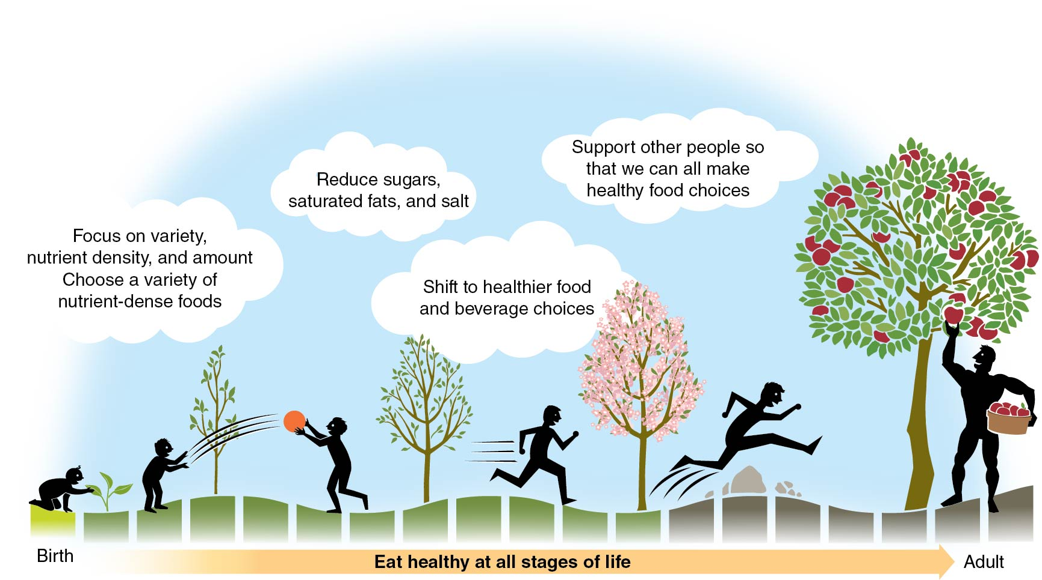
Key Ideas in the Dietary
Guidelines for Americans
Notes:
Figure 3.17 Key ideas in the Dietary Guidelines for Americans.

Slide 8
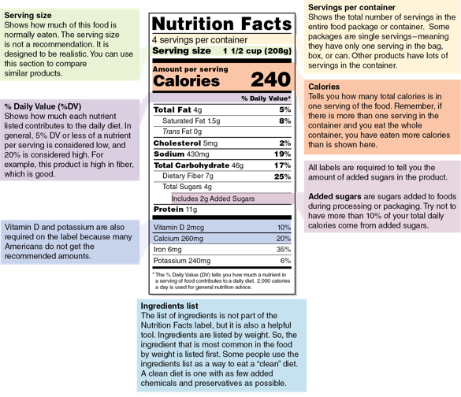
Reading Food Labels (1 of 3)
  A nutrition facts label is a great tool you can use to choose healthy foods.
  This is a label found on all food products and provides you with important nutrition information.
(continued)
Notes:
Figure 3.18 The nutrition facts label is a valid source of nutrition information.

Slide 9
Reading Food Labels (2 of 3)
  Use these components of a nutrition facts label to make healthier food choices:
  Serving size: Shows how much of this food is normally eaten
  Servings per container: Shows the total number of servings in the entire food package or container
  Calories: Tells you the total number of calories in one serving of the food
  % Daily value: Shows how much each nutrient listed contributes to the daily diet
(continued)

Slide 10
Reading Food Labels (3 of 3)
  All labels are required to tell you the amount of added sugar in the product.
  Added sugars are sugars added to foods during processing or packaging.
  The ingredients list is not part of the nutrition facts label, but it is also a helpful tool.
  Ingredients are listed by weight, so the ingredient that is most common in the food by weight is listed first.

Slide 11
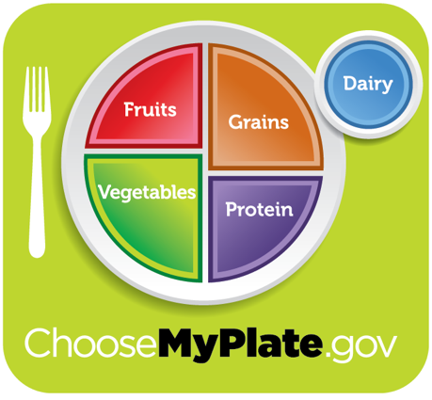
MyPlate (1 of 2)
  MyPlate is a graphic tool and website designed to help you make healthy food choices.
Notes:
Figure 3.19 The MyPlate graphic.
USDA’s Center for Nutrition Policy and Promotion

Slide 12
MyPlate (2 of 2)
  MyPlate can help you make healthier choices.
    Helps you plan a balanced, nutritious meal
    Includes information about how much of each food group to eat
    Can help you balance your calories and get the right types of foods

Slide 13
Other Sources of Nutrition
Information (1 of 2)
Dietitians are professionals who have
  a university education in nutrition and
  a professional license.
Medical doctors, school nurses, and health and physical education teachers may also be reliable resources.
(continued)

Slide 14
Other Sources of Nutrition
Information (2 of 2)
Organizations focused on helping people with a disease or disorder often provide nutrition advice.
  The American Heart Association
  The American Diabetes Association
  The American Cancer Society
Be careful when taking information from nutritionists.
  People who claim to be nutritionists may not have been trained at a university and could be more interested in making money.

