Slide 1
The Digestive and Urinary Systems
Chapter 3
LESSON 3.4
Live Well: Middle School Health
Notes:
krisanapong detraphiphat/ Moment/Getty Images

Slide 2
Write About It
What common digestive problems do you think most people experience at some point in their lives?
Describe a time you experienced one of these problems. What did you do to feel better?

Slide 3
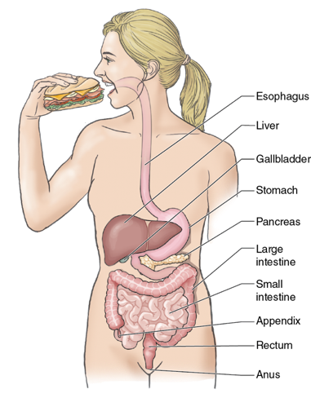
The Digestive System
The digestive system is the group of organs that break down the food you eat and get it to the cells for fuel.
Notes:
Figure 3.22 The organs that make up the digestive system.

Slide 4
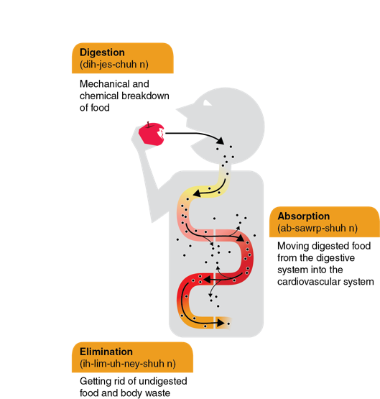
How Digestion Works (1 of 3)
Digestion is a complex process that involves many organs and actions.
This system is involved in digestion, absorption, and elimination.
(continued)
Notes:
Figure 3.23 The digestive functions.

Slide 5
How Digestion Works (2 of 3)
Chewing and swallowing
Chewing is the beginning of digestion.
Salivary glands produce saliva, which begins to break down carbohydrates.
Once swallowed, foods move through the esophagus toward the stomach.
Mixing, storing, and moving foods
The stomach is a hollow organ that functions like a small sack.
The stomach mixes foods with gastric juices, such as hydrochloric acid and pepsin, to chemically break down foods.
The partially digested food produced is called chyme.
The liver makes bile, a yellow-green fluid that helps you break down and absorb the fat you eat.

Slide 6
How Digestion Works (3 of 3)
Absorbing nutrients
Chyme moves from the stomach to the small intestine, where most of the actual work occurs.
About 90 percent of all nutrients are absorbed as food travels through the small intestine toward the large intestine.
Absorbing water and eliminating waste
The large intestine’s primary job is to absorb the remaining water, salts, and vitamins and to eliminate the waste.

Slide 7
Your Gut Bacteria
Your digestive system is home to about 100 trillion (100,000,000,000,000) bacteria—both good and bad.
Good bacteria help break down the nutrients you eat and protect you from infections.
Your digestive health, the balance of your stomach acid, and your good and bad bacteria are called your gut health.

Slide 8
Prebiotics and Probiotics
The bacteria in your system are living organisms and need fuel to survive.
Foods that can feed the bacteria in your gut are called prebiotics.
Examples include bananas, garlic, onions, radishes, carrots, and tomatoes.
Probiotics are the living bacteria found in foods.
Foods high in probiotics include fermented foods and drinks, such as some pickles and sauerkraut, tempeh, kefir, kombucha, and Greek yogurt.

Slide 9
Short-Term Challenges to Digestive Health
Digestive problems can be short term and relate to how your system functions.
Problems can develop in one of the organs in the digestive system.
The following are some short-term conditions:
Indigestion, constipation, gas, vomiting, heartburn, diarrhea, ulcers, hemorrhoids

Slide 10
Long-Term Challenges to Digestive Health
More serious factors can harm the health of your digestive system.
Some of these conditions are genetic.
Others relate to eating habits, other diseases, or medications.

Slide 11
Digestive System Conditions
Condition or disease | Description | Cause
Colitis and Crohn’s disease | Both diseases cause swelling in the colon or small intestine | Unknown; could be partly genetic and made worse by stress or diet
Cirrhosis | Damage and scarring of the liver | Alcoholism or diseases that damage the liver
Colon cancer | Cancer in the large intestine; often begins as polyps, or noncancerous growths, in the colon | Genetics or unknown cause; diet and lifestyle play a role
Lactose intolerance | Inability to fully digest lactose (a form of sugar in milk) | Occurs when the small intestine does not make the enzyme needed to digest lactose
Irritable bowel syndrome (IBS) | Abnormality in colon function resulting in severe cramping, gas, diarrhea, and constipation | Could be caused by disruptions to muscle or nervous system in the colon or by infection
Notes:
Table 4.4 Digestive System Conditions

Slide 12
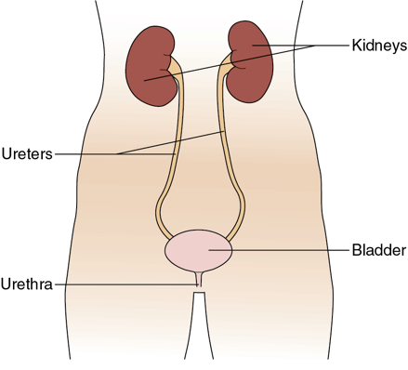
The Urinary System
The urinary system removes liquid from the body.
The system is made up of two kidneys and two ureters, the bladder, and the urethra.
The primary purpose of the urinary system is filtering and cleaning.
Notes:
Figure 3.26 The urinary system.

Slide 13
When Things Go Wrong With Urinary Health (1 of 2)
Urinary Tract Infections
A urinary tract infection (UTI) is an infection to any part of the urinary system.
Most people with UTIs experience a burning pain when going to the bathroom.
Kidney Stones
These stone-like deposits in the urinary system are made of minerals and salts that have been removed from the blood.
Passing a kidney stone is often very painful.
(continued)

Slide 14
When Things Go Wrong With Urinary Health (2 of 2)
Kidney Disease
Kidney disease occurs when a person’s kidneys gradually lose function.
It cannot be cured. Treatments try to prevent the disease from getting worse.
People with advanced cases of kidney disease must have artificial machines filter their blood for them. This process is called kidney dialysis.

Slide 15
Maintaining Good Digestive and Urinary Health
There are several ways you can avoid digestive and urinary problems.
Eat foods high in fiber.
Stay hydrated by drinking plenty of water.
Exercise regularly.
Eat on a regular schedule.
Eat prebiotic and probiotic foods regularly.
Manage your stress.

