Slide 1
Making Healthy Nutrition Decisions
Chapter 3
LESSON 3.5
Live Well: Middle School Health
Notes:
Monkey Business/fotolia.com

Slide 2
Write About It
How often do you eat prepackaged and ready-to-eat food?
Why do you eat these foods?

Slide 3
Nutrition, Health, and Disease (1 of 2)
Processed foods are foods that have been changed before they are sold or eaten.
Examples include boxed macaroni and cheese, cereal, and canned soups.
These foods can lose healthy vitamins and minerals when they are processed, and can have unhealthy levels of salt, sugar, and added chemicals.
(continued)

Slide 4
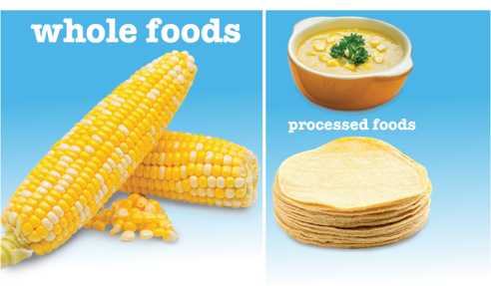
Nutrition, Health, and Disease (2 of 2)
Our society is often called a food toxic environment.
This is an environment in which cheap, unhealthy convenience foods are easy to access.
Most of these foods are processed.
A food toxic environment makes it harder to eat healthy.
Notes:
Figure 3.28 Processed foods usually have more calories, salt, and sugar than the original, whole food.
photos in figure 3.28: Akepong Srichaichana/EyeEm/Getty Images (ear of corn); Amarita/iStock/Getty Images (soup); Juanmonino/E+/Getty Images (tortillas)

Slide 5
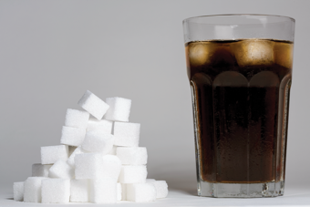
Added Sugars
Remember, added sugars give you empty calories and often take the place of healthy food choices.
Added sugars should be no more than 10 percent of your diet.
Sugars are hidden in many foods as a preservative, keeping foods fresher for longer.
Diets high in added sugar make it more likely that you may end up with type 2 diabetes, cancer, or heart disease.
Notes:
Figure 3.29 Most soda drinks have a full day’s worth of added sugars in them.
Caspar Benson/Getty Images

Slide 6
Diet and Diabetes
Nutrition and physical activity are important for someone with type 1 or type 2 diabetes.
Foods that contain some protein and are high in fiber are better than foods with added sugar and help to keep blood sugar stable.
Individuals with diabetes should always consider what they choose to eat, how much they eat, and when they eat.

Slide 7
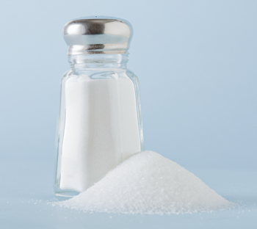
Added Salt
Sodium is a mineral your body needs, and it is commonly consumed in salt.
Sodium helps your muscles contract and helps keep your blood pressure at normal levels.
Too much sodium in your diet could make your blood pressure go too high.
High blood pressure leads to hypertension.
Hypertension is a dangerous disease that can cause damage to your blood vessels and lead to other diseases.
Notes:
Figure 3.30 Eating too much salt can lead to disease.
Kristin Lee/Getty Images

Slide 8
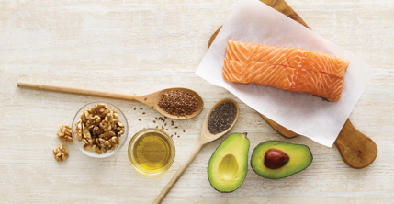
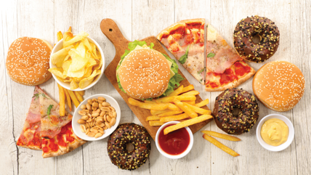
Healthy and Unhealthy Fats
Saturated fats
Most often found in animal fat
Are usually a solid (not a liquid) at room temperature
Too much of this type of fat can lead to heart disease and heart attack.
Unsaturated fats
Found in plant foods, avocados, nuts, and fish
Are the good type of fat
Notes:
Figure 3.31 Fats from nuts, vegetables, and fish are healthy choices. Fats from baked goods and fried foods are not healthy and should be avoided.
Science Photo Library/ Getty Images (top); margouillatphotos/ iStockphoto/Getty Images (bottom)

Slide 9
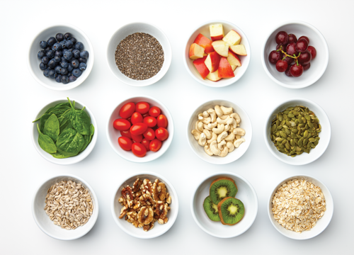
Antioxidants
Antioxidants work to get rid of dangerous chemicals in your body.
Fresh fruits and vegetables are good sources of antioxidants.
A diet rich in antioxidants helps reduce your risk of cancers and other diseases.
Notes:
Lew Robertson/DigitalVision/ Getty Images

Slide 10
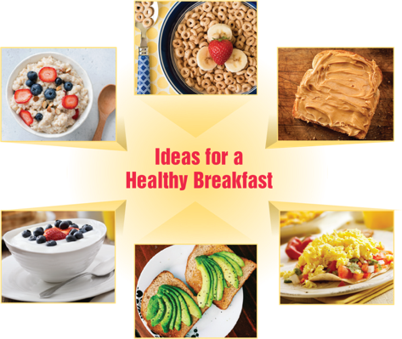
Making Healthy Breakfast Decisions
Breakfast helps to replenish the nutrients your body has lost during sleep and prepares you for the day ahead.
Skipping breakfast can lead to the following:
Difficulty focusing in class
A cranky or restless attitude
Lower grades
Weight gain
Notes:
Natalia Ganelin/Moment/Getty Images (cereal); LauriPatterson/E+/ Getty Images (peanut butter on toast, huevos rancheros, yogurt); Nkisu Machona/EyeEm/Getty Images (avocado on toast); Arx0nt/Moment/Getty Images (oatmeal)

Slide 11
Making Healthy Decisions When Eating Out
Restaurants can provide a wide variety of foods; some are healthier than others.
When eating out:
Ask to see the nutrition information about the foods on the menu to make healthier decisions.
Use the steps to a healthy decision outlined on the next slide.

Slide 12
Steps to a Healthy Decision
Step 1: Understand the problem.
Step 2: Gather information and know your options.
Step 3: Know the consequences.
Step 4: Make a decision.
Step 5: Think about your choice.

Slide 13
Tips for Eating Out
Start with a glass of water.
Pick your vegetables first.
Finish your meal before ordering dessert.
Choose meats that are grilled or broiled.
Avoid fried foods.
Avoid too much salad dressing, gravy, or sauces.
Taste your food before salting it.

Slide 14
Choosing Healthy Convenience Foods
Snacking throughout the day is normal because you are growing and maturing and need calories in your body.
When snacking, choose fresh, unprocessed foods or foods low in fat, salt, and sugar.
The calories you eat as snacks can add up quickly and cause weight gain, which you might not want.
Notes:
JGI/Jamie Grill/Getty Images

