Slide 1
Eating Well as You Grow
Chapter 4
LESSON 4.1
Live Well: Middle School Health

Slide 2
Write About It
How do you think your eating habits have changed since you were a young child?
Do you ever think about how nutrition might affect the way you grow and develop?

Slide 3

Minerals for Healthy Development
  Everyone needs a variety of vitamins and minerals to stay healthy.
  Your nutrient needs will change as you grow and age and face different life events.

Slide 4
Iron and Teen Health
Iron is a mineral that helps blood carry oxygen in your body, which will help your body grow and develop.
Having enough iron gives you more energy throughout the day.
Not having enough iron could lead to a condition called anemia (a disease caused by low red blood cells).
Anemia can cause someone to feel tired and weak, have pale skin, or have a fast or irregular heartbeat, among other side effects.

Slide 5
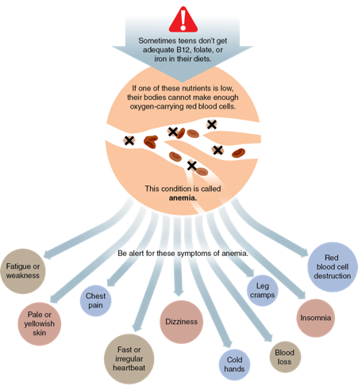
Symptoms of Anemia
Notes:
Figure 4.2 Symptoms of anemia.

Slide 6
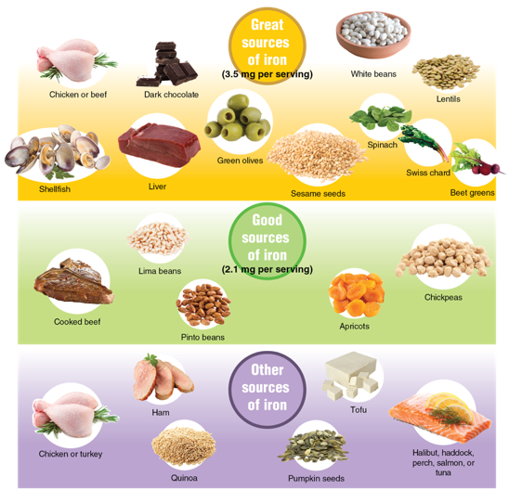
Sources of Iron
Notes:
Figure 4.1 Sources of iron in foods.
photos in figure 4.1: Carlos Gawronski/Getty Images (chicken); R.Tsubin/ Moment/Getty Images (chocolate, apricots); Roberto Machado Noa/Moment/ Getty Images (white beans); Melanie Hobson/EyeEm/Getty Images (lentils, pumpkin seeds); Popovaphoto/iStock/ Getty Images (shellfish); Bdsp/iStock/ Getty Images (liver); Paci77/E+/Getty Images (olives); li jingwang/Getty Images (sesame seeds); Creativeye99/ iStockphoto/Getty Images (spinach); Maribee/E+/Getty Images (swiss chard); vitalssss/Getty Images/iStockphoto (beet greens); Westend61/Getty Images (cooked beef); Diana Taliun/ iStock/Getty Images (pinto beans); Ranasu/E+/Getty Images (lima beans); Dimitris66/Getty Images/iStockphoto (chickpeas); milanfoto/Getty Images (ham); Magone/iStock/Getty Images (quinoa); Kevin Dyer/E+/Getty Images (tofu); gbh007/iStockphoto/Getty Images (fish)

Slide 7

Calcium and Teen Health (1 of 2)
  Calcium is a mineral that helps your bones grow and your muscles function.
  Men and women begin to slowly lose bone mass after age 30. This means that you must pay attention to building strong bones before then.
(continued)
Notes:
Figure 4.3 Foods high in calcium.
LauriPatterson/ E+/Getty Images

Slide 8
Calcium and Teen Health (2 of 2)
  Many teens do not get the recommended amount of calcium in their diet.
  Teens and young adults who smoke or drink caffeinated beverages, such as soda or coffee, may get even less calcium because these things reduce how much calcium your body can absorb.
  Teens, especially girls, who don’t get enough calcium are at risk of developing osteoporosis (weak bones).
  When the body doesn’t have enough calcium, it steals it from your bones.

Slide 9
Great Sources of Calcium
Dairy products: low-fat milk, cheese, cottage cheese, and yogurt
Veggies: broccoli and dark green, leafy vegetables, such as kale and collard greens
Soy foods: fortified tofu, soy milk, and soy yogurt
Beans: baked beans, navy beans, white beans, and others
Notes:
Figure 5.1 Sources of iron in foods.

Slide 10
Communicating for Healthy Eating (1 of 2)
  It is important to learn to communicate your wants and needs so that you can make healthy choices.
  Sometimes you need to say no to someone who wants you to make an unhealthy eating choice.
  Other times, you may need to ask for assistance in making a smart decision.
(continued)

Slide 11
Communicating for Healthy Eating (2 of 2)
  Learn to say no in an unhurtful way to help yourself eat well.
  Ask for help if you feel confused by the food options you have.
  Negotiate with others to make healthier food choices.

Slide 12
Steps for Negotiating
Healthy Food Choices
  1. Identify the conflict.
  2. Brainstorm your options.
  3. Evaluate solutions.
  4. Choose a solution.
  5. Do it.
  6. Reflect on how it went

