Slide 1
Food Access and Safety
Chapter 4
LESSON 4.2
Live Well: Middle School Health
Notes:
MP/fotolia.com

Slide 2
Write About It
What do you know about where your food comes from and what happens to it before it shows up on your plate?
Think about a meal you ate recently and try to trace the journey of that food from its origin to your plate.
You can write a paragraph, use a bulleted list, or make a drawing.

Slide 3
Does Everyone Have Access to Enough Food?
It is estimated that about one in every eight people in the United States is food insecure.
Food insecurity refers to not having enough food to support an active, healthy life.
People may be food insecure because they
they don’t have enough money,
hey may not be able to get food supplies because they don’t have transportation, or
they might be unable to move independently.

Slide 4
Food Safety
Even when you do have access to food, it isn’t always safe to eat.
Food can carry pathogens that cause foodborne illnesses.
Food goes through several steps before it gets to your plate.
These steps are called the food chain.
Production, processing, distribution, and preparation of food

Slide 5
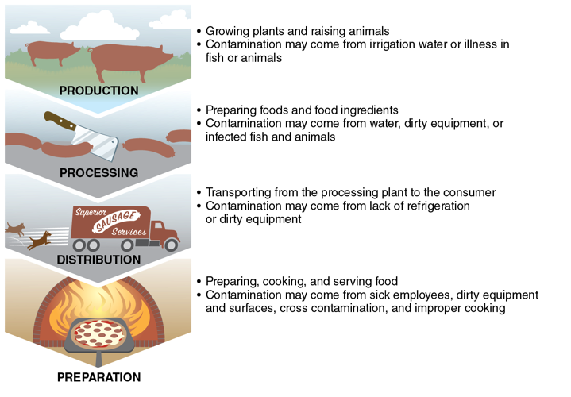
The Food Chain
Notes:
Figure 4.4 Food can become contaminated anywhere along the food chain.

Slide 6
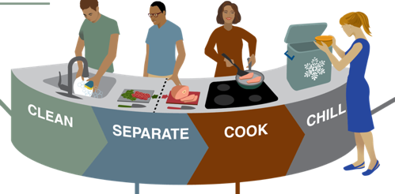
Safe Food Handling and Preparation (1 of 3)
How you handle and prepare your foods will affect how likely they are to become contaminated.
The most important thing you can do when handling and preparing food is to follow the four steps to food safety:
(continued)
Notes:
Figure 4.5 Four Steps to Food Safety

Slide 7
Safe Food Handling and Preparation (2 of 3)
Clean
Clean your hands. Clean all utensils, cutting boards, and surfaces. Wash fruits and vegetables. Clean all surfaces thoroughly when finished prepping food.
Separate
Separate produce from meats, eggs, and poultry. Use separate cutting boards for meat, eggs, and poultry.
(continued)

Slide 8
Safe Food Handling and Preparation (3 of 3)
Cook
Cook foods to the proper temperature to kill known pathogens. Serve food immediately, or make sure to keep cooked foods above 140°F if not being eaten right away.
Chill
As soon as you are done eating, place all leftover foods in the refrigerator. Foods that require refrigeration should not be left out at room temperature for more than two hours to decrease the risk of bacteria growth.

Slide 9
Food Additives and Preservatives
Food additives are substances added to food to
improve freshness
add nutrition
improve taste, texture, or appearance
Additives that are designed to keep food from spoiling are called preservatives.

Slide 10
Pesticides and Organic Foods
Pesticides are chemicals used to protect a crop from insects, weeds, and infections.
Some foods are more likely to absorb chemicals than others.
Organic foods are grown without chemical pesticides and contain no synthetic ingredients, bioengineering, or radiation.

