Slide 1
Maintaining a Healthy Weight
Chapter 4
LESSON 4.3
Live Well: Middle School Health
Notes:
Elenathewise/fotolia.com

Slide 2
Write About It
What does it mean to be overweight?
Can a person be overweight and still be healthy?

Slide 3
Why Is Weight Important?
  Obesity is known to be linked to increased risk for a variety of diseases, including type 2 diabetes, coronary heart disease, and some cancers.
  Weight can be influenced by genetics, the environment, and behaviors.
  Weight is only part of the story. People who are physically active are generally healthier than people who aren’t, regardless of what either person weighs.

Slide 4
What Is Body Composition? (1 of 2)
  Body composition refers to the ratio of lean (muscle) tissue to fat tissue in your body.
  A person with more lean tissue and less fat tissue is generally at lower risk for most diseases.

Slide 5
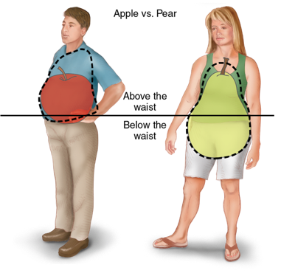
What Is Body Composition? (2 of 2)
  Fat distribution is the location of fat tissue on the body.
  Fat on and above the waist is more dangerous than fat below the waist.
  Activity levels, body composition, and fat distribution tell us more about health than weight or BMI.
Notes:
Figure 4.7 Fat in the upper body is called an apple-shaped distribution; fat in the lower body is called a pear-shaped distribution.

Slide 6
Measuring Body Composition and Fat Distribution
Technique | Description
Skinfold calipers | Fat just below the skin is pinched and measured.
Bioelectrical impedance (BIA) | A small current is sent through the body, and the amount of water and lean tissue is estimated from the speed of the current. Handheld devices, body composition scales, and traditional electrode versions exist.
Underwater weighing | A person is weighed while under water. The volume of the body and the underwater weight of the body are used to estimate the amount of fat tissue in the body.
Waist-to-hip ratio | The waist is measured at the narrowest point and the hips are measured at the widest point. The waist measure is divided by the hip measure. A number under 0.80 for females and 0.95 for males is considered healthy.
Notes:
Table 4.2 Methods for Measuring Body Composition and Fat Distribution

Slide 7
What Is a Healthy Weight for Me?
Human beings come in all shapes and sizes, and we are all genetically different.
Being underweight or overweight does not automatically mean you have a disease or have done something wrong.
A healthy weight is a weight that you are comfortable with and that you can maintain by following basic nutrition and physical activity guidelines.

Slide 8
Losing and Gaining Weight
As a teenager, you should consult with your parents and physician before making any decisions about losing or gaining weight.
Since teenage years are a critical time for your body’s growth and maturation, make sure you don’t do anything that might cause long-term health challenges.

Slide 9
Healthy Weight Gain (1 of 2)
Typically, when someone is trying to gain weight, they are trying to gain more muscle mass.
When trying to gain healthy weight, focus on eating more nutrient-dense food and doing more resistance training.
  Eating foods high in sugar or fat does not help because it typically increases body fat.
  Eating foods high in protein is not effective either because excess protein is not turned into muscle very easily.
(continued)

Slide 10
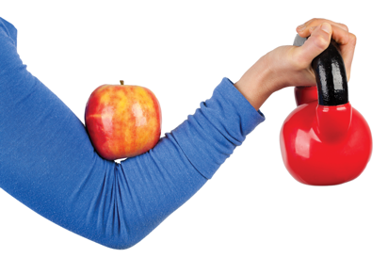
Healthy Weight Gain (2 of 2)
Using supplements or steroids for weight gain is not a healthy approach.
Anabolic steroids are a class of hormones that can stimulate muscle growth but can also cause the following:
  Damage to the cardiovascular system, liver, and kidneys
  Severe acne
  Hair loss
  Mood swings
Notes:
Tsvi Braverman / EyeEm/Getty Images

Slide 11
Healthy Weight Loss
  There is no easy way to lose weight.
  A healthy rate of weight loss is between one and two pounds per week.
  A combination of eating the right amount of nutrient-dense food and increasing physical activity is the healthiest way to lose body fat and weight.

Slide 12
Dangerous Dieting Habits
  People often turn to fad diets and diet pills to try to lose weight.
  People who lose weight quickly on these diets and products often gain the weight back quickly as well, which is called weight cycling.

Slide 13
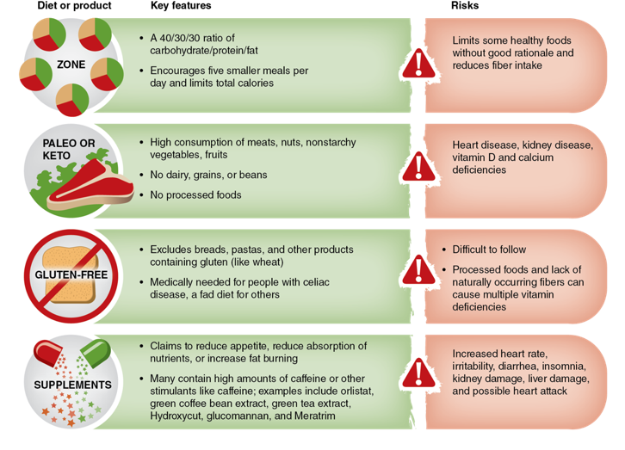
Common Fad Diets and Products
Notes:
Table 4.3 Common fad diets and products.

