Slide 1
Your Body Image
Chapter 4
LESSON 4.4
Live Well: Middle School Health
Notes:
Roy McMahon/Photodisc/Getty Images

Slide 2
Write About It
How often do you compare yourself to images you see in the media?
How do you feel when you compare yourself to others?

Slide 3
What Is Body Image? (1 of 2)
Your body image includes your thoughts, feelings, and behaviors related to your body size, shape, and appearance.
  It is not the image you project to others or how you look.
  It is how you feel about yourself and the way you look.
(continued)

Slide 4
What Is Body Image? (2 of 2)
Negative body image exists when someone has a distorted view of their appearance, or they think and feel negatively about how they look.
People with a positive body image have a realistic sense of how they look, and they are less likely to believe their character, value, or worth is tied to their appearance.

Slide 5
Benefits of a Positive Body Image
1
Good emotional health
2
Improved self-confidence
3
Improved self-esteem
Healthier relationships
4
Healthier habits (exercise, healthy eating)
5

Slide 6
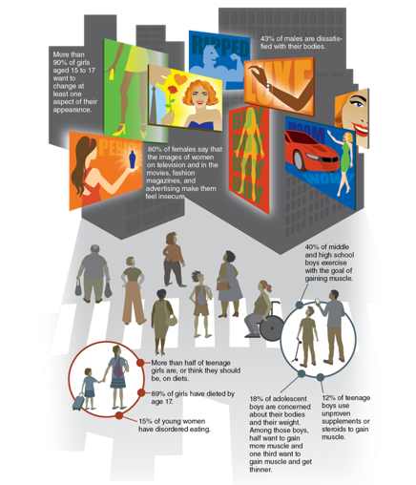
Negative Body Image and Health
  Negative body image is associated with many other unhealthy behaviors.
  People who have a negative body image are more likely to
  have low self-esteem,
  engage in unhealthy behaviors, and
  develop eating disorders.

Slide 7
Weight Prejudice
  Weight prejudice is the presence of negative beliefs, attitudes, and behaviors toward those who appear to be overweight.
  It can lead to physical, social, and psychological consequences.
  Studies show that overweight people are often stereotyped as lazy, unintelligent, or lacking in self-discipline.
  People should be seen for their character and not judged on their appearance, including their weight.

Slide 8
Media Influences on Body Image
  It is common for people to compare themselves to media images of models and celebrities and to feel bad when they do.
  This behavior is called social comparison.
  The truth is that 95 percent of people lack the genetic traits to look like these models and celebrities.

Slide 9
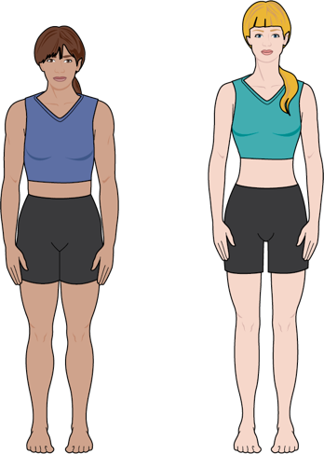
Typical Versus Ideal Body Types
Notes:
Figure 4.8 Typical versus ideal body types.

Slide 10
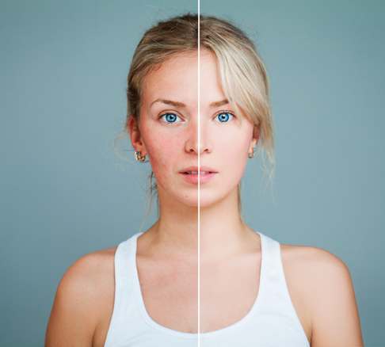
Altering Images
  The images we see in the media and on social media are not only unrealistic but also typically altered digitally to remove imperfections (adjusted waist size, changed facial features, etc.).
  Even the people in the photos usually don’t look like their image.
Notes:
Figure 4.9 One hundred percent of fashion images are digitally altered in some way.
Nemchinowa/iStock/Getty Images

Slide 11
Social Media
  Any time a picture is posted, others can comment on how you look, which can affect your body image.
  Teens admit to posting only photos that represent their best selves or those that are “thinspirational” (inspiring or celebrating thinness) so that they can get more likes.
  These behaviors perpetuate expectations about beauty and size and are a subtle form of weight prejudice.

Slide 12
Disordered Eating and
Eating Disorders
  In all types of eating disorders, people use food to be in control of themselves and their lives.
  Disordered eating includes a range of irregular eating behaviors:
  Skipping meals, stress eating, periodic fasting, occasional bingeing, eating only certain foods, avoiding certain categories of foods completely
  Eating disorders are serious, diagnosable mental illnesses.
  Can develop at any time of life, but most commonly among teenagers
  (continued)

Slide 13
Common Eating Disorders
Avoidant restrictive food intake disorder
Extreme picky eating, severe limits on foods
Anorexia
Restricted eating, bad weight loss
Bulimia
Binge eating, followed by purging
1
2
3
Binge eating
Repeated episodes of excessive eating, followed by feelings of shame
4
Orthorexia
Obsession with eating healthfully
5

Slide 14
Tips for Improving
Your Body Image
  Accept your body. Be less of a critic.
  Don’t body shame yourself or others.
  Focus on the things you like about yourself.
  Focus on what your body can do, not how your body looks.
  Be mindful in your body, how it feels and moves.
  Take care of your body. Eat healthy and stay active.

