Slide 1
Physical Activity
Chapter 5
LESSON 5.1
Live Well: Middle School Health
Notes:
Compassionate Eye Foundation/Robert Kent/DigitalVision/Getty Images

Slide 2
Write About It
Think about the amount of physical activity you get in a typical week.
List the activities you do in a week and how often you do them.
Do you think you do enough physical activity each week?
Please explain why you think you do enough or don’t do enough physical activity.

Slide 3
Understanding Physical Activity,
Exercise, and Physical Fitness
  Physical activity is movement using the large muscles of the body, such as sports, dance, swimming, and biking.
  Exercise is planned, structured, and repetitive physical activity for the purpose of improving or maintaining one or more components of fitness.
  Physical fitness refers to your body systems being able to work together efficiently to allow you to be healthy and able to perform all your daily activities.

Slide 4
Physical Activity Benefits
Physical benefits: builds healthy bones and muscles; decreases the likelihood of obesity; increases energy; improves sleep
Mental health benefits: helps reduce anxiety and depression; increases concentration
Social benefits: meet new people; develop new friendships; learn to work with others
Notes:
Jose Luis Pelaez Inc/DigitalVision/Getty Images

Slide 5
Physical Activity Guidelines for Teens (1 of 2)
The U.S. Department of Health and Human Services recommends that teens get 60 minutes or more of moderate-to-vigorous physical activity daily.
  Moderate intensity is equal to a brisk walk.
  Vigorous intensity is equal to a continuous jog.
Your physical activity should mostly be aerobic.
  Aerobic means with oxygen, and this activity occurs over a longer period of time; it makes your heart beat faster and your breathing harder than normal.
(continued)

Slide 6
Physical Activity Guidelines for Teens (2 of 2)
Sixty minutes of activity a day does not have to be done all at once.
  Divide your 60 minutes into four 15-minute physical activity breaks or three 20-minute breaks.
There are many ways to be physically active.
  Take the stairs instead of the elevator.
  Set an alarm when doing your homework and take a 10-minute break every hour for physical activity.
  Have contests to see who can do the longest wall sit or the longest plank.

Slide 7
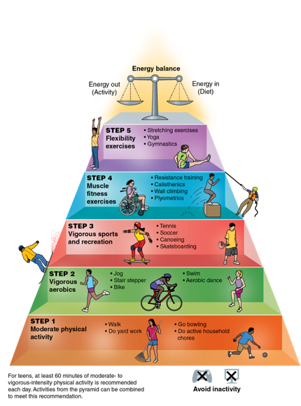
The Physical Activity Pyramid
Notes:
Figure 5.2 The Physical Activity Pyramid shows you how to include different types of physical activity in your life.
© Charles Corbin

Slide 8
Health-Related Fitness
  The term health-related fitness refers to fitness activities you need to do regularly to stay healthy.
  The components of health-related fitness are
    cardiorespiratory endurance,
    muscular strength,
    muscular endurance,
    flexibility, and
    body composition.

Slide 9
Skill-Related Fitness
  Skill-related fitness includes fitness activities you do to help you perform well in sports and other activities that require specific skills.
  The components of skill-related fitness are:
    speed,
    agility,
    balance,
    power,
    coordination, and
    reaction time.

