Slide 1
Health-Related and Skill-Related Fitness Components
Chapter 5
LESSON 5.2
Live Well: Middle School Health
Notes:
Westend61/Getty Images

Slide 2
Write About It
How could you be more physically active at school, especially if you don’t have physical education at this time?
Try to list at least three things you could do throughout your day.

Slide 3
Health-Related Fitness Components
Health-related fitness helps you to be healthy and able to perform daily activities. Components include:
Cardiorespiratory endurance
Muscular strength
Muscular endurance
1
2
3
Flexibility
Body composition
4
5

Slide 4
Cardiorespiratory Endurance
Cardiorespiratory endurance is the ability to exercise your entire body for a long time without stopping.
Aerobic exercises are the foundation for being physically active.
Moderate-intensity activities will increase your heart rate and make you breathe harder than normal, but you’ll still be able to carry on a conversation.
Vigorous-intensity activities will increase your heart rate and make you breathe harder than a moderate-intensity activity, and they’ll make it difficult to talk.

Slide 5
Determining Your Cardiorespiratory Endurance Intensity
To gain the most benefit from being physically active, you should make sure you are working at the proper intensity of moderate or vigorous.
To determine how hard you are working, use the following two measures.
RPE scale
Target heart rate zone

Slide 6
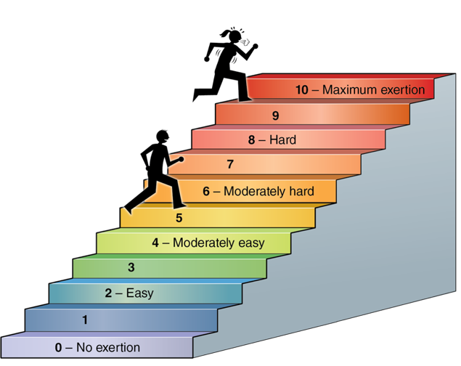
RPE Scale
Notes:
Figure 5.5 You can use the rating of perceived exertion (RPE) scale to determine the intensity level of your activity.

Slide 7
Target Heart Rate Zone
It is a range of two numbers that you want to stay in when exercising to get the most benefit from your workout.
To exercise at a moderate-intensity level, your target heart rate should be at 60 to 75 percent of your maximum heart rate.
To exercise at a vigorous-intensity level, your target heart rate should be at 75 to 90 percent of your maximum heart rate.

Slide 8
Muscular Strength and Endurance
Muscular strength is the amount of force a muscle can produce.
Muscular endurance is the ability of the muscles to perform continuously without tiring.
Muscular strength and endurance exercises include the following:
Lifting weights
Using resistance bands
Using your own body weight

Slide 9
Flexibility and Range of Motion (1 of 2)
Flexibility is the ability to use your joints fully through a wide range of motion.
Your range of motion is influenced by the mobility of the muscles and tendons that surround the joint.
Injury, inactivity, or a lack of stretching can bring about loss of normal joint flexibility.
(continued)

Slide 10
Flexibility and Range of Motion (2 of 2)
Dynamic stretching is being able to perform dynamic movements of the muscles through the full range of motion in the joints.
Static stretching is being able to maintain an extended stretching position.
Before you begin dynamic or static stretching, it’s important that you warm up your muscles to increase blood flow throughout your body, increase the muscles’ range of motion, and prevent straining muscles.

Slide 11
Body Composition
Body composition refers to the ratio of lean (muscle) tissue to fat tissue in your body.
Two people can weigh the same yet look very different due to their body composition.
Body composition is affected by your cardiorespiratory endurance, muscle strength, muscular endurance, and flexibility.
Notes:
Figure 5.12 Body composition can be estimated by using skin fold calipers.

Slide 12
Skill-Related Fitness Components
Skill-related fitness components help you perform well in sports and other activities that require specific skills. These components are:
Speed Ability to perform a movement in a short time
Agility Ability to change position of your body quickly
1
2
3
Balance Ability to stay upright
Power Ability to use strength quickly
Coordination Ability to use senses and body parts together
Reaction time Time it takes you to start moving
4
5
6

Slide 13
Speed, Agility, and Balance
Speed is the ability to perform a movement or cover a distance in a short period of time.
Agility is the ability to change the position of your body quickly and control your body’s movements.
Balance is the ability to keep an upright posture while standing still or moving.

Slide 14
Power, Coordination, and Reaction Time
Power is the ability to use strength quickly. Power involves both strength and speed.
Coordination is the ability to use your senses together with your body parts or to use two or more body parts together.
Reaction time is the amount of time it takes you to move once you realize you need to move.

Slide 15
Body Systems (1 of 2)
The circulatory system controls the flow of blood in your body and consists of your heart, blood vessels, and blood.
The respiratory system controls the flow of oxygen in your body and is made up of your mouth, nose, trachea, diaphragm, and lungs.
The muscular system is responsible for all movement and consists of more than 650 muscles.
(continued)

Slide 16
Body Systems (2 of 2)
The nervous system provides all the electrical signals that control your movements.
The skeletal system is made up of your bones and the tendons, ligaments, and cartilage that connect the bones together.

