Slide 1
Preparing for Physical Activity
Chapter 5
LESSON 5.3
Live Well: Middle School Health

Slide 2
Write About It
What is your favorite physical activity and why?
Is your favorite activity something you can do throughout your life?
Is it something you can do anywhere, or do you need special equipment to do it?

Slide 3
Preparing for Activity or Workout
Whether you are just starting to be physically active or have a regular routine, you should always begin slowly and progressively work into your activity for the day.
Your activity should always include three parts, regardless of what activity it will be:
a warm-up activity
the focus of your workout
a cool-down activity

Slide 4
Warm-Up, Workout, and Cool-Down
Your warm-up should include large muscle movements that get your whole body moving. You want to slowly increase your heart rate so you will be ready for your activity.
Your workout will be determined by what you are trying to improve or what you’re training for.
A cool-down is used to slow your body down and give it time to adjust when ending an activity.

Slide 5
Getting Active and Staying Active Throughout Your Life
Consistent physical activity in all health-related fitness areas is good for you in the moment and has lifelong benefits, including:
Maintaining the ability to live alone
Reducing the risk of falling and fracturing bones
Encouraging feelings of well-being
Improving stamina and muscle strength

Slide 6
Team and Individual Sports (1 of 2)
A team sport is a sport played by a group of people working toward a common goal.
Being involved with a team sport can help you stay healthy and teach you about
working with others,
being a good sport during competition,
time management, and
persistence when things may not be going the way you want them to.
(continued)

Slide 7
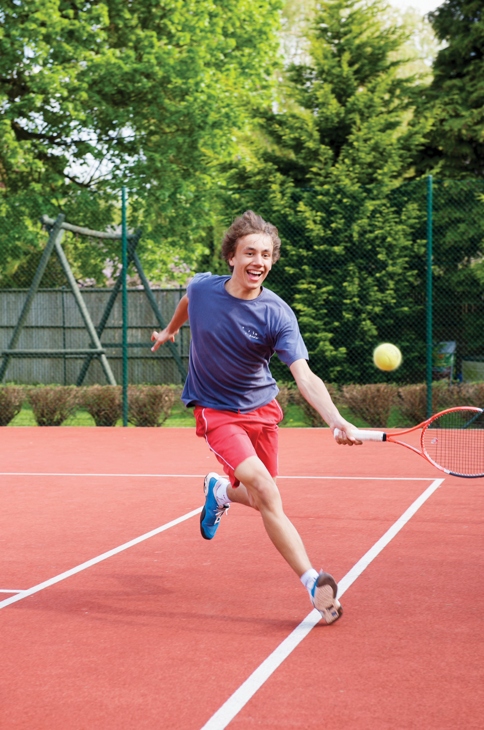
Team and Individual Sports (2 of 2)
An individual sport is played by one person.
Individuals can compete in sports and activities such as track and field, bowling, golf, tennis, swimming, and skiing.
Individual sports can promote
resilience,
self-motivation, and
accomplishment.

Slide 8
Dressing for Physical Activity
Always make sure you are dressed for the activity you are participating in and have the proper equipment to keep you safe.
Wear comfortable clothes so you can move freely.
Dress in layers so you can take layers off if you get too warm and put them back on if you get cold.
Wear proper socks to prevent blisters.
Wear proper shoes for the activity you are participating in.

Slide 9
Physical Activity and Proper Equipment
Many activities you are involved with may have protective equipment to keep you safe and help prevent injuries:
Common equipment you may need includes:
Helmets
Mouth guards
Knee pads, wrist pads, and elbow pads
Face masks or goggles
Notes:
Sean Justice/The Image Bank/ Getty Images

Slide 10
Preventing Injuries While Being Active
Make sure you are using proper technique when exercising.
Vary your activity so that you aren’t using the same muscle groups every day.
Don’t play through pain which often turns a minor injury into a major injury.
Warm up and cool down properly.
Stay hydrated by drinking water regularly before, during, and after your activity.

