Slide 1
Your Emotional Health
Chapter 6
LESSON 6.1
Live Well: Middle School Health
Notes:
Hibatallah Khawaja/EyeEm/ Getty Images

Slide 2
Write About It
When was the last time you felt empathy toward a friend who was hurting or struggling?
Explain the situation and how it made you feel.

Slide 3

Emotional Health
Having good emotional health means that you have a positive state of well-being that allows you to function in society and meet the demands of your daily life.
Mental health involves successful thinking and mental processing.
Notes:
Tassii/E+/Getty Images

Slide 4
What Makes Me Emotionally Healthy?
Emotional health deals with optimum functioning. People with good emotional health share many strong, positive characteristics.

Slide 5
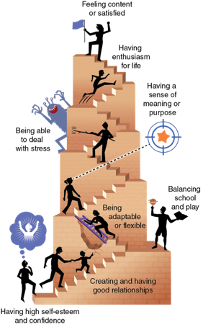
Characteristics of Positive Emotional Health
Notes:
Figure 6.1 Characteristics of positive emotional health.

Slide 6
Emotions and Self-Awareness
Emotional health is being able to identify your own emotions and understand them.
Recognizing and empathizing with the emotions of others allows you to form meaningful connections and better understand what that person is experiencing.

Slide 7

Communicating Your Emotions
People are social beings, and emotions drive much of our connection with others.
When we don’t talk about our feelings we act differently and often withdraw from other people.
Both positive and negative emotions should be shared and expressed with others.
Notes:
Ozgurdonmaz/E+/Getty Images

Slide 8
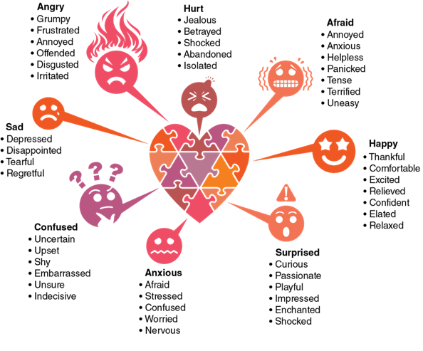
Words and Expressions Help Us Communicate
Notes:
Figure 6.2 Words and expressions can help us communicate emotions effectively.

Slide 9
Your Changing Emotions
Physical changes you go through during puberty can change how you experience emotions in the following ways.
Your hormone levels are changing.
Your sleeping is disrupted.
Your brain is not fully developed.
You are going through social changes.

Slide 10
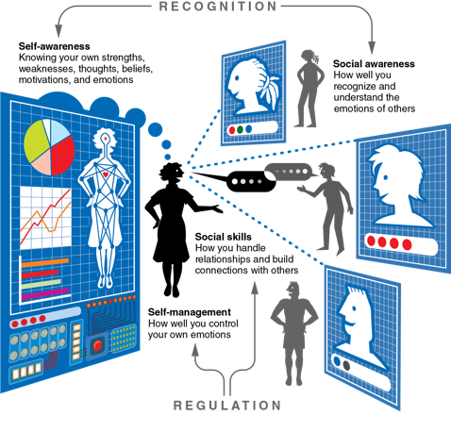
Emotional Intelligence
Learning to identify and use emotions in productive ways is part of what is called emotional intelligence.
There are four parts to emotional intelligence:
Self-awareness
Self-management
Social awareness
Social skills
Notes:
Figure 6.3 Emotional intelligence.

Slide 11
Developing Empathy
Empathy is your awareness of the feelings and emotions of other people.
Sometimes, we aren’t good at showing empathy, or we simply don’t try.

Slide 12
Ways We Develop Empathy
Sharing in other people’s life stories
Trying to understand differences in social cultures, values, and traditions
Asking questions and learning about situations different from our own

Slide 13
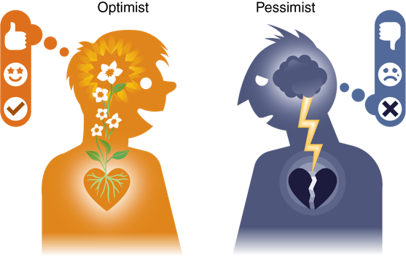
Optimism and Emotional Health
Improving your emotional health is an active process that requires continued self-awareness and effort.
Notes:
Figure 6.4 Optimism versus pessimism.

