Slide 1
Being Yourself
Chapter 6
LESSON 6.2
Live Well: Middle School Health
Notes:
SDI Productions/E+/Getty Images

Slide 2
Write About It
What makes you unique and different from other people?

Slide 3
Self-Awareness
Self-awareness means having a clear sense of your personality, including your strengths, weaknesses, thoughts, beliefs, motivations, and emotions.
Having self-awareness allows you to understand how other people see you. That understanding allows you to respond to others effectively and appropriately.

Slide 4
Your Identity
Your identity is who you are. It includes
physical characteristics and
personality characteristics.
Your abilities, interests, and biography (life story) are also part of your identity.

Slide 5
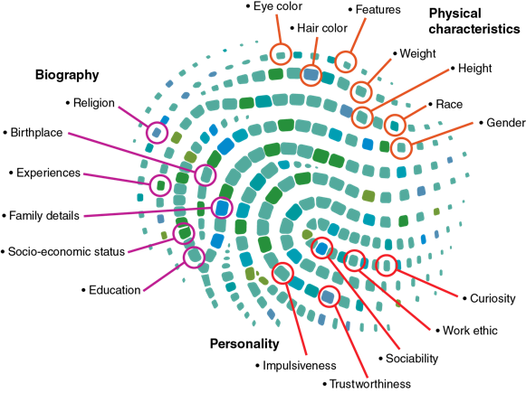
Your Identity Is What Makes You Unique
Notes:
Figure 6.5 Your identity is what makes you unique.

Slide 6
Self-Image
What you think about yourself and what you think others think of you. You may think you are smart, or nerdy, or funny in part because you think others think these things.
Body image comes from the thoughts, feelings, and behaviors you have about your body weight, shape, size, and appearance.

Slide 7
Self-Esteem
Self-esteem is how much you like, admire, and value yourself regardless of what others think.
It is possible to value and like yourself even if you think others don’t like you, but it is hard.
Most people want to be liked and respected by others.
Some people try so hard to be liked by others that they behave in ways that aren’t authentic to who they are.

Slide 8
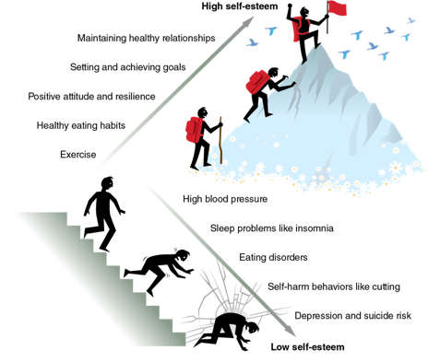
Self-Esteem and Health
There is a strong relationship between self-esteem and physical health.
Notes:
Figure 6.8 High self-esteem is associated with healthy behaviors, and low self-esteem negatively affects health and wellness.

Slide 9
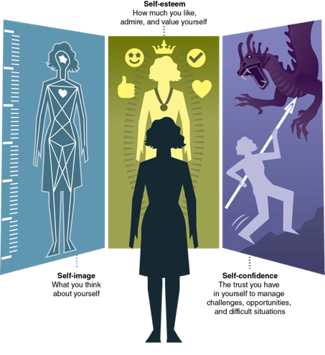
Self-Confidence
Self-confidence means that you trust yourself to manage challenges, seize opportunities, and deal with difficult situations.
Being successful at tasks helps us improve our confidence.
Confidence helps us tackle more challenging tasks.
Confidence is also specific to each task.
Notes:
Figure 6.6 Words that start with self describe how we feel about ourselves.

Slide 10
Busting Your Self-Esteem and Self-Confidence
Staying in your comfort zone. It’s hard to build self-confidence if you never challenge yourself to grow.
Beating yourself up. When you are too hard on yourself, you’ll talk negatively to yourself.
1
2
Making things worse than they are. If something doesn’t go the way you want, don’t make it into a big deal.
Trying to be perfect. If you believe you must be perfect, you’ll become stuck and unable to grow.
3
4

Slide 11
Boosting Your Self-Esteem and Self-Confidence
Learn your strengths and weaknesses. Keep a list of things you do well and poorly.
Be kind to yourself. Treat yourself like you are your own best friend.
1
2
Grow from your mistakes. A good mistake helps you grow; it is a mistake worth making.
Know when to ask for help. Self-confident people are quick to get help when they need it.
3
4

