Slide 1
Building Resilience and Grit
Chapter 6
LESSON 6.3
Live Well: Middle School Health
Notes:
Barcin/E+/Getty Images

Slide 2
Write About It
Describe someone in your life who can keep going even when things aren’t going the way they want them to.
What do you think gives them this type of strength or ability?

Slide 3
What Is Resilience?
Resilience is your ability to bounce back from a difficult or stressful situation.
Resilience is not a trait; it is a skill. A trait is something you are born with, such as your hair or eye color. A skill is something you can develop and improve with effort.
People with resilience have better emotional health and higher satisfaction with their lives.

Slide 4
The Seven Cs of Resilience
1
Competence
2
Confidence
3
Connection
4
Character
5
Contribution
6
Coping
7
Control

Slide 5
Grit
Another important aspect of good emotional health is grit. If you have grit, you have the dedication and passion to achieve long-term goals.
Grit is also known as mental toughness.
Grit and resilience are related.
You need grit when you are exhausted and the road ahead of you is still long.

Slide 6
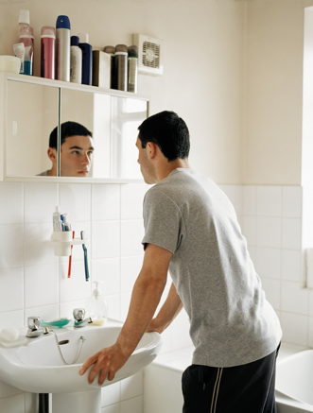
Developing Grit
Grit is linked to
having courage,
being conscientious,
persevering,
being resilient, and
pursuing excellence.
Notes:
Image Source/Getty Images

Slide 7
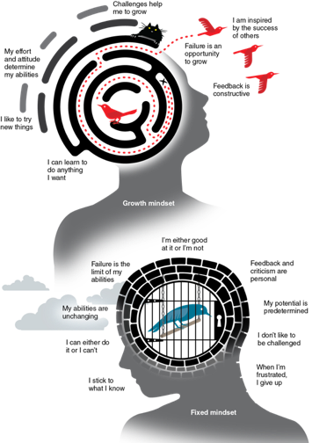
Growth Mindset
If you believe that you can develop your talents and skills, that you can learn and grow through any situation, then you have a growth mindset.
If you give up because you assume you are just never going to be smart enough to learn math, you have a fixed mindset. This mindset causes you to give up or to lose confidence in situations.
Students who have a growth mindset do better in school and develop more resilience.
Notes:
Figure 6.9 Growth mindset versus fixed mindset

Slide 8
Self-Talk for Resilience, Grit, and Growth
Self-talk is the messages we send to ourselves; it is our inner conversation with our self.
The type of self-talk you use will have an impact on your emotional wellness and mental toughness.
Self-talk can be negative or positive.
By learning to recognize negative self-talk, we can challenge and change these messages and the feelings they create.
Negative self-talk has some well-known patterns that we tend to fall victim to.

