Slide 1
Understanding and Managing Stress
Chapter 7
LESSON 7.1
Live Well: Middle School Health
Notes:
SIphotography/iStock/Getty Images

Slide 2
Write About It
What is something that often causes you to feel stress?
Why do you think it is stressful?
What do you do to try to manage or control the stress you feel in that situation?

Slide 3

What Is Stress?
  Stress is the body’s reaction to a demanding or difficult situation.
    Everyone feels stress, but the things that cause us to feel stress differ from person to person.
The thing that triggers you to feel stress is called a stressor.
    A stressor can be anything from someone jumping out in front of you in a dark alley to having to speak in public.
Notes:
JGI/Tom Grill/Getty Images

Slide 4
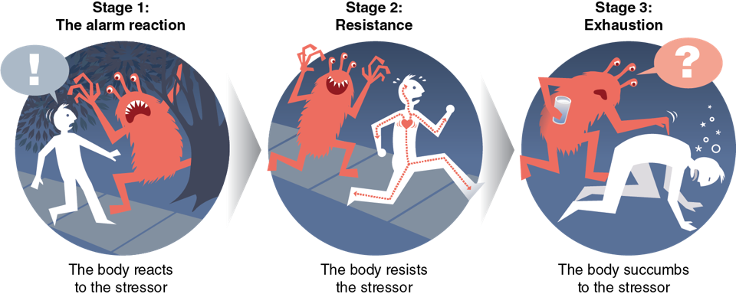
How We Respond to Stress
We go through three stages when we become stressed.
Notes:
Figure 7.1 The three stages we go through when we become stressed.

Slide 5

Types of Stressors
  Acute (short-term) stressors:
    for example, taking a test.
  Chronic (long-term) stressors):
    for example, worrying about a sick relative
  Routine stressors:
    for example, getting homework done on time
  Major life events:
    for example, moving to another state
  Trauma:
    for example, a terrorist attack
Notes:
Hill Street Studios/DigitalVision/ Getty Images

Slide 6
Common Causes of Stress for Teens
Tests and homework
Relationships with friends
Relationships with siblings
Having a significant other
Moving to a new home or school
Sports and other extracurricular activities
Employment
Feeling socially excluded
Too much to do
Too fast or too slow physical development
Family problems, including abuse and alcohol
Not achieving something you really wanted
Money problems in the family
Violence in school or in the neighborhood

Slide 7
Stress and the Body
  The human body is built to deal with physical stressors like a bear on your path or someone chasing you.
  In modern society, most of the stressors we encounter are not direct physical threats but rather psychological or emotional stressors.
  Physiological changes in your body are a negative form of stress called distress.

Slide 8
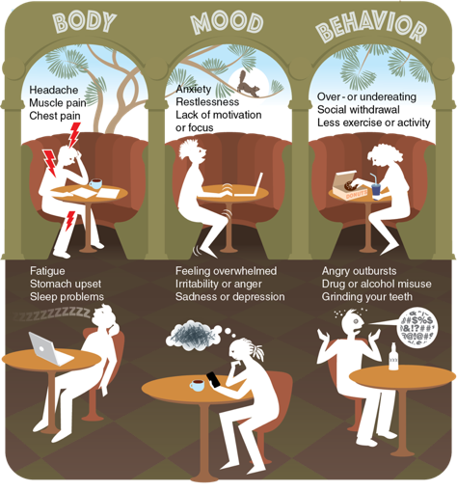
Common Signs of Distress
Notes:
Figure 7. 3 Common signs of distress.

Slide 9
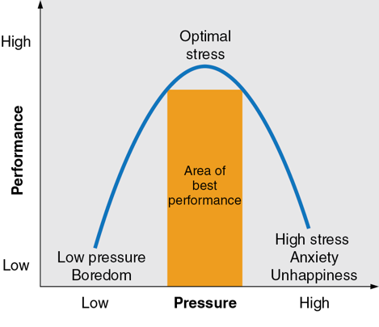
Stress and Performance
  Your body is physiologically alert during stress
    The right amount of stress can help you perform at your best.
Notes:
Figure 7.4 Optimal stress is stress that allows you to perform your best.

Slide 10
Stress and Health
  Chronic stress can contribute to a wide range of health problems:
    Type 2 diabetes
    High blood pressure
    Heart disease
    Obesity
    Ulcers
    Irritable bowel syndrome
    Insomnia
    Skin conditions
    Infections

Slide 11
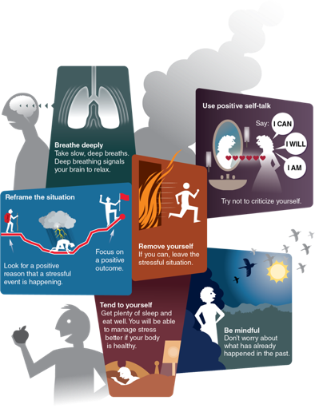
Managing Stress
  Managing your stress is like managing your emotions.
  Stress management can include things such as time management and positive self-talk.
  Relaxation techniques are specific stress management strategies that reduce the intensity of the flight-or-fight response.
Notes:
Figure 7.5 Approaches to stress management.

Slide 12
Stress Management Techniques
    Breathe deeply
    Use positive self-talk
    Reframe the situation
    Tend to yourself
    Remove yourself from the situation
    Be mindful
    Find ways to relax
    Exercise
    Learn time management

