Slide 1
Mental Disorders and Anxiety
Chapter 7
LESSON 7.2
Live Well: Middle School Health
Notes:
tommaso79/iStock/Getty Images

Slide 2
Write About It
Do you know anyone with a mental disorder?
What is the disorder and what do you know about it?

Slide 3
What Are Mental Disorders?
  A mental disorder is a serious and ongoing problem involving how a person thinks and manages emotions.
  A wide range of mental disorders can be diagnosed by a mental health professional.

Slide 4
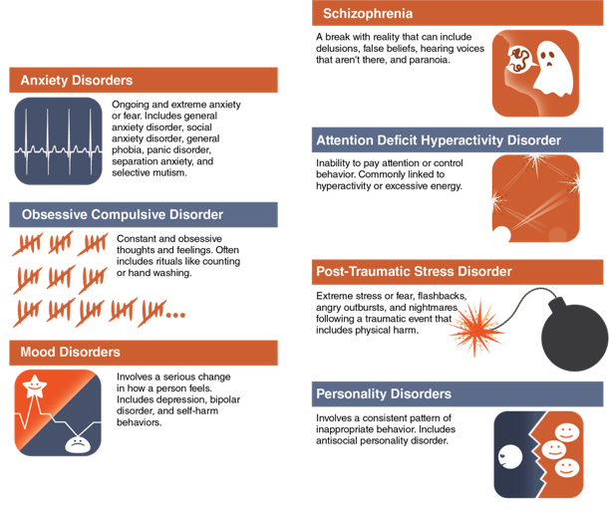
Examples of Mental Disorders
Notes:
Figure 7.6 Examples of Mental Disorders

Slide 5
Mental Disorders and
Youth by the Numbers
Seventeen percent of young people experience an emotional, mental, or behavioral disorder.
Half of all chronic mental illness begins by age 14 and three-quarters by age 24.
Attention deficit hyperactivity disorder, behavior problems, anxiety, and depression are the most diagnosed mental disorders in youth.

Slide 6
Causes of Mental Disorders
  A variety of factors come together to affect an individual’s likelihood of developing a mental disorder.
1
Genetics and family history
2
Environment and experiences
3
Brain injury
4
5
How the brain functions
Prenatal history

Slide 7
Care and Treatment of Mental Disorders
Each type of mental disorder requires its own plan for care and treatment.
The most common approaches to treatment include counseling and therapy and medications.

Slide 8
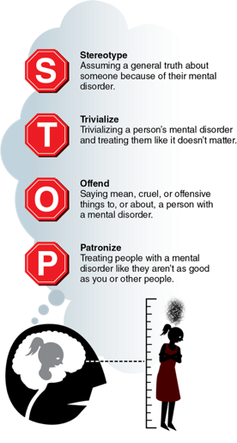
Social Stigma and Mental Disorders
A stigma is when someone views another person in a negative way because that person has a distinguishing characteristic or personal trait that is thought to be or is a disadvantage.
Learning about mental disorders and developing empathy for the challenges they cause will help to reduce prejudice toward those with mental disorders.
Notes:
Figure 7.7 Use STOP to help you recognize stigma and avoid applying it.

Slide 9
Anxiety Disorders
  Anxiety is an emotion that includes tension, worried thoughts, and physical changes like increased blood pressure.
  People with anxiety disorders frequently have intense, excessive, and persistent worry and fear about everyday situations.

Slide 10
Common Anxiety Disorders
Panic attacks or panic disorder
Social anxiety disorder
General anxiety disorder
1
2
3
4
Simple phobia
5
Separation anxiety
Selective mutism
6

Slide 11
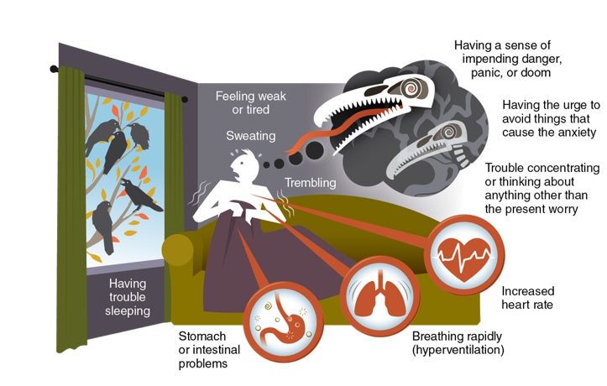
Common Symptoms of Anxiety Disorders
Notes:
Figure 7.8 Common symptoms of anxiety disorders.

Slide 12
Getting Help for Anxiety Disorders
Mental disorders, such as anxiety, can be hard to manage.
Common techniques for managing anxiety-related disorders include:
  therapy
  medication
  support groups
  self-care
Notes:
Comstock/Stockbyte/Getty Images

