Slide 1
Understanding Violent Behavior
Chapter 9
LESSON 9.1
Live Well: Middle School Health
Notes:
GeorgiaCourt/E+/Getty Images

Slide 2
Write About It
How might your opinion of someone else influence the way you treat that person?
How might opinions lead to violent behavior?
How so?

Slide 3
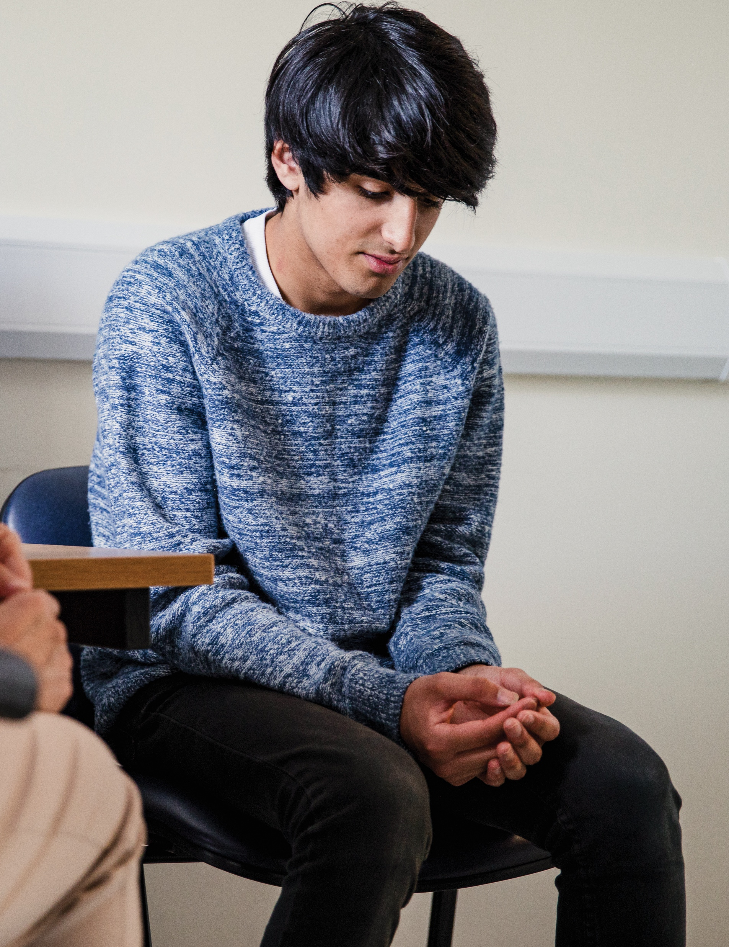
Violent Behavior
Violent behavior includes the intentional use of words or actions that cause or threaten to cause injury.
Violent behavior may be:
Physical violence
Sexual violence
Emotional violence
Notes:
SolStock/E+/Getty Images

Slide 4
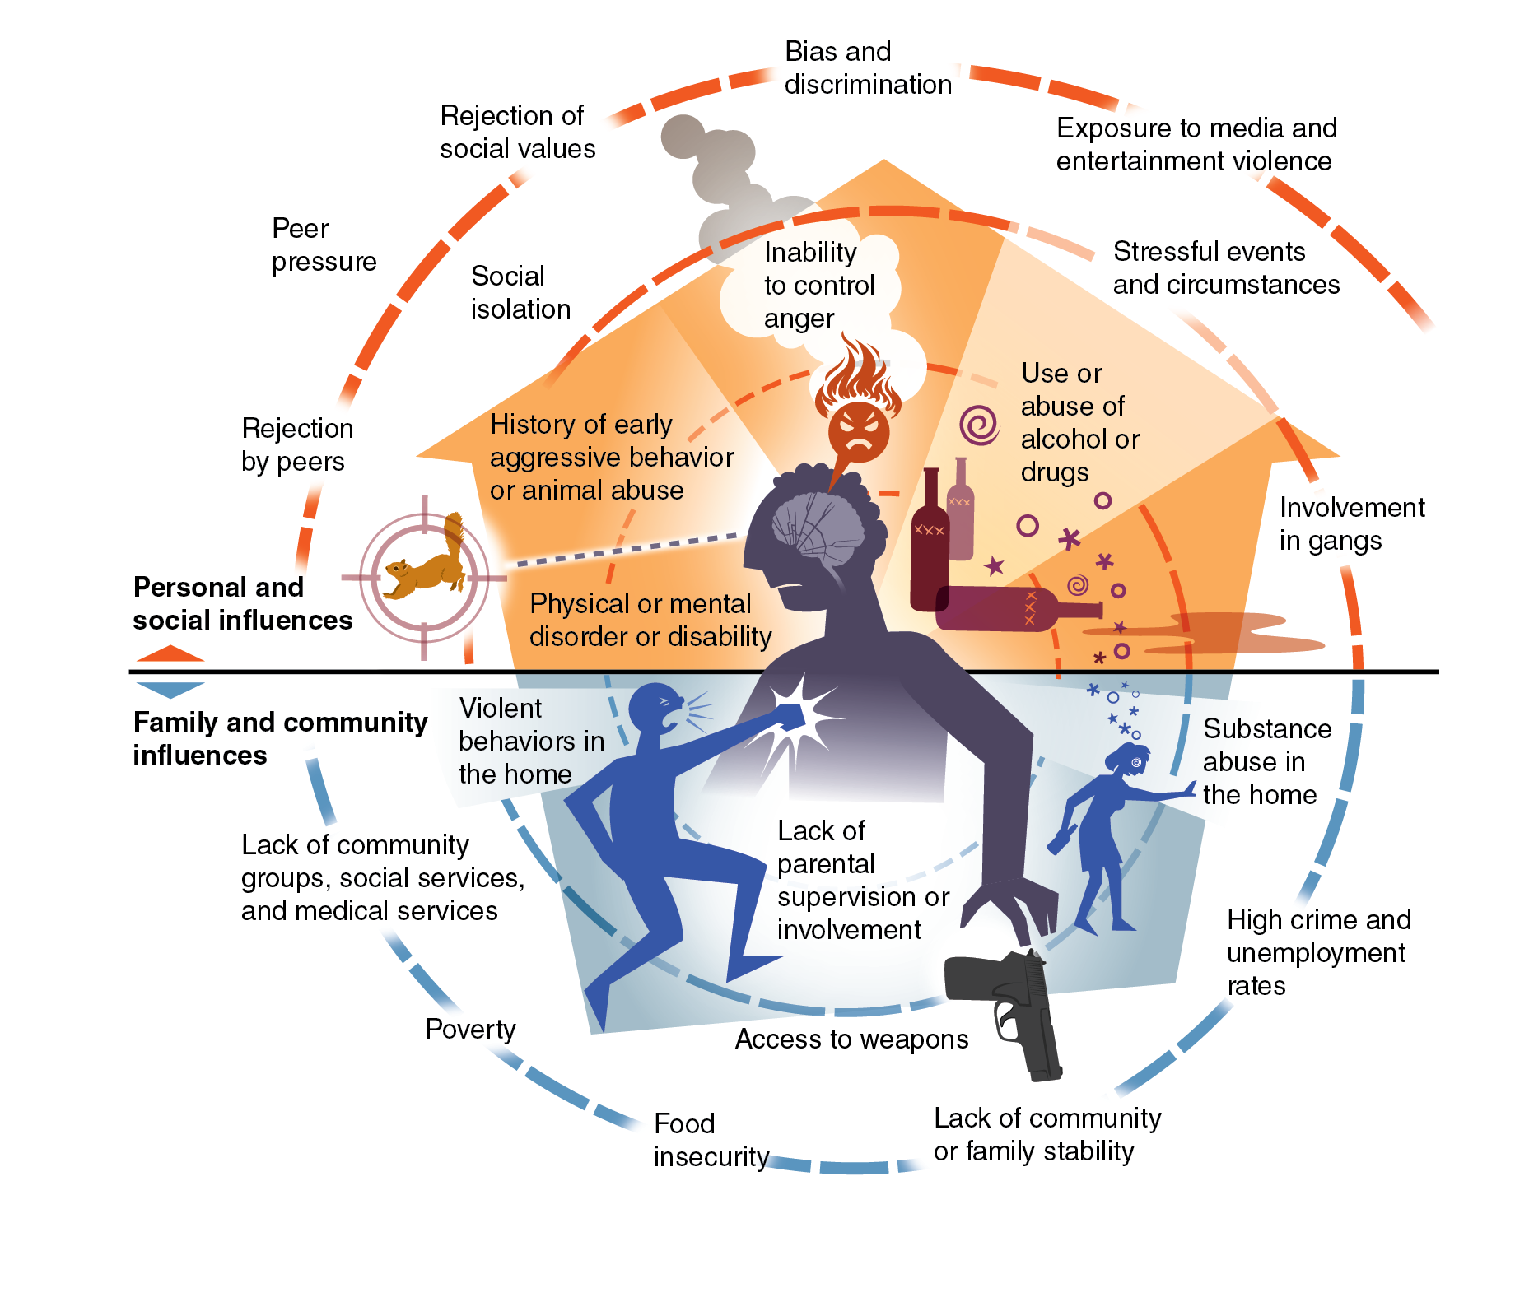
Influences on Violent Behavior
The offender is the person who commits a violent act.
The victim is the person on the receiving end of the violent act.
Violent behavior is linked to the following:
Personal and social risk factors, such as peer pressure, rejection of social values, and bias and discrimination
Family and community risk factors, such as substance abuse, violence in the home, and high crime rates
Notes:
Figure 9.2 Influences and risk factors for violent behavior.

Slide 5
Prejudice, Bias, and Intolerance
Prejudice is having an opinion about someone or something that is not based in reason or actual experience.
Bias is treating a person or group differently based on how we think about them.
Intolerance is when we don’t examine our prejudices and biases and are unwilling to accept others’ beliefs or behaviors.
Intolerance can lead to hate and violence.

Slide 6
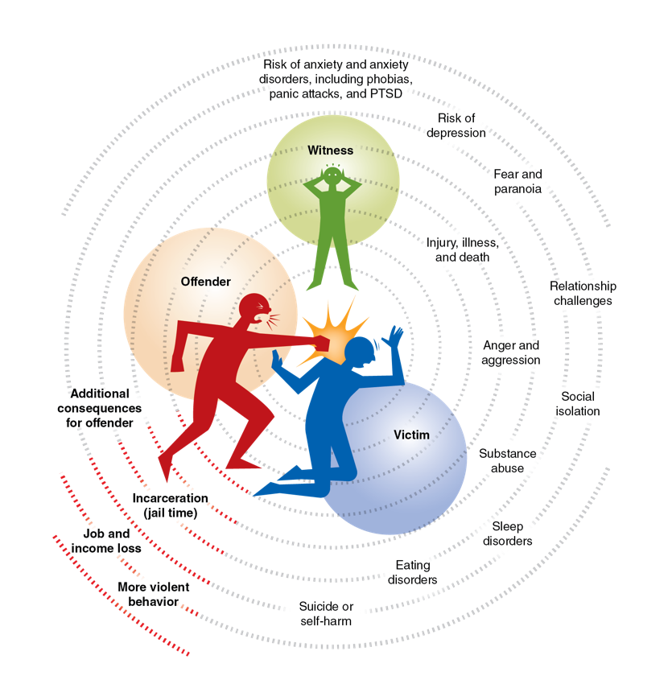
Consequences of Violent Behavior
Violent behavior can lead to
Emotional and mental disorders, such as anxiety and depression
Injury, illness, and death
Substance abuse
Suicide
Jail time, job loss, and more violence
Notes:
Figure 9.3 Consequences of violent behavior

Slide 7
Preventing Violence
Individuals can help prevent violence the follow ways:
Examine their attitudes, beliefs, and behaviors
Accept and celebrate differences
Surround themselves with supportive people
Community and society can
Reduce social isolation
Promote tolerance
Develop policies and laws that promote equity

Slide 8
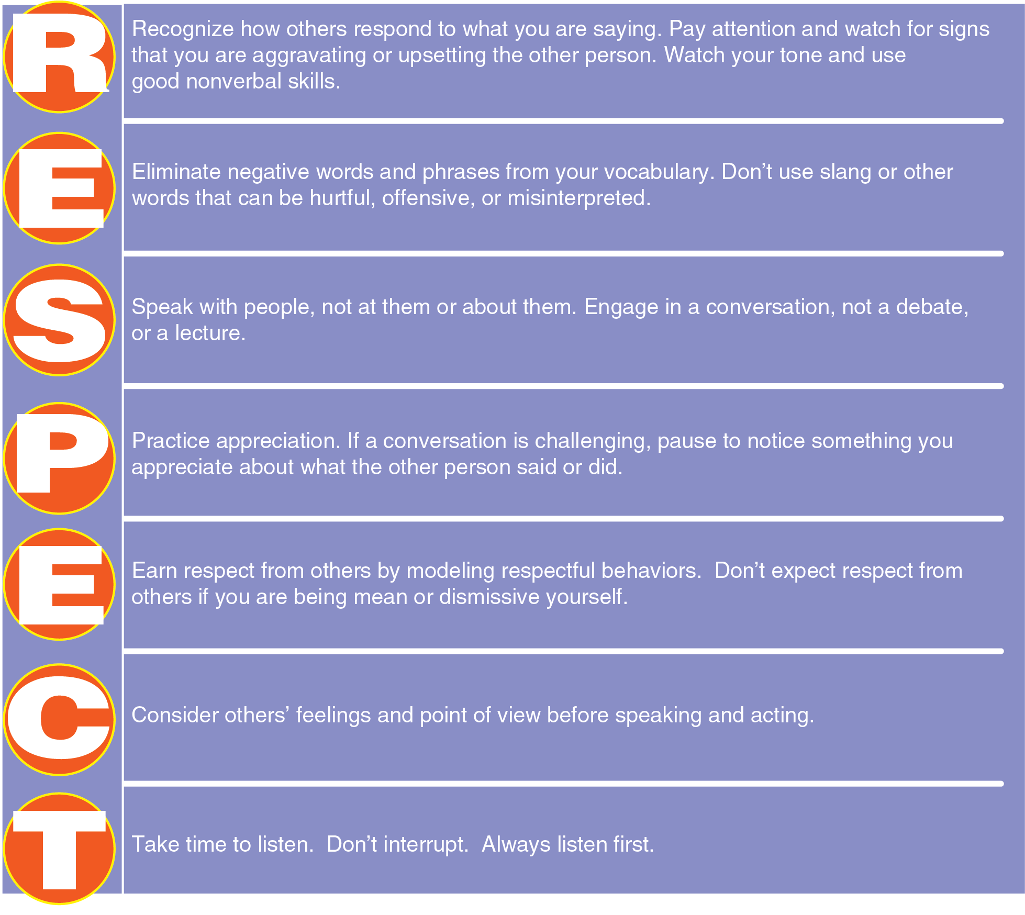
Communicating Respect for Others
Notes:
Figure 9.4 Talk with RESPECT to help reduce violence.

