Slide 1
Anger, Aggression, and Conflict
Chapter 9
LESSON 9.2
Live Well: Middle School Health
Notes:
Fizkes/iStock/Getty Images

Slide 2
Write About It
When you experience a conflict, how does it make you feel?
How do you usually handle conflict?

Slide 3

Anger and Aggression
Anger is a normal human emotion.
Aggression is when someone engages in a forceful action with the intent to dominate or control another person.
  Aggression is a behavior, not an emotion.
  Aggression is not always violent, such as in competitive sport.
  Aggression is often linked with violence.
Notes:
Juanmonino/E+/Getty Images

Slide 4
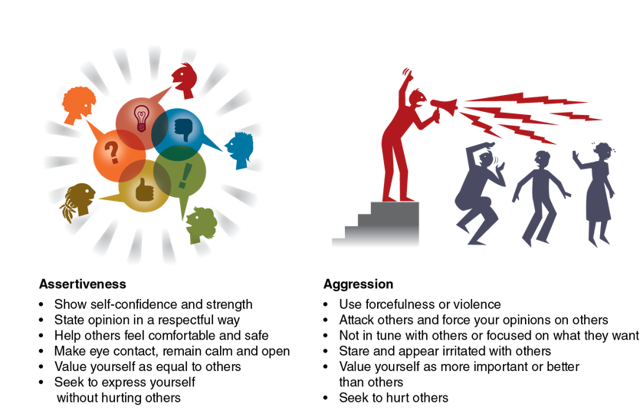
Assertiveness Versus Aggression
Notes:
Figure 9.5 Assertiveness versus aggression.

Slide 5
Conflict
Conflict occurs when two or more people disagree on an issue and feel threatened in some way.
Conflict is unavoidable and not always bad.
Conflict is often caused by difference in
  values
  relationships
  interests
  resources

Slide 6
Managing Conflict
When we don’t manage conflict effectively, the situation can escalate, or become more intense.
Styles for managing conflict include the following:
  Accommodating approach
  Avoiding approach
  Collaborating approach
  Competing approach
  Compromising approach

Slide 7
Conflict Resolution (1 of 2)
Conflict resolution is the informal or formal process that two or more individuals or groups use to find a peaceful solution to their disagreement.
Conflict is unavoidable.
Not all conflict is bad. Conflict can motivate us to grow and appreciate others or to find solutions to problems.
(continued)
Notes:
Figure 10.7 Steps to conflict resolution.

Slide 8
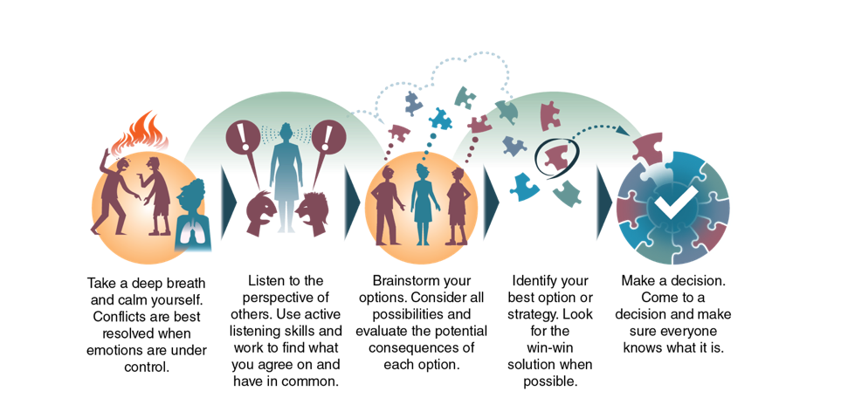
Conflict Resolution (2 of 2)
Conflict resolution is the process for finding a peaceful solution to a disagreement.
Notes:
Figure 9.6 Steps to conflict resolution.

