Slide 1
Youth Violence, Bullying, and Gangs
Chapter 9
LESSON 9.3
Live Well: Middle School Health
Notes:
Fstop123/E+/Getty Images

Slide 2
Write About It
Do you think teasing someone is the same as bullying?
Explain your answer.

Slide 3
Youth Violence
Youth violence is any violent behavior between young people ages 10 to 24.
  It includes fights, threats with weapons, gang violence, and bullying.
  It is linked with lack of impulse and emotion control.
  One in five students report being bullied at school.
Youth violence also affects the larger community.
  It creates a need for more emergency medical care, makes certain neighborhoods undesirable, and creates a greater burden for police and social service workers.

Slide 4

Bullying
Bullying is the most common form of youth violence.
Bullying is any unwanted aggressive behavior by another youth or group of youths who are not siblings or dating partners.
  Bullying involves perceived differences in power.
  Bullying can be physical, emotional, or social.
Notes:
Francesco Carta fotografo/ Moment/Getty Images

Slide 5
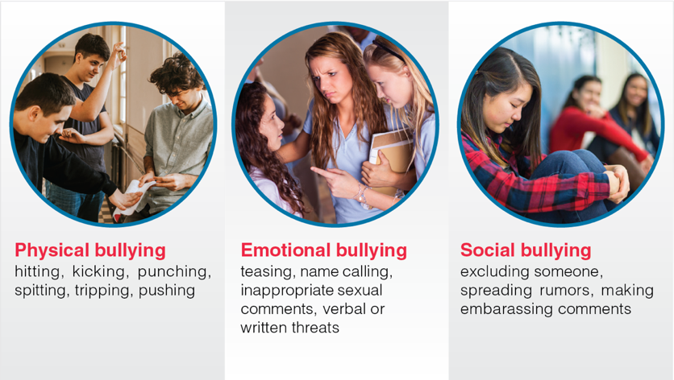
Types of Bullying
Notes:
Figure 9.7 Types of bullying.
photos in figure 9.7: Constantinis/E+/ Getty Images (left); SDI Productions/ E+/Getty Images (middle); FatCamera/ E+/Getty Images (right)

Slide 6
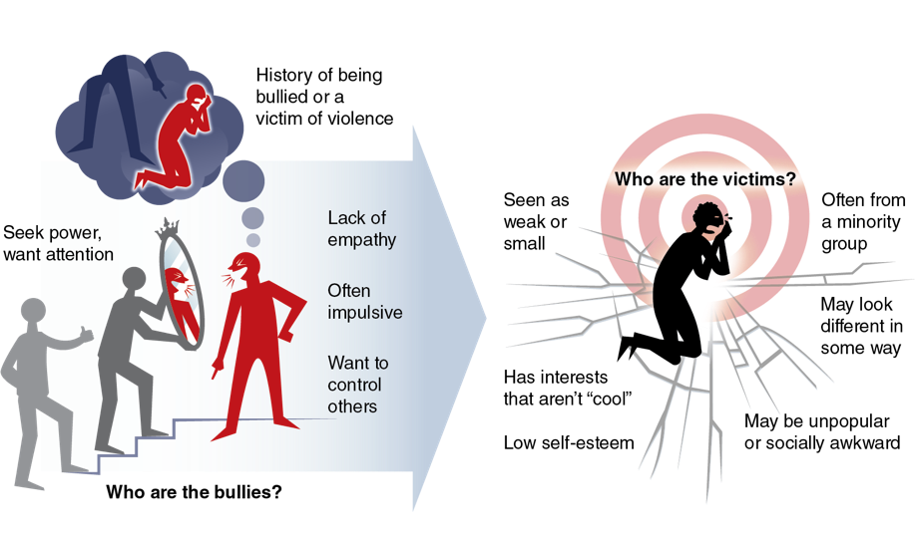
Influences on Bullying Behavior
Notes:
Figure 9.8 Characteristics of bullies and victims of bullying.

Slide 7
Consequences of Bullying
Consequences of bullying can be short- and long-term for the victim. They include the following:
  Fear
  Anxiety
  Difficulty concentrating
  Poor academic performance
  Depression
  Suicide

Slide 8

Responding to Bullying
Speak up and tell someone.
Ask the bully to stop.
Don’t respond; just walk away.
Avoid a physical confrontation.
Stay close to friends and adults.
Notes:
Daisy-Daisy/iStock/Getty Images

Slide 9
Helping Others Who Are Bullied
Say something to the bully.
Don’t bully back.
Be a friend to the victim.
Say something to other bystanders.
Tell an adult or someone in authority.

Slide 10
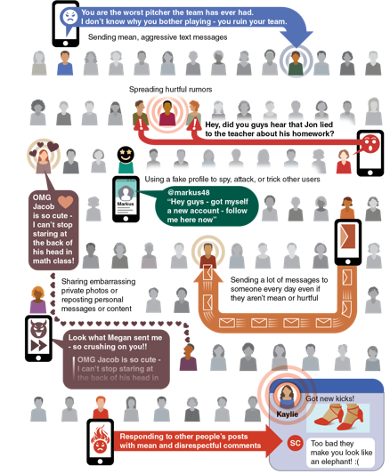
Cyberbullying
Cyberbullying is bullying that occurs through technology, such as by text or social media.
  Electronic media are very fast, and damage can be done quickly.
  People are more aggressive when they can “hide” online.
Cyberbullying can happen repeatedly over time.
  It is definitely bullying; treat it as bullying.
Notes:
Figure 9.9 What cyberbullying looks like.

Slide 11
Gang Violence
Risks of gang violence include illegal activities, friends in gangs, friends who use drugs, family members who use drugs, lack of role models, family violence, and neglect.
Consequences of gang violence often last a lifetime.
  They include death, injury, criminal record, and loss of job or inability to go to school or get work in the future.

Slide 12
Avoid and Report Gang Violence
Use a strong voice, stand up tall, and be clear that your answer is no.
Give a reason for saying no.
Walk away, and go to a safe place, such as your classroom, your home, or a community center.
Reach out for help.

Slide 13
School Violence
School violence is any violence that happens on school property.
  It can have consequences for education even if criminal charges are not filed.
Follow rules and policies at school.
Report suspicious activity and violence.
  Suspicious activity is anything that seems out of place or doesn’t belong.

