Slide 1
Relationships and Violence
Chapter 9
LESSON 9.4
Live Well: Middle School Health
Notes:
Juanmonino/iStock/Getty Images

Slide 2
Write About It
How does the media you use (television, social media, and movies) portray violence in relationships?
Do you think it is accurate?
Why or why not?

Slide 3

Understanding Abuse
Abuse is the consistent and violent mistreatment of a person.
  Abuse can be physical, emotional, or sexual.
Healthy relationships are neither violent nor abusive.
Notes:
SDI Productions/E+/Getty Images

Slide 4
Child Abuse and Neglect
Child abuse is when a parent or caregiver causes injury, death, emotional harm, or risk of serious harm to a child.
  A report of child abuse is made every 10 seconds in the United States.
Neglect happens when adults fail to meet the basic physical, emotional, medical, or educational needs of a child.

Slide 5
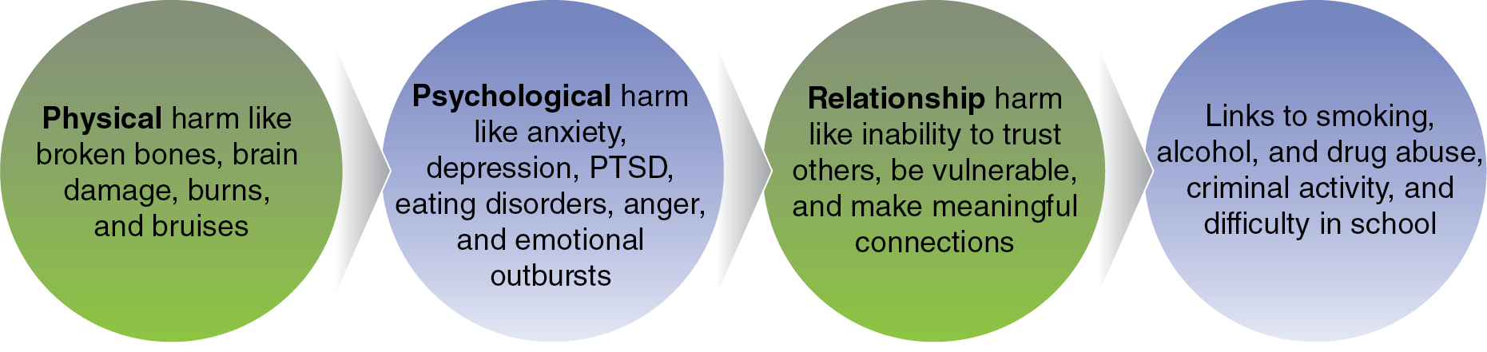
Consequences of Child Abuse and Neglect
Notes:
Figure 9.11 Consequences of child abuse and neglect.

Slide 6
Signs and Symptoms of Child Abuse (1 of 2)
Type of abuse | Examples of abuse | Signs of abuse
Physical abuse | Burns the child Hits, kicks, or bites the child Holds the child under water Shakes or throws the child Throws objects at the child Ties up the child | Bruising Severe injuries (e.g., broken bones) Several injuries spread over the body Injuries over a period of time
Emotional abuse | Abuses others when the child is around Fails to show love and affection Ignores the child and doesn’t provide emotional support and guidance Shames, belittles, criticizes, or embarrasses the child Teases, threatens, bullies, or yells at the child | Withdrawn Anxiety Difficulty sleeping Difficulty concentrating Aggressive or inappropriate behavior
Notes:
Figure 10.12 Risks associated with access to firearms.

Slide 7
Signs and Symptoms of Child Abuse (2 of 2)
Type of abuse | Examples of abuse | Signs of abuse
Sexual abuse | Forces the child to take part in sexual images Has any sexual contact with the child, including kissing Talks to child in sexually inappropriate ways Sends the child sexually explicit emails, texts, or other messages Exposes (abuser’s) genitals to the child Shows pornography to the child Tells dirty jokes or stories | Fear of being touched Pain when walking or sitting Torn clothing Bruising around genitals Sexual knowledge not typical for child’s age Inappropriate touching
Neglect | Fails to provide clothing Fails to provide food Fails to provide heat in cold weather Forces the child to live in unclean or unsanitary conditions Does not provide needed medical care | Missing school Poor hygiene Underweight Lack of development
Notes:
Figure 10.12 Risks associated with access to firearms.

Slide 8
Sibling and Elder Abuse
Sibling abuse is the mistreatment of one sibling by another.
  Half of children report some degree of sibling abuse.
  Injury between siblings is always serious.
Elder abuse is abuse of an older adult in a nursing home, in a hospital, or at home.
  Caregivers and family members are most likely to commit elder abuse.

Slide 9
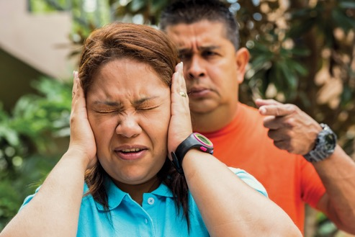
Domestic Violence
Domestic violence is violence in a romantic relationship or between a married couple.
  It can happen in any relationship.
  It often begins with verbal insults and escalates over time.
  It often includes controlling behavior, with one person trying to control the other.
Notes:
Juanmonino/iStock/ Getty Images

Slide 10
Sexual Assault
Sexual assault is any forced or unwanted sexual contact.
  It can occur between strangers, romantic partners, or friends.
  Both sexes can be victims.
  Sexual assault is never okay.
  It should be reported as soon as possible.

Slide 11
Coercive Relationships
Coercion is the act or process of persuading someone to do something that they do not want to do.
Coercion can exist in any type of relationship.
It is unhealthy and can lead to violence and abuse.

Slide 12
Human Trafficking (1 of 2)
Human trafficking happens when people are forced to perform a service or job against their will or in exchange for a basic human right like food or water.
When the victim is required to perform sexual acts, it is called sex trafficking.
Human trafficking and sex trafficking are major crimes that should be reported immediately.
(continued)

Slide 13
Human Trafficking (2 of 2)
Young children and teens are most vulnerable to human trafficking and sex trafficking.
Girls are the most common victims.
Coercion is often used to lure victims.
Offenders are often older males who pretend to be younger online and use flattery and gifts to lure victims.
Setting boundaries to protect yourself is important.

Slide 14
Breaking the Cycle of Abuse
Acknowledge the abuse.
Avoid trying to be the hero.
Help an abuse victim leave the situation.

Slide 15
Setting Personal Boundaries (1 of 2)
Intellectual boundaries: You are entitled to your own thoughts and opinions.
  If someone tries to silence your perspective or doesn’t value your thoughts, they may be crossing this boundary.
Emotional boundaries: You are entitled to your own feelings.
  If someone tries to tell you how you should feel or dismisses how you feel, they may be crossing this boundary.

Slide 16
Setting Personal Boundaries (2 of 2)
Physical boundaries: You are entitled to your own space.
  When someone touches you without permission or tries to coerce you into sexual acts, they may be crossing this boundary.
Social boundaries: You are entitled to your own friends and social activities.
  When someone tries to isolate you from others, they may be crossing this boundary.
Spiritual boundaries: You are entitled to your own beliefs.
  When someone disrespects your religion or beliefs, they may be crossing this boundary.

