Slide 1
Alcohol Use
Chapter 10
LESSON 10.1
Live Well: Middle School Health
Notes:
aijohn784/iStock/Getty Images

Slide 2
Write About It
What do you know about the different types of alcoholic drinks?
Do they all contain the same amount of alcohol?

Slide 3
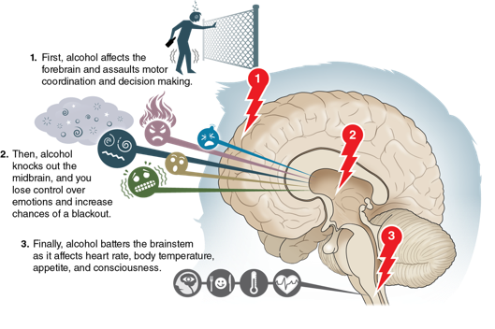
What Is Alcohol? (1 of 2)
Alcohol is one of the most used and abused substance of middle school students.
  Alcohol is legal only for people 21 and older.
Alcohol is a depressant.
  Makes brain function slower than normal
  Makes basic tasks more difficult
The most common types of alcohol are beer, wine, and liquor.
(continued)
Notes:
Figure 10.1 How alcohol affects the different parts of the brain.

Slide 4
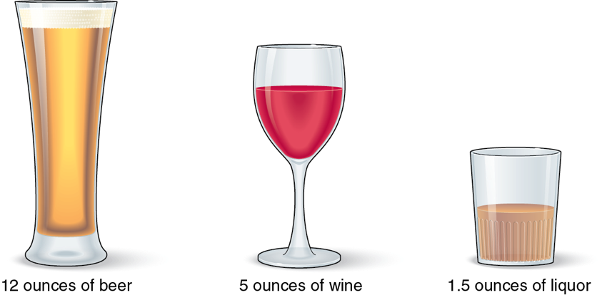
What Is Alcohol? (2 of 2)
Notes:
Figure 10.2 Standard sizes of alcoholic drinks. Each of these has about the same amount of pure alcohol.

Slide 5
Blood Alcohol Content (1 of 2)
Blood alcohol content (BAC) is the amount of alcohol in the bloodstream.
  In every state, it is illegal to drive with a BAC of .08 percent.
  There is no average number of drinks a person can have before they reach a BAC of .08 percent due to body size, how fast a person drinks, or medications the person is taking.
Notes:
Powerofforever/E+/Getty Images

Slide 6
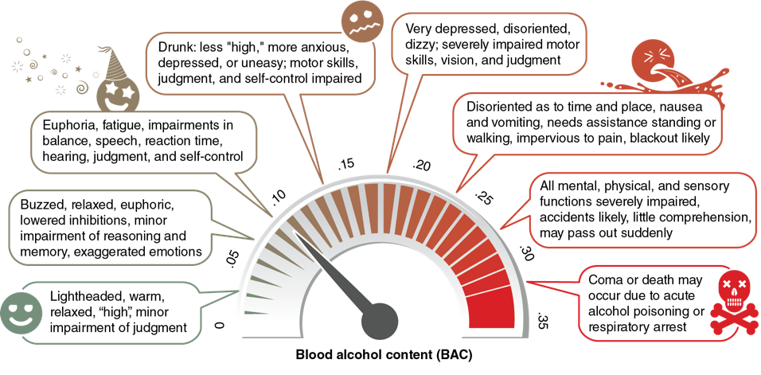
Blood Alcohol Content (2 of 2)
Notes:
Figure 10.3 Blood alcohol content and its effects.

Slide 7
Drinking Levels Defined (1 of 2)
In the United States, it is illegal for anyone under the age of 21 to drink alcohol.
There are three drinking levels.
  Moderate drinking: 1 drink per day for females and 2 for males
  Binge drinking: 4 or more drinks per day for females and 5 or more drinks for males
  Heavy drinking: more than 3 drinks a day or 8 or more per week for females and more than 4 a day or 15 or more per week for males
(continued)

Slide 8
Drinking Levels Defined (2 of 2)
People who drink too much become intoxicated.
  It is difficult for them to do simple tasks, such as walking and talking.
  They may act happier or sadder than normal.
Drinking too much alcohol at one time may cause a hangover (feeling tired, having headaches, or vomiting).

Slide 9
Consequences of Alcohol Use (1 of 2)
All elementary, middle, and high schools ban alcohol on school grounds.
Each school has its own rules about what happens if you have alcohol at school.
MIP (minor in possession) means you are under 21 and in possession of alcohol (law enforcement may be called, and you may be arrested).
(continued)

Slide 10
Consequences of Alcohol Use (2 of 2)
If you are charged with an MIP:
  you will be charged with a misdemeanor
  you will usually be suspended from school for a specific amount of time
  you will usually be suspended from the team if you are an athlete and suffer consequences if you are involved in a school club
  you may experience long-lasting consequences that could affect your future life and career goals.

Slide 11
Drinking and Driving
Although you aren’t old enough to drive, it’s important for you to know the risks that come with alcohol use and driving or riding in a car with someone who has been drinking.
Two out of three people will be involved in a drunk driving crash in their lifetime.
  Car crashes are the leading cause of death for teens. About a quarter of those crashes involve an underage drinking driver.
  Even though you can’t drive, you need to know the risks of getting in a car with someone who has been drinking.

