Slide 1
The Effects of Alcohol
Chapter 10
LESSON 10.2
Live Well: Middle School Health
Notes:
Julie Eydman/fotolia.com

Slide 2
Write About It
What do you know about the physical, mental, emotional, and social effects of drinking alcohol?

Slide 3
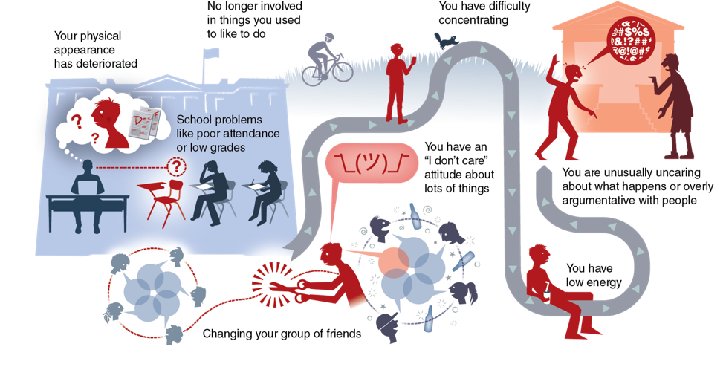
Signs of Alcohol Use
Notes:
Figure 10.4 Signs of underage drinking.

Slide 4
What to Do for an Alcohol Overdose
An alcohol overdose is when a person has drunk so much alcohol that the areas of the brain controlling basic life-support functions begin to shut down.
If you think someone has overdosed:
Call 911.
Do not leave them alone. They may be semiconscious or unconscious.
Lay them on their side with their ear to the floor so that, if they vomit, it will come out of their mouth, and they won’t choke on it.

Slide 5
Factors That Influence Effects of Alcohol
1
2
How fast you drink
3
Body size
Food
4
5
How much you drink
Medications

Slide 6
Short-Term Physical Effects on the Body
Vision is blurred or double.
Sweating increases, and skin becomes flushed.
The more you drink, the longer it takes for your liver to metabolize the alcohol; therefore, you become drunk faster.
Dehydration occurs.
Nausea, vomiting, diarrhea, and indigestion may happen.

Slide 7
Long-Term Physical Effects on the Body
Brain damage, memory loss, or stroke
Cardiovascular disease and high blood pressure
Cirrhosis of the liver and cancer
Less ability to fight off infections
Inflamed lining and bleeding and cancer of the esophagus

Slide 8
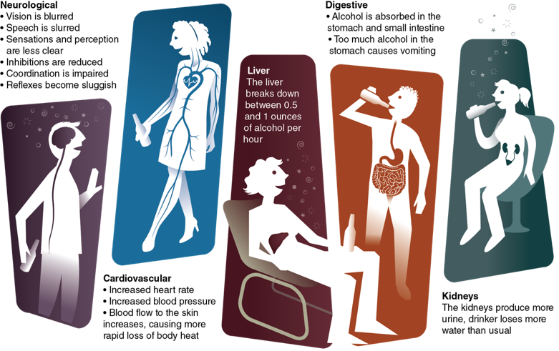
Physical Effects on the Body
Notes:
Figure 10.6 Effects of alcohol on the body.

Slide 9
Effects of Alcohol on Pregnancy (1 of 2)
There is no safe time or amount of alcohol for a pregnant woman to drink because a baby also absorbs the effects of alcohol.
Drinking alcohol during pregnancy can cause miscarriages, stillbirths, and fetal alcohol spectrum disorder (FASD).
FASD is a group of conditions that can cause a child to have physical, behavior, and learning problems.

Slide 10
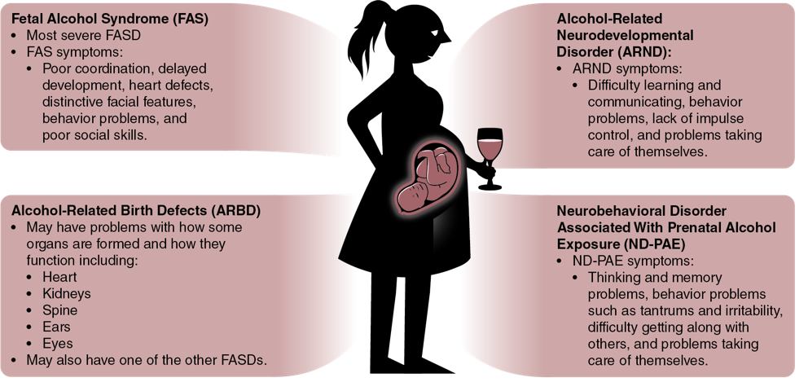
Effects of Alcohol on Pregnancy (2 of 2)
Notes:
Figure 10.7 Types of fetal alcohol spectrum disorders.

Slide 11
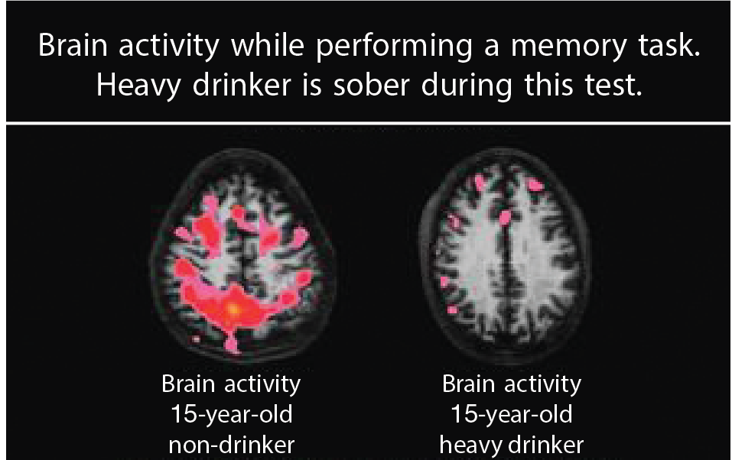
Mental Effects of Alcohol Use
Alcohol affects your brain and ability to do simple, routine tasks.
Even one or two drinks can affect your ability to walk, see, speak, react, and think clearly.
Notes:
Figure 10.8 Brain activity in a teen who drinks alcohol versus one who doesn’t.
Used with permission of Susan Tapert, University of California, San Diego.

Slide 12
Short-Term Mental Effects of Alcohol Use
Short-term mental effects of drinking alcohol may last a few hours, depending on how much you have had to drink, and may include:
Difficulty with decision making
Engaging in inappropriate or risky behavior
Being less likely to recognize potential dangers
Aggressive or violent behavior

Slide 13
Long-Term Mental Effects of Alcohol Use
Long-term mental effects of drinking alcohol may be permanent and may include:
Difficulty understanding information
Difficulty learning new information
An increase in the risk of developing an alcohol use disorder later in life

Slide 14
Emotional Effects of Alcohol Use (1 of 2)
People may choose to drink alcohol because it can initially change their mood and how they feel.
1
Increase positive mood
2
Gain approval
3
Reduce painful, negative feelings
4
Fit in
(continued)

Slide 15
Emotional Effects of Alcohol Use (2 of 2)
People also hope alcohol will help them be able to:
Express feelings
1
2
Mask feelings
3
Avoid feelings

Slide 16
Social Consequences of Risks of Underage Drinking
You may lose some of your friends.
Family and friends may not trust you because you may lie to them in order to drink.
You may have hangovers and not feel well if you drink too much.
You may act more impulsively, meaning you don’t think before you do something.

Slide 17
Risk Taking
Drinking can result in making risky decisions that lead to:
Unintentional injuries
Violence
Suicide
Sexual risk behaviors
Use of other drugs

