Slide 1
Saying No to Alcohol
Chapter 10
LESSON 10.4
Live Well: Middle School Health
Notes:
Hero Images/Getty Images

Slide 2
Write About It
People are asked questions every day, some big, some small. What do you think was the most important question you were asked in the past year?
Was it hard to say yes? Was it hard to say no? Explain why

Slide 3
Deciding Not to Use Alcohol (1 of 3)
You live in a world where you get a lot of mixed messages about drinking alcohol.
Understanding the situations you may put yourself in will make a difference on the decision you make about whether you use or don’t use alcohol.
(continued)

Slide 4
Deciding Not to Use Alcohol (2 of 3)
Situations that may encourage you to drink:
  You have access to alcohol at your or a friend’s house.
  You may have a job or get an allowance, so you have your own money to spend.
  You may spend a lot of time alone or don’t have expectations of when to be home.
  You may be around siblings, friends, or family members who began drinking at an early age.
  The friends you hang out with drink, and you may feel pressure to drink too.
(continued)

Slide 5
Deciding Not to Use Alcohol (3 of 3)
Situations that may encourage you not to drink
  You don’t have access to alcohol.
  If you decide to drink, you might lose your freedom to do things.
  You are involved in school activities or have a job that drinking could put in jeopardy.
  Your family members don’t drink or drink only on special occasions.
  The friends you hang out with don’t drink.

Slide 6
How to Avoid Difficult Situations
Involving Alcohol
There will be situations where alcohol is involved that require you to decide about what you will do.
  It may be good to get help from others, such as friends, family, or supportive adults.
If you and a friend are trying to decide whether you should go to a party, think through the pros and cons.
  If you decide to go, make sure the two of you stick together and keep each other safe, especially if there is alcohol involved.
  If you decide not to go to the party, do something else fun together.

Slide 7
Using Effective Communication Skills to Avoid Alcohol Use
Being able to communicate is important to who we are as people.
  We communicate all the time, in person, through text, and on the phone.
  To be an effective communicator, it is important that the information you provide gets your point across.

Slide 8
Verbal Communication
The use of spoken or written words to send a message:
  It is important to use I messages when you are talking with people about how you are feeling.
  An I message is a statement you use to express your own opinion or to make a comment.
  An effective I message might be “Thank you for asking, but I don’t drink alcohol.”

Slide 9
Nonverbal Communication
Nonverbal communication means using body language to communicate without talking.
Examples include:
  Using your head to nod in agreement or shake back and forth in disagreement
  Using your face to smile or frown
You may also use a combination of verbal and nonverbal communication when you are talking to someone.

Slide 10
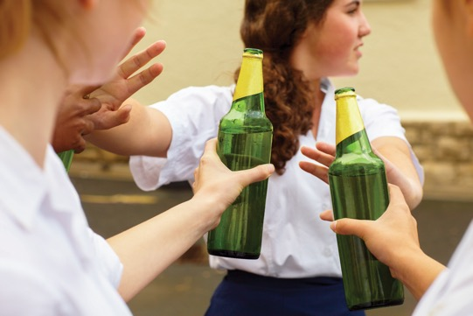
Refusal Skills (1 of 2)
Refusal skills are techniques you use to say no and then stick with it.
  You will need to use a combination of verbal and nonverbal communication to get your point across.
  It can be hard to say no in a situation, such as refusing to drink, especially if everyone else seems to be drinking.
(continued)
Notes:
PeopleImages/E+/Getty Images

Slide 11
Refusal Skills (2 of 2)
When refusing to take a drink, it is okay to make up an excuse. For example:
  I need to go because I have to help a family member.
  Drinking makes me sick.
You can also be honest with the person. For example:
  I don’t drink.
  I’d be kicked off the team.

Slide 12
Benefits of Being Alcohol Free
More energy
Higher self-esteem
Better relationships with your friends and family
Better able to manage stressful situations
Healthier eating
No hangovers
Higher grades than students who drink (Drinking may cause memory loss, which can affect your ability to do well in school.)

Slide 13
Alternatives to Drinking Alcohol
Go to a movie.
Play games (video or card or board).
Volunteer (at a hospital, a community center, etc.).
Exercise.
Find a new hobby.
Spend time with your family.
Advocate for something you believe in.
Try out for a sports team.
Get a job

