Slide 1
Treating Alcohol Use Disorders
Chapter 10
LESSON 10.5
Live Well: Middle School Health
Notes:
Skynesher/E+/Getty Images

Slide 2
Write About It
List everything you know about treatment for an alcohol use disorder.
Then, list questions related to treatment that you would like to have answered.

Slide 3
Alcohol Use Disorder (1 of 2)
Alcohol use disorder (AUD) is a medical condition that is diagnosed when a person’s drinking causes distress or harm.
AUD ranges from mild to moderate to severe.
AUD is diagnosed if a person answers yes to two or more questions from an 11-question list about their drinking experience in the last year.
Severity of the AUD is defined by how many questions a person answers with yes.

Slide 4
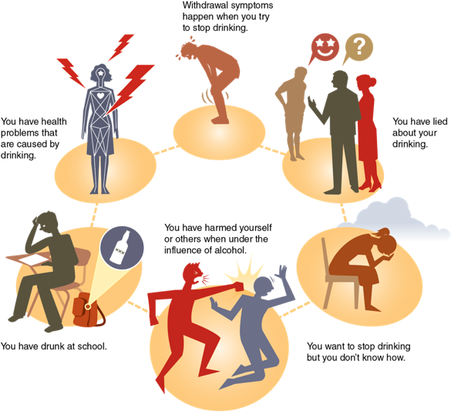
Alcohol Use Disorder (2 of 2)
Notes:
Figure 10.10 Indications that help may be needed for an AUD.

Slide 5
Common Reasons for Teen Alcohol Use Disorder
Lack of family support and communication
Family conflicts and a history of alcohol or drug use
Peer pressure to drink
Teen drinking in the media
Starting to drink by age 16 or earlier
Having family members with an alcohol use disorder
Suffering from low self-esteem or depression

Slide 6

Helping Friends or Family Who Have an Alcohol Use Disorder
If your friend or family member has an alcohol use disorder, they need help.
It is important for you to talk with someone concerning your friend or family member.
Talk with an adult you trust, such as a teacher, counselor, or parent.
Talk with the person with the problem when they are sober.
Notes:
Jose Luis Pelaez Inc/DigitalVision/ Getty Images

Slide 7
Alcohol Treatment Programs (1 of 2)
An alcohol treatment program is where people go to get professional help for an alcohol use disorder.
Outpatient treatment means that you can still go to school and live at home, but you must attend counseling.
A substance abuse counselor or mental health therapist will determine the type of outpatient treatment and how many times a week you must go.
(continued)

Slide 8
Alcohol Treatment Programs (2 of 2)
Individual counseling is outpatient counseling where a person meets with a substance abuse counselor or a mental health therapist.
Group therapy is outpatient treatment in a group setting with other members who have similar situations.
Student assistance programs bring substance abuse counselors into your school and meet with students individually or in groups.
A mutual support group is a group of people who have the same problems or concerns. The best-known mutual support group is Alcoholics Anonymous.

Slide 9
Medications
Sometimes, medications are given to help stop or reduce drinking. They may help to prevent a relapse.
Two of the most used medications to make drinking less enjoyable are:
disulfiram (Antabuse), which will make you feel sick or throw up when you drink
naltrexone (ReVia), which blocks the craving you get from drinking

Slide 10
Residential Treatment Centers for AUD
A residential treatment center is where an individual would live full time for the length of their treatment for an AUD.
Residential treatment centers also want the family involved in the alcohol user’s treatment.

Slide 11
Support Groups for Families
Al-Anon helps family members and friends of alcoholics. They learn how to help themselves as well as the person with the drinking problem.
Alateen is specifically for teens who have a family member or friend who is an alcoholic.

