Slide 1
Tobacco Products and the Rise of E-Cigarettes
Chapter 11
LESSON 11.1
Live Well: Middle School Health
Notes:
NengLoveyou/iStock/Getty Images

Slide 2
Write About It
Can you name four types of tobacco products?
Can you name the common ingredient found in all forms of tobacco?

Slide 3
Tobacco Facts (1 of 2)
According to the Centers for Disease Control and Prevention (CDC), there has been a significant increase in middle school and high school students’ use of tobacco products, primarily in e-cigarettes.
Tobacco use is the number one cause of preventable deaths in the United States.
(continued)

Slide 4
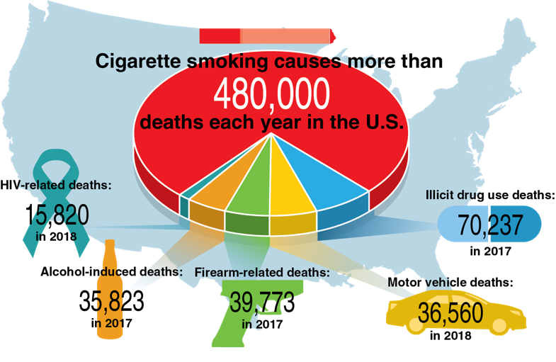
Tobacco Facts (2 of 2)
Notes:
Figure 11.1 Common preventable deaths in the United States.

Slide 5
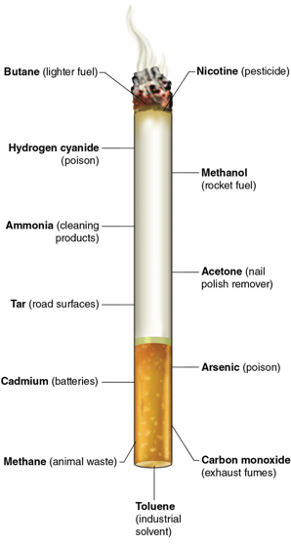
Tobacco and Its Ingredients
Tobacco is a plant grown for its leaves, which are dried and put into tobacco products.
Tobacco contains nicotine, which is the addictive chemical and the main ingredient in tobacco.
Nicotine stimulates the release of dopamine in the brain, which is the chemical responsible for feelings of excitement, relaxation, and stress relief.
Notes:
Figure 11.2 Common cigarette components and what else they can be found in.

Slide 6
Types of Tobacco Products
Cigarettes
Cigars
Electronic cigarettes (e-cigarettes)
Pipe
Chewing tobacco
Snuff and snus
Dissolvables

Slide 7
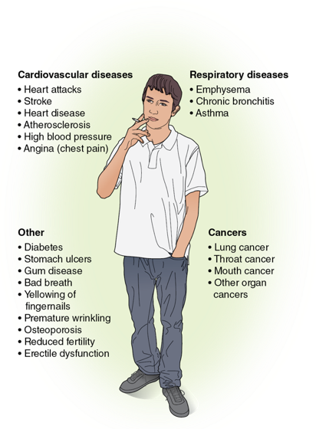
Tobacco’s Effects on the Body
Notes:
Figure 11.3 Effects of tobacco on the body.

Slide 8
Health Effects of Smokeless Tobacco
Smokeless tobacco is also a serious risk to your mouth and overall health.
Contains twice as much nicotine as a regular cigarette.
Can cause cancer of the mouth, esophagus, or pancreas.
Destroys gum tissue and causes cavities, tooth decay, and bone loss around the teeth.

Slide 9
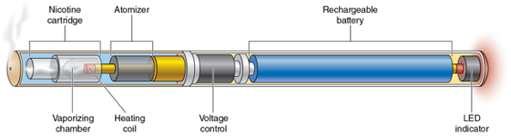
E-Cigarettes (1 of 2)
They are also known as e-cigs, vape pens, vapes, mods, tank systems, and ENDS, which stands for electronic nicotine delivery systems.
An e-cigarette is a battery-operated device that heats a liquid and produces an aerosol.
The aerosol that is inhaled and exhaled can contain nicotine, flavorings, ultrafine chemical particles, cancer-causing chemicals, and heavy metals such as nickel, tin, and lead.
(continued)
Notes:
Figure 11.4 The internal part of an e-cigarette.

Slide 10
E-Cigarettes (2 of 2)
Vaping is the act of inhaling and exhaling aerosol produced by an e-cigarette.
The liquid is often referred to as e-juice and usually contains nicotine, flavoring, and other chemicals.
The amount of aerosol produced by the e-cigarette affects how much nicotine is consumed.
Notes:
VICTOR DE SCHWANBERG/ Science Photo Library/Getty Images

Slide 11
Who Uses E-Cigarettes?
E-cigarettes are popular with teens who have never smoked cigarettes before and may never have intended to.
Teens using e-cigarettes are at an increased risk of smoking cigarettes later in life partly because of nicotine addiction.
E-cigarettes may be more socially acceptable than smoking cigarettes because the aerosol does not smell as bad as cigarette smoke.

Slide 12
E-Cigarettes Are a Dangerous Alternative to Smoking
E-cigarettes have been advertised as a safe alternative to smoking and a method to quit smoking cigarettes.
Little evidence shows e-cigarette use reduces smoking or leads to completely quitting smoking.
Vaping an average-sized e-cigarette is equal to 12 cigarettes, and most tobacco cigarettes contain between 8 and 20 milligrams of nicotine.

Slide 13
Health Risks and E-Cigarettes
Since e-cigarettes are relatively new, there is still much to be learned about their long-term effects.
Many of the health risks people are aware of are like those for cigarettes.
It is unclear what all the ingredients are in the different e-juices, so no one knows what the side effects will be. It could be years before this information is available.
Vaping can cause lung and cardiovascular diseases, lung cancer, and fainting and can reduce how well your immune system works.

Slide 14
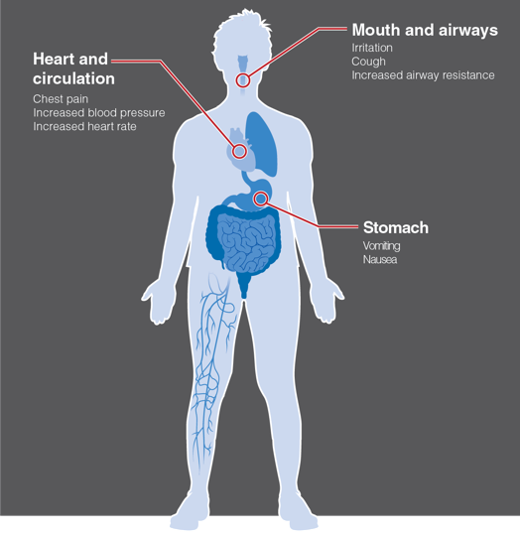
Side Effects of Vaping
Notes:
Figure 11.5 Side effects of vaping.

Slide 15
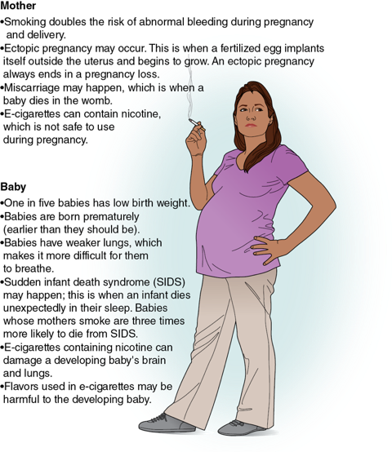
Pregnancy and Tobacco Product Use
Women who smoke have more difficulty becoming pregnant than women who don’t smoke.
Men who smoke can have damaged sperm and have difficulty getting their partner pregnant.
Smoking while pregnant can cause many health problems to the mother and her baby.
Notes:
Figure 11.6 Effects of smoking on the mother’s and baby’s health.

Slide 16
Secondhand and Thirdhand Smoke or Vape
The smoke or vape from a cigarette, e-cigarette, cigar, or pipe and the smoke breathed out by a smoker are known as secondhand smoke or secondhand vape.
More than 60 of the 7,000 chemicals in tobacco smoke are known to cause cancer. The chemicals that cause cancer are known as carcinogens.
Secondhand vape contains nicotine, ultrafine metal particles, and low levels of toxins that are also known to cause cancer.

