Slide 1
Avoiding and Quitting Tobacco Product Use
Chapter 11
LESSON 11.3
Live Well: Middle School Health
Notes:
Bobbieo/E+/Getty Images

Slide 2
Write About It
Why do you think it is so hard for teens to quit using tobacco products once they start?

Slide 3
Tips for Staying Tobacco-Free (1 of 2)
Stay away from situations where tobacco products are being used.
Spend time with friends who don’t use tobacco products.
Have specific lines you use to get yourself out of using, such as I have asthma and I could become very ill or I don’t think this is a good idea.
Recognize what situations, people, or places may trigger you to want to use, and try not to put yourself with those people or in those situations.
(continued)

Slide 4

Tips for Staying Tobacco-Free (2 of 2)
Celebrate moments when you convince yourself not to give into your cravings and all the days you don’t use.
Replace using tobacco products with a new hobby or activity so you have something to do when you want to use.
Write down your reasons for quitting and look over them when you think about using again.
Notes:
Hill Street Studios/DigitalVision/ Getty Images

Slide 5

Refusal Skills to Avoid Tobacco Use
Refusal skills are techniques you use to say no to something you don’t want to do.
To say no to tobacco products, use a combination of verbal and nonverbal communication to get your point across.
Make sure your verbal response is firm and confident and your nonverbal response matches it.
Notes:
Rob Lewine/Getty Images

Slide 6
Nicotine Addiction
Nicotine is the addictive substance found in all tobacco products.
  It is poisonous when used in its pure form.
  It is a central nervous stimulant.
  When you inhale, your brain releases epinephrine, or adrenaline, causing your heart rate and blood pressure to increase.
  Your brain also releases dopamine, which is the hormone linked to feelings of happiness, motivation, and concentration.
Nicotine can harm the parts of the brain that control attention, learning, mood, and impulse control.

Slide 7
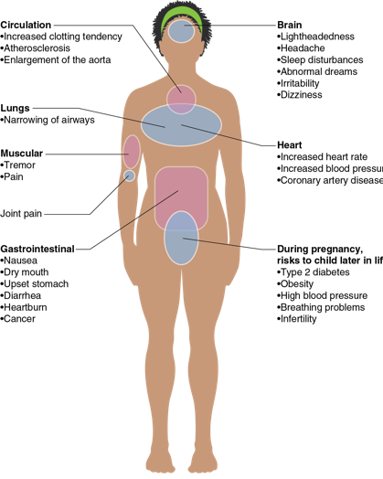
Side Effects of Nicotine Addiction
Notes:
Figure 11.7 Side effects of nicotine use.

Slide 8
Common Signs of Nicotine Addiction
Using more tobacco more often to get the same feeling you did when you began using
Experiencing withdrawal symptoms, such as irritability, anxiety, and difficulty concentrating
Wanting to quit but being unable to because of the withdrawal symptoms
Experiencing cravings and intense urges to use tobacco
Continuing to use tobacco despite being aware of the consequences and health risks

Slide 9
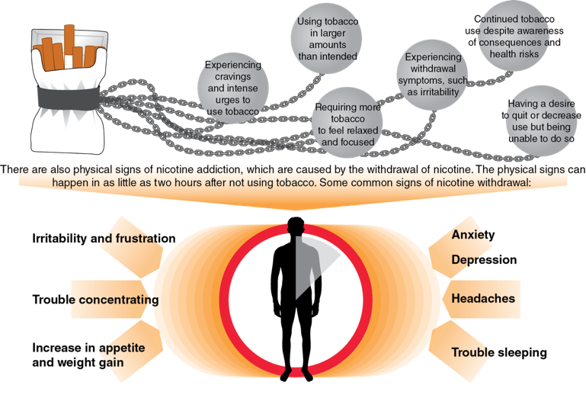
Common Signs of Nicotine Withdrawal
Notes:
Figure 11.8 Signs of nicotine addiction

Slide 10
Benefits of Being Tobacco-Free (1 of 2)
You no longer have to find places and times to smoke.
You will have more money.
Your skin and nails will look healthier, your teeth will look whiter, and your breath will be fresher.
You will have more energy.
You’ll be able to do normal activities without losing your breath.
You will not expose others to secondhand smoke.
(continued)

Slide 11
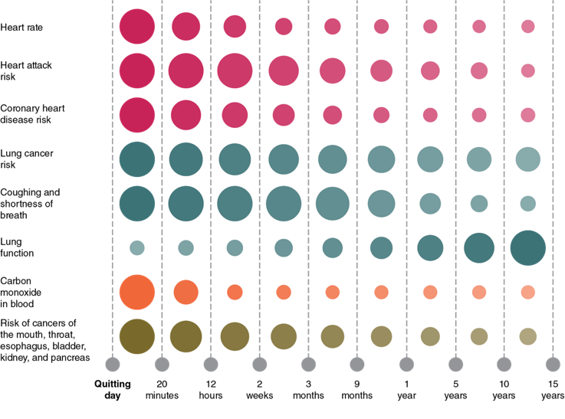
Benefits of Being Tobacco-Free (2 of 2)

Slide 12
Quitting Methods (1 of 2)
Quitting isn’t easy, and there may be times when you aren’t completely successful. But having a plan will help you get back on track.
To be successful at quitting, do the following:
  Set a quit date.
  Make a list of reasons why you want to quit.
  List the triggers that make you want to use a tobacco product.
  Have a plan to fight the cravings and get rid of all the smoking reminders.
  Keep trying to quit until you meet your goal.
(continued)

Slide 13
Quitting Methods (2 of 2)
Use apps and text message programs to help with quitting.
Consider nicotine replacement therapy (NRT):
  Patch, gum, inhalers, lozenges, nasal sprays
Seek individual, group, or telehealth counseling.
Exercise, use deep breathing techniques, or meditate.
Get support from family and friends

