Slide 1
Government Regulation of Tobacco Products
Chapter 11
LESSON 11.4
Live Well: Middle School Health
Notes:
HAZEMMKAMAL/iStock/Getty Images

Slide 2
Write About It
Do you think an advertisement for vaping, smoking, or chewing tobacco should be on social media sites that are known to attract teens and young adults? Why or why not?

Slide 3

E-Cigarette Advertising
Store signs, television ads, movies, Internet sites, social media, and magazines are used to get teens to notice their brand.
Teens are targeted through themes of independence, rebellion, celebrity figures, and convenience.
Notes:
Andrew Lichtenstein/Corbis via Getty Images

Slide 4
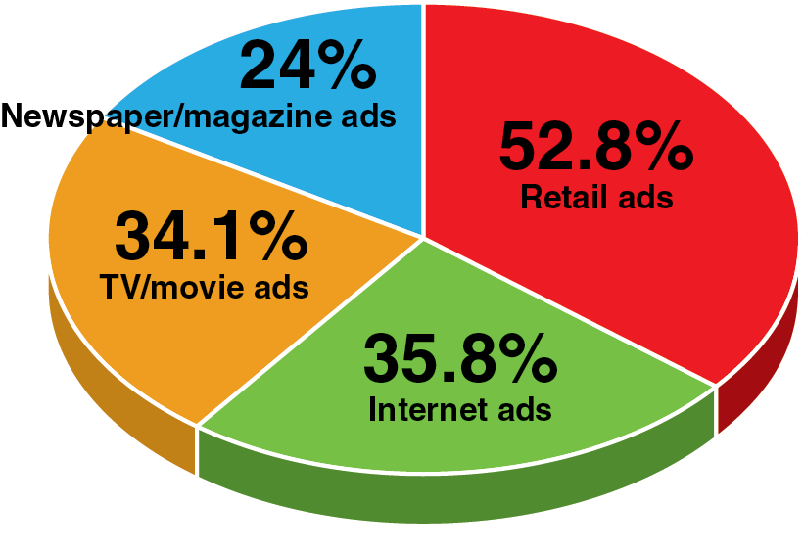
Advertising and Marketing
Techniques on Tobacco Use (1 of 2)
7 in 10 teens exposed to advertising for e-cigarettes.
(Continued)
Notes:
Figure 11.10 E-cigarette advertising targets teens in many different forms.

Slide 5
Advertising and Marketing
Techniques on Tobacco Use (2 of 2)
The tobacco industry spends billions on marketing each year.
Marketing includes:
  promotion
  placement
  price

Slide 6
The Role of the Food and Drug Administration (1 of 2)
The FDA is responsible for regulating the manufacturing, marketing, and distribution of tobacco products to protect the public health and to reduce tobacco use by minors.
The FDA banned:
  the sale of e-cigarettes to minors
  free samples of e-cigarettes
  vending machine sales of e-cigarettes except in adult-only facilities
  the sale of flavored e-cigarettes
  (continued)

Slide 7
The Role of the Food and Drug Administration (2 of 2)
Advertising for all tobacco products must include an addictiveness warning statement.
  WARNING: This product contains nicotine. Nicotine is an addictive chemical.
The FDA has put these bans and restrictions in place to try to decrease vaping in young people.

Slide 8
Role of Government and Communities in Decreasing Tobacco Use
The CDC’s Office on Smoking and Health (OSH) helps states and communities implement tobacco control programs.
The OSH created the National Tobacco Control Program (NTCP) to coordinate national efforts to reduce tobacco-related diseases and deaths.
Each state has access to the CDC’s OSH and NTCP resources to help inform and implement effective tobacco prevention and cessation best practices.

Slide 9
Federal Government Role in
Decreasing Tobacco Use
Tracking e-cigarette use and supporting research on health effects and factors contributing to teen e-cigarette use
Providing information on the health effects of e-cigarette use by teens
Developing regulations for e-cigarettes to reduce or prevent teen use
Funding and promoting campaigns that inform people about the dangers of tobacco product use, including e-cigarettes

Slide 10
Role of State, Local Government, and
Communities in Decreasing Tobacco Use
Funding tobacco product prevention programs currently emphasizing preventing teen e-cigarette use
Limiting where and how tobacco products are sold to reduce teen e-cigarette use and advertising exposure
Restricting the number of stores that sell tobacco products and regulating how close they can be to schools
Supporting efforts to implement and continue proven youth tobacco prevention approaches

Slide 11
Role of Health Care Providers, School Personnel, and Family Members in Decreasing Tobacco Use
Counseling teens on dangers of nicotine, e-cigarettes, and other tobacco products
Encouraging teens who use tobacco products to quit and providing help with quitting
Teaching teens how to analyze media and Internet use to be able to tell what is truthful and what is not
Family members setting a good example by not using tobacco products

Slide 12
State Smoking Bans
Twenty-five U.S. states have comprehensive smoke-free laws covering workplaces, restaurants, and bars, which means they are 100 percent smoke free.
Five states have 100 percent smoke-free restaurants and bars.
Twenty states do not have any smoke-free indoor areas.

