Slide 1
Over-the-Counter and Prescription Drugs
Chapter 12
LESSON 12.1
Live Well: Middle School Health
Notes:
Photodisc

Slide 2
Write About It
List three ways you think over-the-counter (OTC) medications are different from prescription medications.

Slide 3
Over-the-Counter and Prescription Drugs
Medicine is the science of diagnosing and preventing disease and maintaining health.
Medicine can also be defined as a drug used to maintain health or treat a health issue.
Drugs can ease symptoms, help prevent or manage diseases, relieve pain, and treat multiple conditions.
Drugs are divided into two categories:
Nonprescription or over-the-counter (OTC) drugs
Prescription drugs
Notes:
BSIP/Universal Images Group via Getty Images

Slide 4
Differences Between OTC and Prescription Drugs
OTC drug | Prescription drug
Does not require a doctor’s prescription | Prescribed by a doctor
Bought off the shelf in stores | Bought at a pharmacy
Can be used by more than one person | Prescribed for and to be used by only one person
Regulated by the FDA | Regulated by the FDA

Slide 5
Using OTC and Prescription Drugs Safely (1 of 2)
The U.S. Food and Drug Administration (FDA) is the government agency that decides which drugs require a prescription and which may be sold over the counter.
To use an OTC drug safely means using the drug properly.
To use prescription drugs safely, it is important to use them as they are prescribed by your doctor.
(Continued)

Slide 6
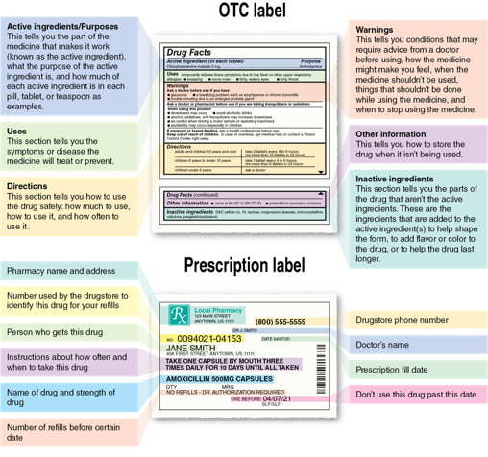
Using OTC and Prescription Drugs Safely (2 of 2)
Notes:
Figure 12.1 Both OTC and prescription drugs require drug facts labels.

Slide 7
Potential Risks of Taking OTC and Prescription Drugs
Side effects: These may include nausea, dizziness, dry mouth, skin irritation, and drowsiness.
Drug–drug interactions: Using two drugs together affects how your body processes them.
Drug–food interactions: What you eat and drink can prevent a drug from working as it should.
Allergic reactions: Signs may include itching, hives, and breathing problems.

Slide 8
Abuse of OTC and Prescription Drugs
Middle school students are more likely to abuse OTC and prescription drugs because the drugs are easy to obtain and the desire to fit in with peers is strong.
Prescription drugs are the fourth most abused substance by teens.
The use of prescription drugs, other than as prescribed, by teens is the fastest-growing drug problem in the United States, affecting teens’ mental and physical health.

Slide 9
Commonly Misused OTC and Prescription Drug
Commonly misused OTC and prescription drugs include:
cough syrup
cold medicine
Adderall and Ritalin
Vicodin and OxyContin

Slide 10
Performance-Enhancing Drugs
Performance-enhancing drugs are substances used to improve athletic performance.
Caffeine is a stimulant most often found in coffee and energy drinks.
It may be used by athletes to speed up the central nervous system and increase heart rate and blood pressure.
Your body produces creatine, which helps muscles release energy.

Slide 11
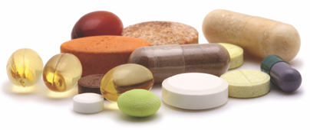
Diet Pills
Diet pills often come with a large promise of significant weight loss.
Diet pills may help with weight loss, but they can also have health risks.
OTC diet pills are marketed to help you lose weight by increasing your metabolism.
The primary ingredient of most diet pills is caffeine, but they may have other ingredients that may or may not be safe.
Notes:
rudchenko/Getty Images/ iStockphoto

