Slide 1
Illicit Drugs
Chapter 12
LESSON 12.2
Live Well: Middle School Health
Notes:
Cnicbc/E+/Getty Images

Slide 2
Write About It
Brainstorm three potential short-term and three long-term consequences of using drugs to cope with problems.

Slide 3
Illicit Drugs and Drugs of Abuse
Illicit drugs are substances that are illegal to possess, have no medical applications, and can be dangerous to consume.
They stimulate or slow the central nervous system or cause hallucinogenic effects.
Notes:
Silas Stein/picture alliance via Getty Images (top); MERJA OJALA/ AFP via Getty Images (bottom)

Slide 4
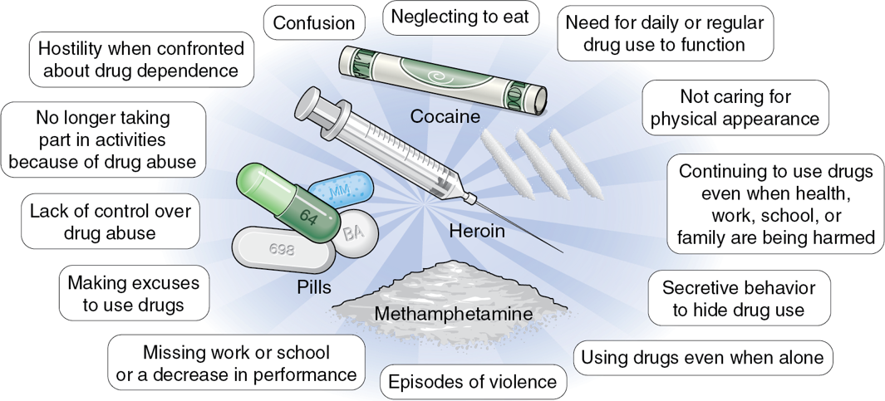
Dangers of Illicit Drugs
Notes:
Figure 12.3 Dangers of using illicit drugs.

Slide 5
Marijuana (Cannabis) (1 of 2)
Marijuana (also known as cannabis) is one of the most popular drugs and is commonly used by smoking or vaping or consumed as edibles.
  It is a mind-altering psychoactive drug made from the Cannabis sativa plant.
  Its main ingredient is tetrahydrocannabinol (THC), which produces the psychoactive “high.”
  Short-term side effects may include being overly relaxed, increased appetite, an altered sense of time, and impaired judgment.
  Long-term side effects may include mental health problems, respiratory infections, and addiction.
  (continued)

Slide 6
Marijuana (2 of 2)
Marijuana is currently legal in many U.S. states and in the District of Columbia for people over the age of 21.
Some states have approved medical marijuana only, and other states have approved adult-use recreational marijuana.
It is still illegal to use marijuana according to the federal government.
Notes:
Thanasis/Moment/Getty Images

Slide 7
Stimulants
Stimulants speed up the body’s systems.
This class of drugs includes the following:
  Prescription drugs such as amphetamines used to treat ADHD
  OTC drugs
  diet pills
  Illicit drugs such as cocaine and methamphetamine
Notes:
mikroman6/Moment/Getty Images (top);

Slide 8
Cocaine
Cocaine is a white, crystalline powder derived from coca leaves.
  Its street names include coke, crack, rock, and snow.
  Crack cocaine, another common form, looks like small, unevenly shaped white rocks.
  Cocaine makes the user feel energetic, alert, and overly sensitive to sights and sounds.

Slide 9
Methamphetamine
Methamphetamine, one of the most common Illicit drugs in the United States because it is so easy to create.
  Its street names include meth, speed, ice, and crystal.
Meth creates a type of excitement that makes people feel good partly because of the high level of dopamine that is released.
Common side effects of meth use are a severe dental problem called meth mouth and intense itching and scratching leading to skin sores.

Slide 10
Opioids (1 of 2)
Opioids, or narcotics, are naturally found in the opium poppy plant.
This class of drugs includes the illicit drug heroin as well as pain relievers available by prescription, like oxycodone, hydrocodone, and morphine.
Synthetic opioids, such as fentanyl, are made in a lab.
Opioids are often used as medicine because they contain chemicals that relax the body and relieve pain.
(continued)

Slide 11
Opioids (2 of 2)
Heroin is an opioid drug made from morphine.
Heroin can be a white or brown powder or a sticky black substance known as black tar.
Heroin can be injected, snorted, or smoked.
Short-term effects may include dry mouth, heavy feeling in the arms and legs, and difficulty in thinking.
Long-term effects may include an inability to make decisions, antisocial behavior, and heart and lung complications.

Slide 12
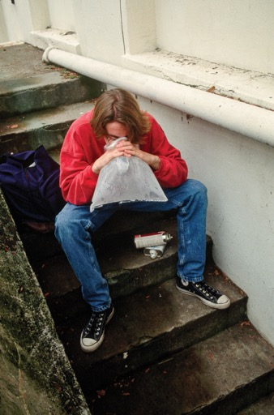
Inhalants
Inhalants are invisible, dangerous substances found in common household products that are inhaled as vapors through the nose or mouth.
The high they produce usually lasts only a few minutes.
  Examples of inhalants include felt-tip markers, spray paint, hairspray, nail polish remover, and gasoline.
  Short-term effects include slurred speech, lack of coordination, headaches, and dizziness.
  Long-term effects can include loss of coordination and brain damage and may result in death.
Notes:
James Marshall/Corbis/Getty Images (bottom)

Slide 13
Steroids
Anabolic steroids are a lab-created version of the male hormone testosterone.
They are used illegally to promote muscle growth, enhance athletic performance, and improve physical appearance.
Steroid use can have many side effects:
  Men: shrinking testicles, decreased sperm production, mood swings, and aggression
  Women: deepening of the voice, decrease in breast size, increase in face and body hair

Slide 14
Club Drugs: Hallucinogens
Club drugs are primarily used by teens and young adults at parties, concerts, and clubs.
Hallucinogens are used to alter perception and mood.
Two examples of hallucinogens
  Ecstasy comes in pill or powder form.
  GHB comes in pill form but more often is a colorless, odorless liquid put into drinks.

Slide 15
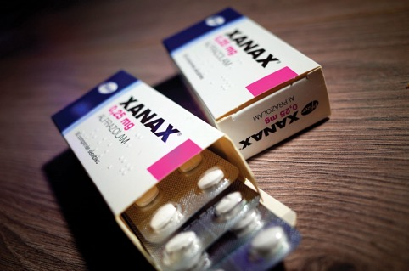
Club Drugs: Depressants
When prescribed by a doctor and used properly, depressants can calm nerves and help you sleep.
Two examples of depressants:
  Benzodiazepines such as Ativan, Valium, and Xanax.
  Rohypnol (not approved for medical use in the United States)
Notes:
BSIP/Universal Images Group via Getty Images

Slide 16
Why Some Teens Use Illicit Drugs
Teens experiment with drugs for a variety of reasons.
To fit in and be accepted by peers
To feel good or experience pleasure
1
2
Are curious
3
Have low self-esteem
To feel better or to forget
To do better in competition
4
5
6
To overcome feelings of boredom
To cope with problems
7
8

Slide 17
How Drugs Affect Athletic Performance
Drugs take a toll on your mind, body, physical activity, and athletic performance in many negative ways.
Depressants affect your alertness and concentration, slow down your breathing, and reduce your coordination.
Stimulants increase your heart rate, can make you irritable and restless, and can make it difficult to concentrate on the game.

Slide 18
Illicit Drugs and Risky Behaviors
There is a direct connection between using illicit drugs and engaging in risky behaviors, such as unprotected sex, number of sex partners, underage drinking, and dating violence.
Teens who don’t use any substances are the least likely to engage in sexual risk taking.

Slide 19
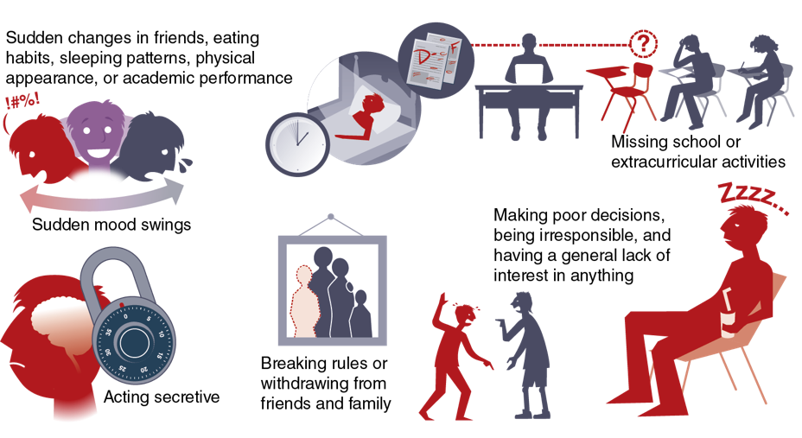
Warning Signs of Teen Drug Use
Notes:
Figure 12.5 Potential signs of drug use.

