Slide 1
Influences on the Use of Medications and Drugs
Chapter 12
LESSON 12.3
Live Well: Middle School Health
Notes:
sefa ozel/iStock/Getty Images

Slide 2
Write About It
Who or what is your most positive influence and why?
Who or what is your most negative influence and why?
Which external influencing factors have the greatest impact when it comes to making significant decisions in your life?
Why are they so important to you?

Slide 3
Factors That Influence the Use of Drugs
There are many factors that will influence you to use or not use medications and drugs.
Family influence, such as a sibling using drugs
Peer influence, or friends who use drugs
Media influence, or magazines, radio, and TV
Social media influence, or celebrities on Snapchat or Instagram
You as an influence, or deciding what is best for you
Life influence, or transition periods when drug use may occur

Slide 4
Media and Advertisements
Federal law states that advertising must be truthful and backed by scientific evidence. Drug ads are required to tell the consumer three things.
At least one approved use of the drug
The generic name of the drug (A generic drug is a copy that is the same as a brand name drug in dosage, safety, strength, how it is taken, quality, performance, and intended use.)
All the risks of using the drug

Slide 5
Advertising Techniques and Their Influence on Teens (1 of 2)
Making interesting commercials
Engaging teens by incorporating an experience in the ad such as games, apps, and contests
Using emotions to have teens identify with a product
Taking advantage of teen insecurities by appealing to their need to fit in and to be viewed as attractive, athletic, or popular
Using celebrities and athletes to endorse their products
(continued)

Slide 6
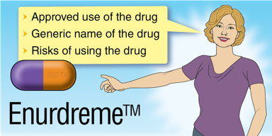
Advertising Techniques and Their Influence on Teens (2 of 2)
Using message that imply everyone is doing it
Tracking teens’ digital trail to determine their interests, purchases, preferences, and even location
Using peer influence on social media by having teen followers market their products for them
Notes:
Figure 12.6 Drug ads must tell consumers three things.

Slide 7
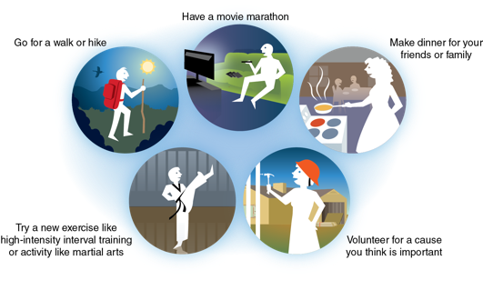
Healthy Alternatives to Substance Abuse
Teens need to realize there are always other things to do besides drugs; sometimes they just need to think about it ahead of time.
When teens are engaged in productive and healthy activities such as sports, volunteering, and youth groups, they are much less likely to turn to drugs for recreation.
Notes:
Figure 12.7 Some suggestions for healthy alternative activities to drugs. There are many more ideas you can come up with based on where you live and the options you have.

Slide 8
Communicating Using Refusal Skills
At times, you might find yourself in a difficult situation you shouldn’t be in or don’t want to be in, such as a place where drugs are being used.
Being able to communicate effectively that you don’t want to use drugs is an important skill to have; this is a refusal skill. A refusal skill allows you to say no using verbal and nonverbal communication and then stick with it.

