Slide 1
Prevention, Treatment, and Being Drug-Free
Chapter 12
LESSON 12.4
Live Well: Middle School Health
Notes:
SDI Productions/E+/Getty Images

Slide 2
Write About It
What would be the consequences if you were found using or possessing marijuana at school?
Are you aware of your school’s policies related to the use, possession, and sale of illicit drugs? If so, list them.
If you don’t know what they are, where do you think
you could find this information?

Slide 3
Substance Use Disorder (1 of 2)
A substance use disorder is a pattern of symptoms resulting from the use of a substance that you continue to take, even though you experience problems as a result.
A substance use disorder means the use of a drug is changing how a person lives their life.
Even when they know the drug is causing problems at school or with their family or friends, the person continues to use.
  (continued)

Slide 4
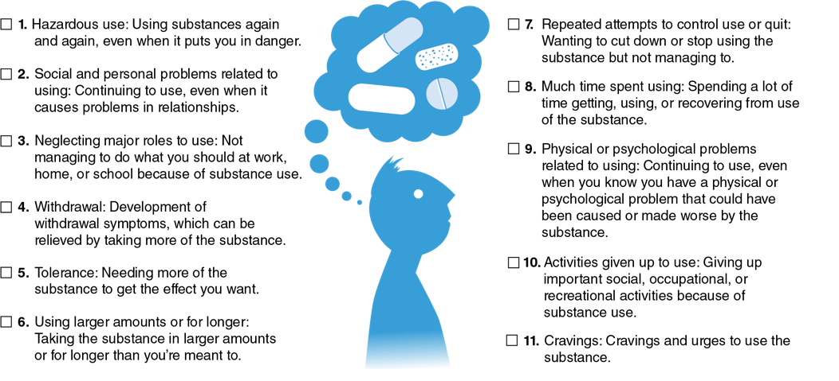
Substance Use Disorder (2 of 2)
Notes:
Figure 12.8 Substance use disorder criteria.

Slide 5
Addictive Potential of Drugs (1 of 2)
A drug’s addictive potential is determined by the drug’s ability to provide the following characteristics:
    The effects of the drug happen quickly.
    The feeling of great happiness and excitement go beyond normal expectations.
    Both tolerance and withdrawal are effects of the drug.
The more of these characteristics a drug has, the higher its addictive potential.
  (continued)

Slide 6
Addictive Potential of Drugs (2 of 2)
Tolerance means the user will require higher doses of the drug to have the same effect and they will want to continue use of the drug to prevent withdrawal symptoms.
Withdrawal is a group of symptoms that a person experiences when the quantity of the substance is reduced.

Slide 7
Effects of Drugs on the Brain (1 of 2)
Drugs with an addictive potential flood the brain with dopamine, the chemical responsible for feelings of excitement, relaxation, and stress relief.
If you continue to use drugs, the brain reduces the amount of dopamine it produces, which reduces the ability to be happy.
To get the happy feeling back, dopamine encourages the brain to make you want to take more drugs to feel good again.

Slide 8
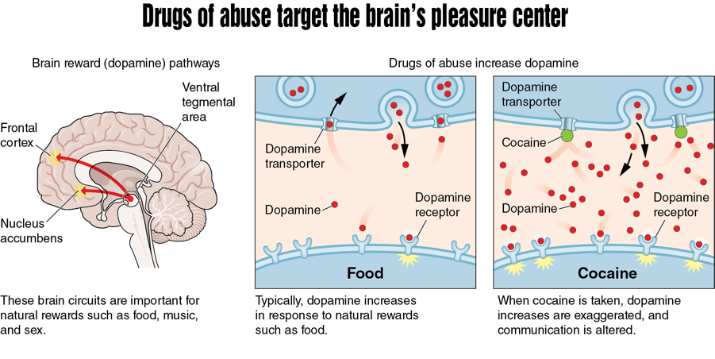
Effects of Drugs on the Brain (2 of 2)
Notes:
Figure 12.9 Drugs with an addictive potential target the brain’s pleasure center.

Slide 9
Being Drug-Free (1 of 2)
Being drug-free is a behavior that teens choose to practice.
The choice to be drug-free can be difficult because peers and friends may encourage you to use with them and make it hard to say no.
Being aware of why you are choosing not to use drugs is an important step in practicing healthy behaviors.
  (continued)

Slide 10
Being Drug-Free (2 of 2)
Schools can help educate teens about the risks of using different substances: alcohol, nicotine, OTC drugs, prescription drugs, and illicit drugs.
Families and adult role models can also play a large part in teen substance use prevention.

Slide 11
Benefits of Being Drug-Free
1
Healthier life
2
Clean conscience
3
4
Better school and job opportunities
Making friends
5
Mental health

Slide 12
Barriers to Being Drug-Free
Users don’t feel they need treatment.
1
2
Not ready to stop using
3
Family cannot afford treatment
4
Negative effect on education
Concerned with what others will think
5
6
Don’t know where to go

Slide 13
Treating Substance Use
Disorders (1 of 2)
The most effective types of treatment are a combination of medication (when appropriate and available) and behavioral therapy.
Medications are used to treat withdrawal symptoms while the teen stops using prescription drugs.
Behavioral therapy helps teens learn how to modify their attitudes and behaviors around using drugs.
(Continued)

Slide 14
Treating Substance Use
Disorders (2 of 2)
Treatment must be long enough and strong enough to be effective.
The most common treatment settings for teens
  Outpatient treatment programs
  Intensive outpatient treatment programs
  Day treatment and partial hospitalization treatment programs
  Residential treatment programs

Slide 15
School Policies
All schools have specific policies related to the use, possession, and sale of drugs on school grounds and at school functions on or off school grounds.
They also have policies for the use, possession, and sale of illicit drugs off school grounds if you are an athlete or represent the school in clubs or organizations.
How schools handle the use, possession, and sale of illicit drugs is described in their student handbook.

Slide 16
Community Laws
Juvenile courts have a much wider range of options when dealing with offenders. (A juvenile is an individual under the age of 18.)
  Possession of an illicit substance
  Sale of an illicit substance
  Intent to distribute an illicit substance
  Transportation of an illicit substance
  Cultivation of an illicit substance
Even a small amount of illicit drugs can result in serious legal charges being filed

