Slide 1
Injury Prevention and Safety at Home
Chapter 13
LESSON 13.1
Live Well: Middle School Health
Notes:
zimmytws/fotolia.com

Slide 2
Write About It
If you have been in a natural disaster, describe what happened.
If you haven’t been in a natural disaster, explain what natural disaster could strike where you live and what you are most worried about.

Slide 3
Injuries
Two types of injuries
Unintentional injuries: caused by accidental or unplanned events
Caused by motor vehicle crashes, drowning, poisoning, fires, and falls
Intentional injuries: caused by another person or self-inflicted to cause injury
Caused by another person or is self-inflicted to cause injury, such as violence, suicide, self-injury, and homicide

Slide 4
Falls
Falls are the leading cause of nonfatal injuries for children and teens.
Follow these tips for preventing falls:
Clear objects from the floor to remove tripping hazards.
Have good lighting outside.
Use night-lights to avoid tripping in the dark.
Don’t stand on a chair or table to reach something.
If using a ladder, make sure someone is there to steady it for you.
Notes:
Tanya Constantine/Getty Images

Slide 5
Poisoning
Poison is a substance that causes harm to a person if too much is eaten, inhaled, injected, or absorbed through the skin.
Children under six can be poisoned by personal care products or household cleaning supplies such as detergent pods laundry and dishwashers.
Preteens and teens are unintentionally poisoned when they mix different prescription medicines.
Poison Control
Center:
800-222-1222

Slide 6
Firearm Safety
Keep firearms unloaded and locked up.
Add gun locks and lock ammunition separately from the firearms.
If you see or hear about someone having a gun at school, tell an adult right away. Even if it is not true, it’s better to be cautious and report it.

Slide 7
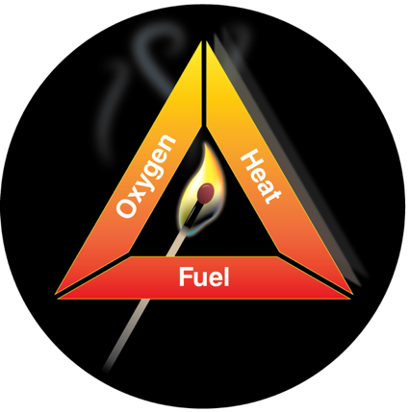
Fire Safety
Fire safety involves both planning to prevent fires from ever starting and what to do if a fire does happen.
The fire triangle is a simple way to understand the elements of fire.
Each side of the triangle represents one of the elements needed for fire: heat, fuel, and oxygen.
Notes:
Figure 13.1 The fire triangle
Rookman/iStock/Getty Images

Slide 8
Natural Disasters
Natural disasters are any type of severe weather or natural event that has the potential to threaten human health, safety, and property.
Types of natural disasters include winter storms, floods, thunderstorms, tornadoes, hurricanes, earthquakes, volcano eruptions, wildfires, and tsunamis.

Slide 9
Preparing for Disasters
Create a disaster preparedness plan.
Sign up for your community or state warning system.
Make sure you have food that will keep if power goes out, extra water, first aid supplies, flashlights, and batteries.
Make sure you have food and water for your animals.
Plan how you will communicate with your family members after a disaster.

