Slide 1
Safety in the Community
Chapter 13
LESSON 13.2
Live Well: Middle School Health

Slide 2
Write About It
Explain why it is important to report someone having a weapon at school even if you have only heard about it from someone and haven’t seen it yourself.

Slide 3
Community
A community is a group of people with a common interest participating in similar activities or having similar experiences.
Your community includes your school, public places you go to, your home, and the online community of your social media.
Community safety involves reducing injuries, practicing safe behaviors, and working to change unsafe situations.

Slide 4
School Safety
Schools are taking action to be safer and more prepared for dangerous situations:
They are teaching problem-solving and communication skills so students can handle their emotions better.
They are improving school designs by building hallways that have convenient exits and are well lit without dead-end hallways.
They are locating office areas centrally for easy access from all locations.
They are locking all outside doors so visitors must enter through a main door and show identification to get in.

Slide 5
Active Shooter Situations
An active shooter is an individual actively engaged in killing or attempting to kill people in a populated area.
The appropriate active shooter response is to:
Run from the shooter.
Hide, if escape is not possible.
Fight as a last resort and only if your life is in danger.

Slide 6
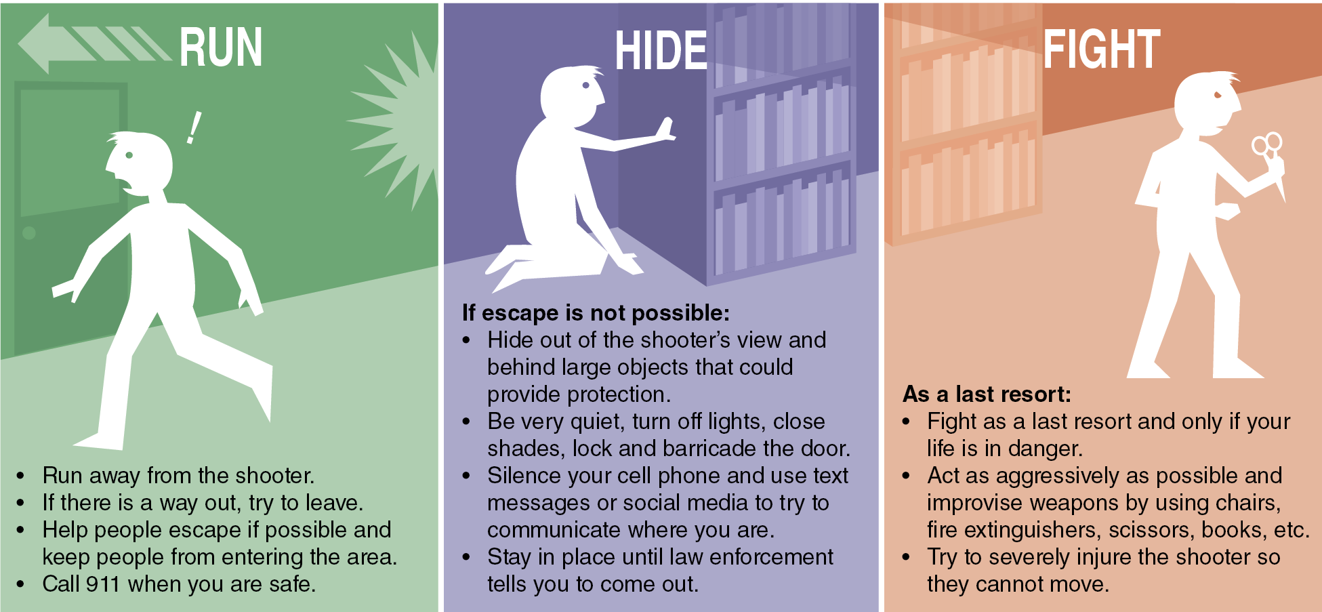
Active Shooter Procedures
Notes:
Figure 13.2 Active shooter procedures.

Slide 7
Public Safety
Be aware of where you are and who is around you.
Always tell your guardian where you’re going and whom you are with.
Never talk to strangers or accept rides.
Be alert for suspicious people or vehicles.
Avoid walking alone at night.
Always have your charged cell phone with you.
Carry only as much cash as you need.
Trust your judgment and leave a location if you feel uncomfortable.

Slide 8
Pedestrian and Bicycle Safety
Stay alert to what you are doing.
Wear bright clothing and reflective gear so you are easily seen.
Look both ways several times before crossing a road and cross only at corners, intersections, or marked crosswalks.
If there is no sidewalk, walk on the shoulder on the left side of the road facing traffic.
When riding a bike, wear a properly fitting bicycle helmet to reduce head and brain injuries if there is a crash.

Slide 9
Distracted Driving
Distracted driving is any activity that takes the driver’s attention away from driving.
Passengers in the car should
not talk, as it could distract the driver
take charge of the entertainment and navigation systems so the driver doesn’t have to worry about them
If you ride the school bus, make sure to listen to the directions given by the driver.

Slide 10
Water Safety
Always swim with a friend and in areas with a lifeguard.
Wear a U.S. Coast Guard–approved life jacket when swimming if you are inexperienced or on a boat of any kind.
Don’t dive into shallow water or water you cannot see into.
When swimming in a lake, river, or an ocean, avoid swimming in really cold water and watch out for currents.

Slide 11
Helping a Drowning Person
Reach out and have them grab your hand or arm so you can pull them to the edge.
Make sure someone is holding on to you so you don’t get pulled in.
Throw a life ring or buoy or extend a pool noodle for the person to grab onto so you can pull them to the edge.

