Slide 1
Safety Online
Chapter 13
LESSON 13.3
Live Well: Middle School Health
Notes:
Francesco Carta fotografo/ Moment/Getty Images

Slide 2
Write About It
How could you be safer on the Internet or on your phone?
List at least three ways you could be safer.

Slide 3
Internet Safety
There are so many things we can do on the Internet, such as search for information, get help with homework, listen to music, stream shows and movies, and interact on social media.
With so many options also come risks you need to be aware of. Some of the risks include social media sharing, identity theft, and phishing attacks.
Notes:
Huntley Paton/Moment

Slide 4
Social Media Sharing
Social media is electronic communication in which users create online communities to share information, ideas, personal messages, and other content.
Social media sharing is when you share your current location through pictures or checking in to a specific building or event.
Social media criminals can easily find where you are when you are sharing so much information. They will also know where you aren’t, such as your home, which can lead to break-ins.

Slide 5
Identity Theft
Identity theft occurs when someone uses your identity or personal information without your permission in order to commit a crime.
Your identity can be stolen, and you may not know about it until you are older and applying for student loans or a credit card and are denied because your identity was stolen.
Make sure your computer and cell phone are protected with a password, fingerprint scan, or facial recognition.

Slide 6
Phishing Attacks
Phishing attacks involve dishonest websites, apps, or emails that look legitimate but are not.
Phishing attacks often appear as a link in an email that you are asked to click on to fix a problem with your password or a credit card.
The link takes you to a website that looks real. When you log in, all your personal information has been given to the attacker.

Slide 7
Passwords
Many of the hacks to your social media, email, and online sites are due to weak or stolen passwords.
Passwords should be complex and multiple types of characters, including numbers, letters, and symbols.

Slide 8
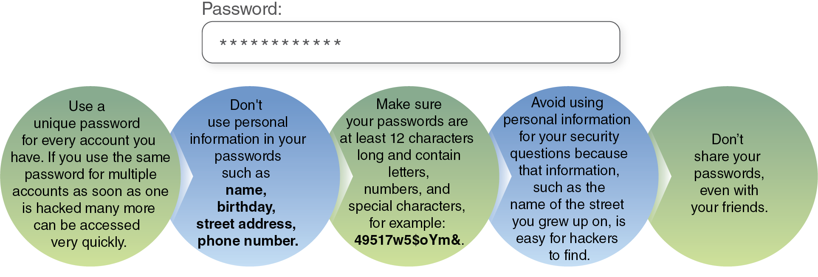
Password Tips
Notes:
Figure 13.6 Tips for creating a strong password.

Slide 9
Technology Safety Tips
Don’t click on unfamiliar links or apps, as they often spread malware, which is a computer virus that invades your computer system.
Think before you share your location.
Don’t accept friend requests from people you don’t know in real life.
Use antivirus software to detect, prevent, and remove malware.
Don’t meet people in person that you know only from being online.

