Slide 1
First Aid and Emergency Procedures
Chapter 13
LESSON 13.4
Live Well: Middle School Health

Slide 2
Write About It
What would you do if your guardian said they weren’t feeling well and collapsed onto the floor?

Slide 3
Preparing for Emergencies
An emergency is an unexpected situation that requires immediate action.
The first thing you should do is call 911.
In an emergency, you may be able to provide first aid, which is providing basic medical care to someone experiencing a sudden injury or illness.

Slide 4
Emergency Action Steps
In any emergency situation, use the emergency action steps of check, call, care.
  Check the scene to make sure it is safe and check the person to determine what the illness or injury might be.
  Call 911.
  Care for the person according to the conditions you find and your level of knowledge and training.

Slide 5
Universal Precautions
Steps taken to reduce the risk of transmitting pathogens from one person to another through close physical contact and/or a contaminated surface or object
Help protect a person from blood borne pathogens, such as HIV; hepatitis B, C, and D; and airborne pathogens from people coughing and sneezing
May include wearing gloves, masks, gowns, and other personal protection equipment as deemed necessary based on the situation

Slide 6
Cardiac Emergencies
The two most common cardiac emergencies are heart attack and cardiac arrest:
  Heart attack: occurs when blood flow to part of the heart muscle is blocked
  Cardiac arrest: occurs when the heart stops beating or beats too ineffectively to circulate blood to the brain
Cardiopulmonary resuscitation (CPR) is used when a person is not breathing and doesn't have a heartbeat
  CPR keeps oxygenated blood moving to the brain and other vital organs until advanced medical help arrives.
  CPR involves 30 chest compressions and two rescue breaths.

Slide 7
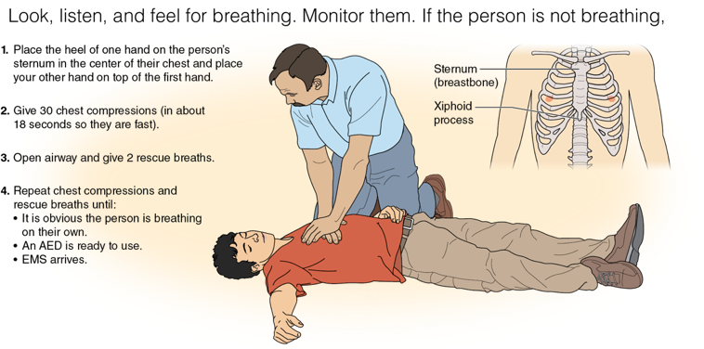
Cardiopulmonary Resuscitation
Cardiopulmonary resuscitation (CPR) keeps oxygenated blood moving to the brain and other vital organs until advanced medical help arrives.
Notes:
Figure 13.9 Steps for performing CPR.

Slide 8
Sudden Illness
Examples of sudden illness include
  asthma, allergic reactions and anaphylaxis, diabetic emergencies, seizures, and fainting.
Sudden illness often happens with little or no warning.
Symptoms may include:
  trouble breathing
  dizziness
  blurred vision or slurred speech
  numbness or weakness

Slide 9
Choking Emergencies
Occur when the airway becomes either partially or completely blocked
Signs and symptoms:
  Placing hands around throat (most common sign)
  Trying to cough but unable to
Care:
  Give five back blows and five abdominal thrusts.
  Continue the back blows and abdominal thrusts if the person becomes unresponsive or until they can cough forcefully, speak, breathe, or become unresponsive.

Slide 10
Heat-Related Emergencies
Caused by overexposure to heat and hydration
  Heat cramps: painful muscle spasms
  Heat exhaustion: more severe than heat cramps
  Heatstroke: most severe and least common
Notes:
THOMAS SAMSON/AFP via Getty Images (top);

Slide 11
Cold-Related Emergencies
Caused by overexposure to cold
  Frostbite: freezing of the skin and underlying tissues as a result of prolonged exposure to freezing or below freezing temperatures
  Hypothermia: lowering of the body’s core temperature to a point at which body function becomes impaired
Notes:
Science Photo Library/Getty Images

Slide 12
Burns
Burns are caused by contact with extreme heat, chemicals, radiation, or electricity.
Burns are classified by how deep they are; the deeper the burn, the greater the severity.
A sunburn is a heat-related emergency and a type of burn that is caused by overexposure to the sun.
Notes:
ROBERTO SCHMIDT/AFP via Getty Images (bottom)

Slide 13
Wounds
Wounds are injuries that result when the skin or other tissues of the body are damaged.
The two types are closed and open wounds:
  Closed wounds: bruises, internal bleeding
  Open wounds: abrasions, lacerations, avulsions, amputations, punctures

Slide 14
Muscle, Bone, and Joint Injuries
Sprains result from a stretched or torn ligament.
Strains result from a stretched or torn tendon or muscle.
Dislocations occur when bones that meet at a joint move out of their normal position.
Fractures are a complete break, chip, or crack in a bone.

Slide 15
Head, Neck, and Spinal Injuries
These injuries are very serious and can leave a person with a permanent disability.
A concussion is a common type of traumatic brain injury that involves a temporary loss of brain function.
Spinal cord injuries occur when bone fragments from vertebrae press into the soft tissue of the spinal cord or the soft tissue of the spinal cord swells, compressing it against the vertebrae.

