Slide 1
Exploring Public Health
Chapter 14
LESSON 14.1
Live Well: Middle School Health
Notes:
Pakorn Kumruen/EyeEm/Getty Images

Slide 2
Write About It
Have you ever heard of public health?
What do you think it means?
Provide examples in your response.

Slide 3
What Are Public and Community Health?
Public health is the art and science of protecting and improving the health of individuals and large populations.
Community health is a form of public health that is focused on a group of people or geographic area.

Slide 4

Public Health and You
Your individual health is affected by the people around you, the community you live in, and the society you live in and the policy and rules that govern it.
Notes:
Jose Luis Pelaez Inc/DigitalVision/Getty Images

Slide 5
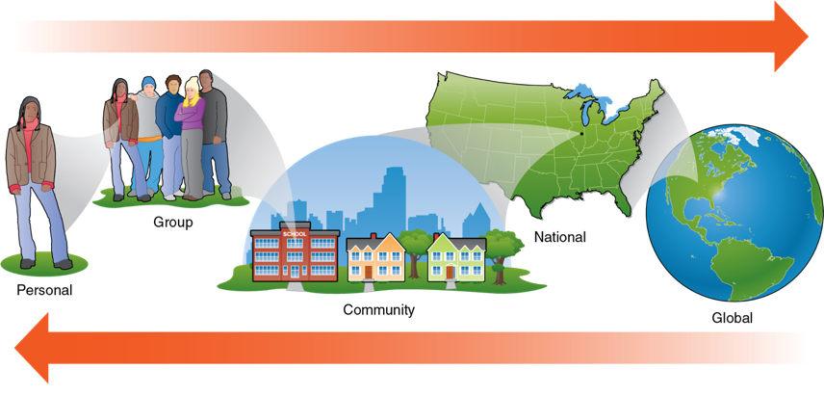
You Are Surrounded by Public Health Influences
Notes:
Figure 14.1 As an individual you are surrounded by public health influences.

Slide 6
Careers in Community and Public Health
Public and community health workers are part of the health care industry.
There are a wide range of jobs in public and community health.
Most of these jobs require at least an undergraduate college degree, and many require graduate education.

Slide 7
Examples of Public and Community Health Careers (1 of 2)
Career | Description
Epidemiologist | Researches and investigates patterns on diseases
Social Worker | Provides counselling and assistance to people in need (like children, veterans, seniors, homeless)
Public Health Nurse | Focuses on working to improve the health of a specific group or community
Microbiologist | Researches microorganisms with the goal of developing drugs to fight infectious diseases
Public Health Educator | Provides education to a community in order to promote their health or prevent the spread of disease

Slide 8
Examples of Public and Community Health Careers (2 of 2)
Career | Description
Public Health Analyst | Gathers and tracks data about public health activities and programs to determine their effectiveness
Health Inspector | Ensure that state laws and sanitary codes are followed in a community

Slide 9
Examples of Public Health Organizations
Government Agencies
Centers for Disease Control and Prevention
Health and Human Services
National Institutes of Health
Indian Health Services
Food and Drug Administration
Division of Adolescent and School Health
State Health Departments
Local Health Departments
City Health Departments
Nongovernment Agencies
World Health Organization
American Public Health Organization
Doctors Without Borders
World Bank
The Carter Center
Bill and Melinda Gates Foundation
American Red Cross
National Kidney Foundation

Slide 10
State and Local Health Departments (1 of 2)
Each state has its own state and local health departments with the goal of reducing health disparities.
A health disparity is a preventable difference in disease, injury, violence, or opportunities to achieve optimal health.
(continued)

Slide 11
State and Local Health Departments (2 of 2)
Health disparities exist for a variety of reasons, including:
Poverty
Environmental conditions
Inadequate access to health care
Individual and behavioral factors
Educational inequities

Slide 12
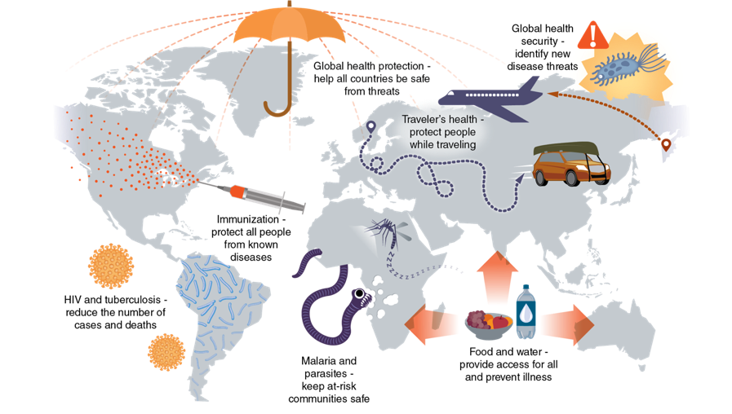
Major Global Health Issues
Notes:
Figure 14.2 Major global health issues.

