Slide 1
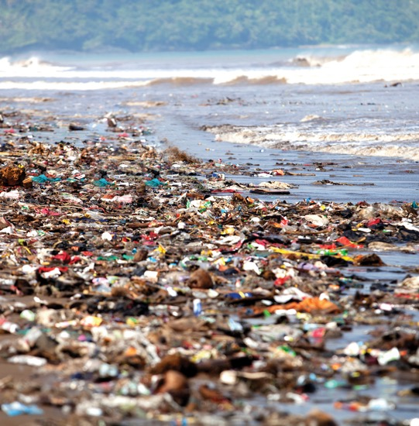

Air, Water, and Noise Pollution
Chapter 14
LESSON 14.2
Live Well: Middle School Health
Notes:
Herianus Herianus/EyeEm/ Getty Images

Slide 2
Write About It
Do you think you are exposed to much pollution in your daily life?
Explain your answer using specific examples.

Slide 3
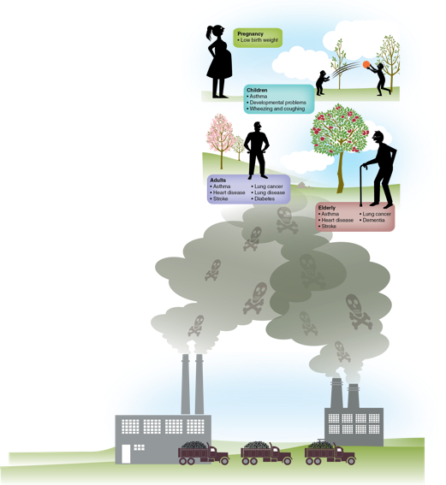
Air Pollution and Your Health
Air pollution happens when the air contains dangerous particles.
Air pollution can trigger asthma and allergy attacks; sleepiness; headaches; and irritation of the eyes, nose, throat, and skin.
Notes:
Figure 14.3 Air pollution can contribute to health problems at all stages of life.

Slide 4
Outdoor Air Quality (1 of 2)
Outdoor air is influenced by natural forces in the environment and human activity.
Smog is the combination of moisture in the air that has mixed with smoke and chemical fumes.
Acid rain is caused when chemicals that are released into the air mix with water and oxygen to form acids.
(continued)

Slide 5
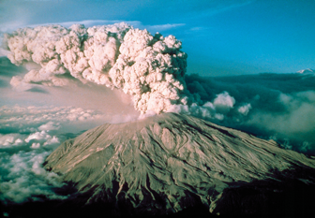
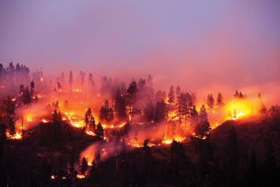
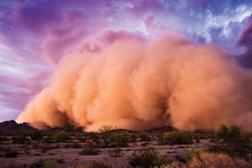
Outdoor Air Quality (2 of 2)
Volcanic eruption
Forest Fire
Sandstorm
Notes:
Figure 14.4 Air pollution can come from natural events like volcanic eruptions, wildfires, and dust storms.
PROF. STEWART LOWTHER/ SCIENCE PHOTO LIBRARY/Getty Images (left); Patrick Orton/Getty Images (middle); mdesigner125/iStock/Getty Images (right)

Slide 6
Indoor Air Quality (1 of 2)
Indoor air quality refers to how polluted the air is inside buildings, including your school.
Here are the best ways to improve indoor air quality:
Keep things clean, including bedding, clothing, curtains, and furniture.
Keep air filters clean in heating and cooling units.
Use chemical-free cleaning products.
Use an air purifier.
Let in fresh air when outdoor air quality is good.

Slide 7
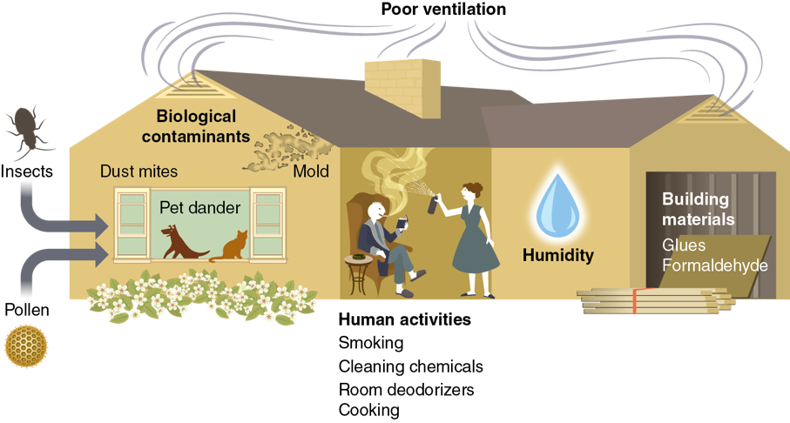
Indoor Air Quality (2 of 2)
Notes:
Figure 14.6 Sources of indoor air pollution.

Slide 8
Water Pollution and Your Health
Potential causes of water pollution include the following:
People using chemicals on lawns, washing the car in the driveway, and using weed killers
Chemicals used in manufacturing products
Improper disposal of products containing chemicals (paint, batteries, and medicines)
Microorganisms from animals and human waste and garbage or food waste
Natural disasters

Slide 9
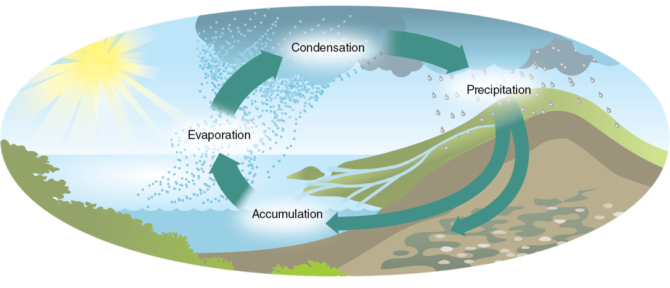
The Water Cycle
Notes:
Figure 14.8 The water cycle.

Slide 10
Noise Pollution and Your Health
When sound is unwanted, excessive, or bothersome, it is called noise pollution.
Can damage hearing
Can cause high blood pressure, difficulty sleeping, and poor performance at school or work
A major source of noise comes from earbuds and headphones worn with personal devices.
An estimated one in five teens have developed mild hearing loss.
Reduce the volume on personal devices to protect your hearing.

