Slide 1
Chemicals, the Environment, and Your Health
Chapter 14
LESSON 14.3
Live Well: Middle School Health
Notes:
Tunart/E+/Getty Images

Slide 2
Write About It
Have you ever considered whether the personal care products you use are safe?
How would you feel if you found out that your shampoo, soap, or sunscreen contained dangerous ingredients?
Would you try to change the products you use?

Slide 3
What Are Chemicals?
A chemical is a substance that cannot be broken down without changing into something else.
Chemicals can occur naturally (gold found in rocks or vitamin C found in fruits) or be man made (synthetic chemicals).
A toxic chemical is any chemical that can cause death, make you pass out for a period, or cause permanent harm to humans or animals.

Slide 4
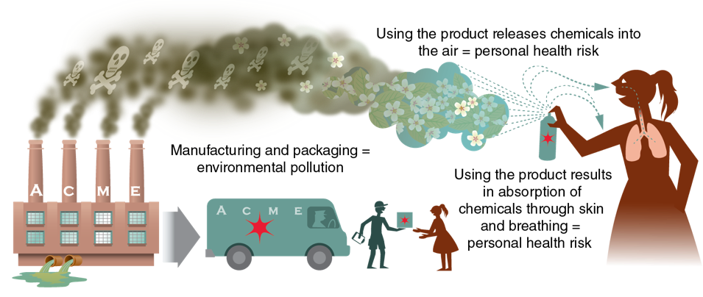
Why Chemicals Matter
Chemicals are linked to both environmental and personal health risks.
Notes:
Figure 14.9 Chemicals are linked to both environmental and personal health risks.

Slide 5
Chemicals in Personal Care Products (1 of 2)
Your body absorbs chemicals through your lungs and your skin when you breathe, bathe, eat, drink, and use personal care products.
  Personal care products include shampoo, toothpaste, deodorant, sunscreen, and makeup.
A single product may have a chemical level that is considered safe, but the use of multiple products over many years may be dangerous.

Slide 6
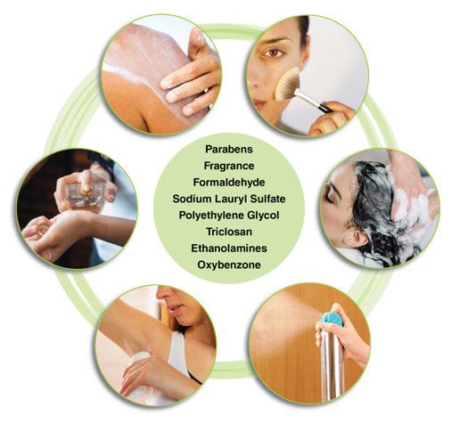
Chemicals in Personal Care Products (2 of 2)
Notes:
Figure 14.10 Personal care products like perfume and shampoo often contain potentially dangerous chemicals.
photos in figure 14.10: Image Source/Getty Images (sunscreen); PhotoDisc (makeup); Stevica Mrdja/ EyeEm/Getty Images (shampoo); belchonock/iStock/Getty Images (air freshener); artursfoto/iStock/Getty Images (deodorant); Visoot Uthairam/ Moment/Getty Images (perfume)

Slide 7
Chemicals in Household Items (1 of 2)
Household products and materials that we use to build our homes and communities can also contain toxic chemicals.
  Examples include solvents, pool cleaners, paints, batteries, antifreeze, and insect and weed killers.
Groups most at risk are babies, young children, and pregnant women.
(continued)

Slide 8
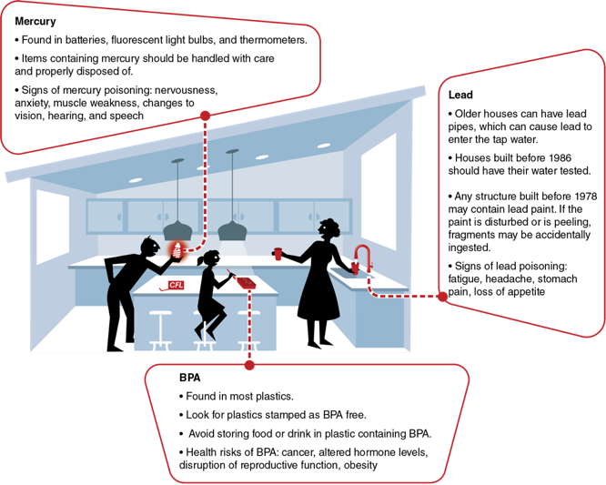
Chemicals in Household Items (2 of 2)
Notes:
Figure 14.11 Examples of hazardous chemicals in household items.

Slide 9
Getting Help When Needed
All products containing dangerous chemicals are labeled according to the danger they pose.
If you inhale or ingest a dangerous chemical, or your skin is exposed to a chemical, tell a doctor, school nurse, or trusted adult immediately.
Call the national Poison Control Center toll free at 800-222-1222 to ask for advice.

Slide 10
Proper Disposal of Chemical Waste
Hazardous materials include all items that could cause damage to human or animal life or to the environment.
All products containing chemicals are labeled with instructions on proper disposal.

