Slide 1
Living Green
Chapter 14
LESSON 14.4
Live Well: Middle School Health
Notes:
Nora Carol Photography/ Moment/Getty Images

Slide 2
Write About It
What does it mean to live green?
Do you think about the environmental impact of your daily life?
Why or why not?

Slide 3
Our Changing Environment
Climate change refers to any significant change in the measures of climate that last for an extended period.
  Temperature changes
  Changes in precipitation (rain and snow)
As the human population grows and we produce more pollution in the air, we are contributing to climate change.

Slide 4
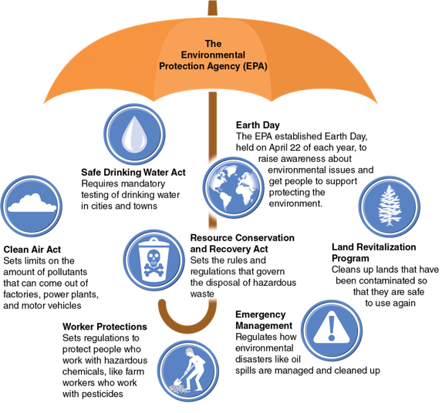
Protecting the Environment
According to the EPA, there are five ways to protect the environment:
  Reduce
  Reuse
  Recycle
  Treat
  Dispose
Notes:
Figure 14.12 How the EPA works to protect the environment.

Slide 5
Reduce
The most impactful way to protect the environment is to reduce the amount of trash and pollution we create in the first place.
  Focus on energy sources that create less pollution.
  Use renewable energy sources, a type of energy that will never run out (e.g., energy generated from the sun and wind).

Slide 6
Reuse
On average, each person in the United States produces five pounds of waste every day.
Strategies for reuse include the following:
  Try buying fewer items and reuse what you have.
  Reuse plastic shopping bags.
  Give clothing items you no longer want to someone who will use them longer.

Slide 7
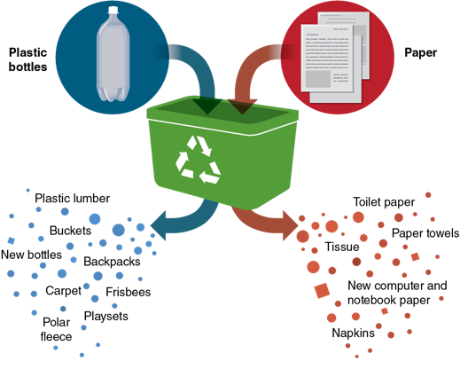
Recycle
Recycling is the process of collecting and processing materials that would otherwise be thrown away as trash and turning them into new products.
Recycling reduces the amount of trash that goes into landfills.
In most places, plastics, paper products, and glass are commonly recycled.
Notes:
Figure 14.13 What happens to commonly recycled items.

Slide 8
Treatment
Treating substances that may be dangerous to the environment can protect people and the environment from the damage the substances cause.
Examples include treating
  contaminated water for safe use
  contaminated land for future use

Slide 9
Dispose
Dispose properly of materials that can’t be recycled or otherwise treated.
This includes:
  not littering
  properly disposing of items containing toxic or dangerous substances so that they don’t contaminate the water, soil, or air
  disposing of batteries at designated areas

Slide 10
What Does Living Green Mean?
Living green means being aware of the effect your lifestyle and choices have on the environment.
Living green means being earth friendly or environmentally friendly in your personal choices.

Slide 11
Tips for Being a Green Student
Take notes electronically.
Carry a water bottle.
Use a reusable lunch bag.
1
2
3
Walk, bike, carpool, or use public transportation.
Recycle your paper.
4
Power down.
5
6
Take only what you’ll eat.
7

