Slide 1
Exploring Health and Wellness
Live Well: Foundations of High School Health
Chapter 1, Lesson 1

Slide 2
Write About It
Why do you think it can be hard for people to change basic health behaviors like their exercise or eating habits?
Explain your thinking.

Slide 3
Can you . . .
Explain the difference between health, wellness, and illness?
Describe the stages of behavior change?
Describe the interrelationship of individual, social, environmental, and genetic influences on a person’s health?
Analyze the relationship between healthy behaviors and personal health?
Analyze the types of influences that affect personal health and wellness?

Slide 4
Health, Wellness, and Disease
Health means you are free of illness or disease.
Wellness is the positive component of health that includes having a positive sense of personal well-being and quality of life.
A disease is something that causes the body not to function properly.

Slide 5
Components of Wellness
(1 of 2)
Emotional
  How you feel, connect with others, manage stress, solve complex problems, and deal with changes
• Intellectual
  How you do in school and engage in creative activities
• Spiritual
  Having a sense of purpose in life
(continued)

Slide 6
Components of Wellness
(2 of 2)
Social
  Finding meaningful connections with others and doing well in different social situations
Physical
  Having the physical energy and ability to bounce back from being sick, cope with stress, and recover from injury

Slide 7
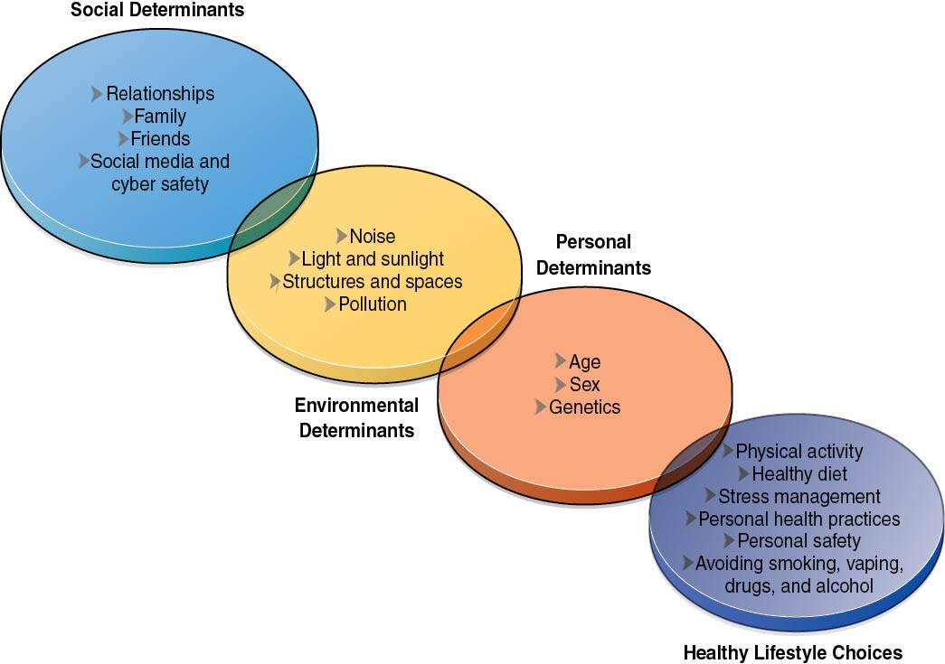
Determinants of Health
Notes:
Figure 1.2 Determinants of health.

Slide 8
Individual Determinants of Health
Individual determinants of health are things you cannot control.
  Age
  Heredity (genetics)
  Biological sex
Heredity is the passing of characteristics from a parent to a child.
Heredity can increase or decrease your risks of common diseases like heart disease and cancer.

Slide 9
Environmental Determinants of Health
Loud noises can harm hearing.
Sunlight can damage skin and cause cancer.
Pollution can affect respiratory health.
Access to open space, food, and medical care can affect all aspects of your wellness.

Slide 10
Social Determinants of Health
The people you socialize with influence your choices and your health.
If your friends take risks, you are more likely to take risks.
If your friends exercise and eat healthy, you are more likely to do those things too.

Slide 11
Healthy Lifestyle Choices
Getting regular physical activity
Eating a well-balanced diet
Managing your stress and anxiety
Getting regular and adequate sleep
Practicing good hygiene and personal health
Avoiding dangerous situations and maintaining boundaries
Avoiding tobacco, vaping, alcohol, and drugs

Slide 12
Benefits of Healthy Lifestyle Choices
Having more energy
Being more emotionally stable
Learning better
Feeling your best
Achieving goals and aspirations

Slide 13
Stages of Health Behavior Change
Stage 1: You have no intention to change the behavior.
Stage 2: You acknowledge an intention to change the behavior.
Stage 3: You actively plan to change the behavior.
Stage 4: You change the behavior.
Stage 5: You sustain the behavior change for at least six months.

Slide 14
Skill-Building Challenge
Think about influences on your wellness.
For each part of wellness identified in the following list, write down three different influences on that part of your wellness.
  Physical
  Emotional
  Social
  Spiritual
  Intellectual

