Slide 1
Communicable Diseases
Live Well: Foundations of High School Health
Chapter 1, Lesson 4

Slide 2
Write About It
How does regular hand washing protect you and others against the spread of some infectious diseases?
How might you be exposed to a disease if someone else doesn’t wash their hands regularly?

Slide 3
Can you . . . (1 of 2)
Explain what an infectious disease is?
Compare the different methods of transmitting an infectious disease?
Identify actions you can take to keep from getting an infectious disease?
Identify common symptoms of infectious disease?
(continued)

Slide 4
Can you . . . (2 of 2)
Explain what personal protective equipment is and how it can help reduce disease transmission?
Demonstrate assertive communication to reduce health risk?

Slide 5
Communicable Disease
A disease that spreads between people is contagious.
A contagious disease is also called a communicable disease.
Learning about the most common communicable diseases and how they spread can help you understand how to stay healthier and reduce your risk of getting sick.

Slide 6
Methods of Transmission (1 of 2)
Direct contact
  Occurs from kissing, sharing straws, exchanging bodily fluids through sexual contact, or being treated with unsterilized medical equipment
Indirect contact
  Occurs when you touch an object such as a cell phone, computer keyboard, doorknob, or other surface where a pathogen may be found
  (continued)

Slide 7
Methods of Transmission (2 of 2)
Airborne transmission
  Can occur from a pathogen in small droplets in the air, such as a sneeze from an infected person
Host transmission
  Occurs from contact with an infected animal, being bitten by an insect carrying a pathogen (like a mosquito), or eating infected foods

Slide 8
Preventing Communicable Diseases (1 of 2)
Wash your hands with soap and water.
Cover your nose and mouth with a tissue when sneezing.
Get vaccinated.
Stay home if you are sick.
Prepare food safely.
Abstain from sexual activity.
(continued)

Slide 9
Preventing Communicable Diseases (2 of 2)
Don’t share personal items like spoons or cups.
Keep your environment clean, especially kitchen and bathroom surfaces.
Wash clothing, towels, and bedding regularly.
Use bug repellent when spending time outdoors.

Slide 10
Types of
Communicable Diseases
Bacterial infections
  Lyme disease and tuberculosis
Viruses and viral infections
  Flu, cold, mononucleosis, and conjunctivitis (pink eye)
Fungi and fungal infections
  Athlete’s foot
Protozoan infections
  Malaria

Slide 11
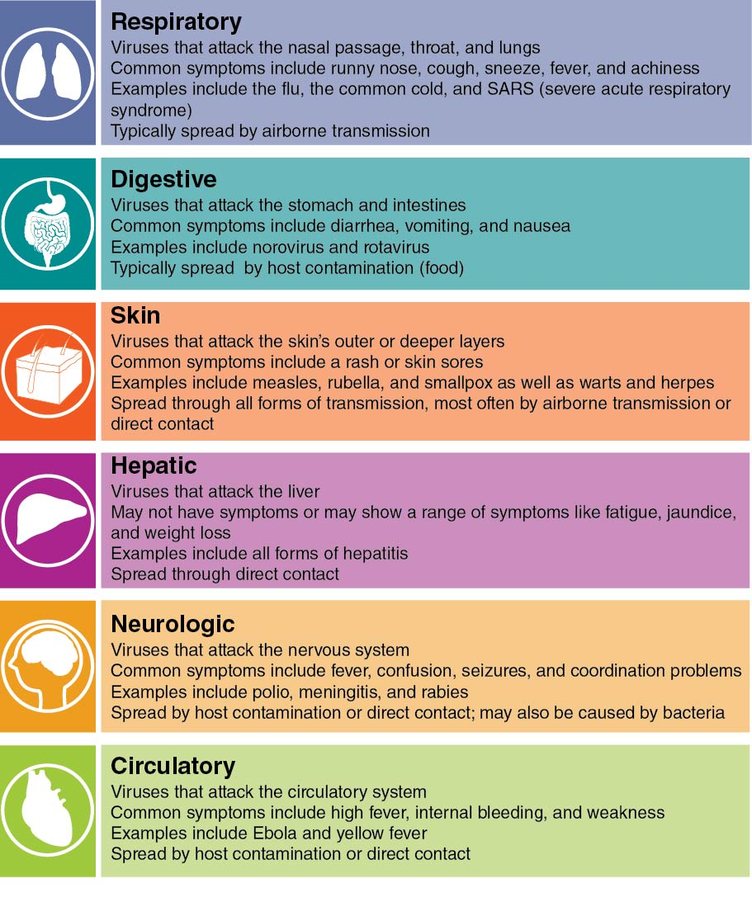
Types of Viral Infections
Notes:
Figure 1.20 Some common types of viral infections.

Slide 12
Other Risks of
Communicable Disease
Getting a tattoo
  Risk of an infection like hepatitis or a reaction to toxic substances in the ink
Eating undercooked food or meat products
  Risk of food pathogens like lice, mites, and some worms
Getting bitten by insects that spread pathogens
  Risk of vector-borne illness caused by mosquitoes, ticks, and fleas

Slide 13
Skill-Building Challenge
Be assertive by expressing yourself effectively and standing up for your point of view.
Think of a scenario when you had to stand up for your own health by missing out on something you wanted to do.
Write a short script that demonstrates how to use assertive communication to express yourself in that situation.

